Slide 1
Application Migration​ & Modernization
Database migrations

Slide 2
Azure Database Migrations Targets
SQL Managed Instance
IaaS
Azure PaaS
SQL
MySQL
Cosmos DB
PostgreSQL

Slide 3
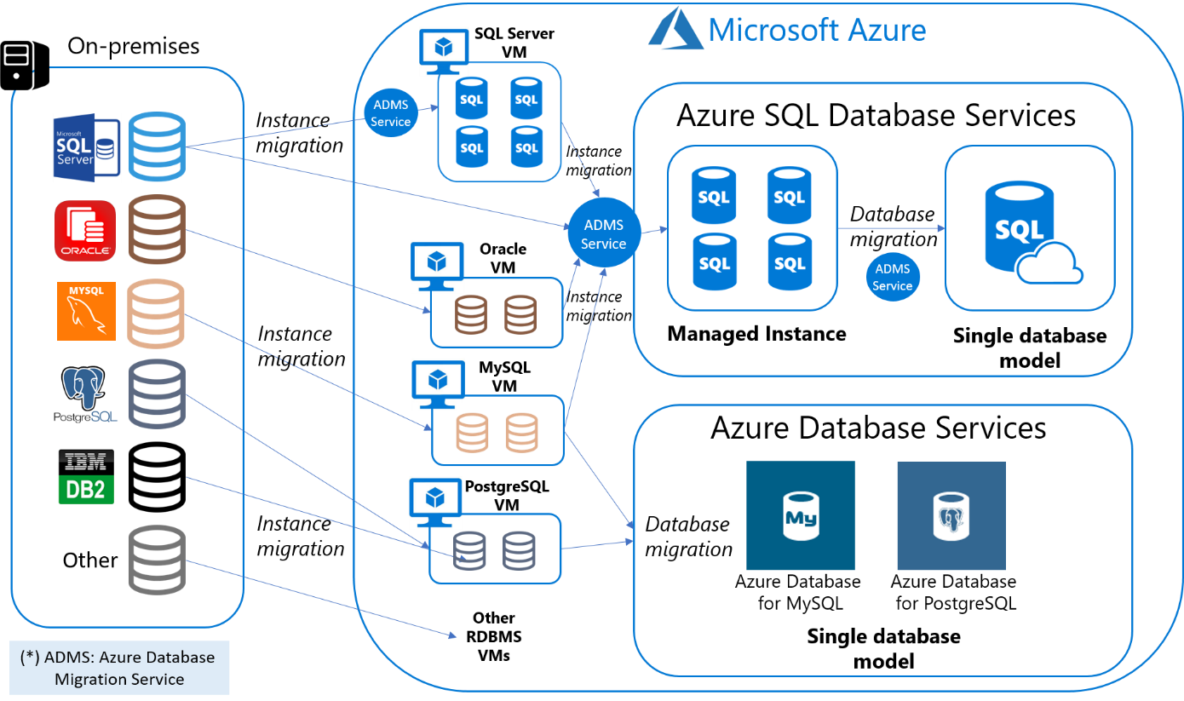
Potential Migration Options

Slide 4
Data Collection Points
Compute Environment
Database
Database assessment
Application dependencies
ISV/COTS dependencies

Slide 5
Collect Data – Compute Environment
Software and server (physical or virtual) inventory
Detailed analysis of current DB environments, including CPU and Disk
Data movement
Connected devices
Database names, versions, install path
Memory consumed
IOPS and throughput
Storage consumed
Virtual hosts/movement
Comparable Azure sizing

Slide 6
Collect Data - Database
How many DB instances do you have running (production vs. test/dev vs. HA)?
How large is each instance (memory, rows, users, cores/environment)?
How many FTEs do you currently have administering those instances? Are they dedicated?
How complex are those instances in terms of customization (stored procedures, clustered architecture, partitioning, identity and access management, encryption, mirroring, integration points)
What is the backup schedule?
What is the DR plan?

Slide 7
Collect Data - Database Assessment
SSMA for Custom Application Database discovery
  Discovery across all objects in the source DB schemas and creation of a target SQL Server schema.
Convert source DB database objects to SQL Server database objects, create those objects in SQL Server, and then migrate data from source DB to SQL Server.
  Objects include: Functions, Procedures, Packages, Sequences, Tables w/dependent objects, Views w/dependent objects, materialized views, triggers, synonyms, and user-defined types.
Before objects are loaded any data migrated to SQL Server, determine relative complexity of migration

Slide 8
Collect Data - Application
What is the application name, type, size, custom vs. COTS, deployment preference
What is the level of customization within each application that affects migration complexity
  Data access layer
  Transaction model (e.g., Distributed Transactions)
  Materialized views
  Architecture (e.g., integration)
  Other custom business logic
What is the relative criticality of each of those applications?
Who are the application owners?
What is your strategy and timeline for cloud deployment?
For custom applications, application discovery process is manual

Slide 9
Collect Data - ISV Inventory
Understand SQL Compatibility, Dependencies, Lifecycle
Obtain inventory by vendor from customer, including module and version details, database instance mapping
Discuss integration points, application lifecycle, and modernization potential
Determine SQL Compatibility
  Version support
  Working with vendors to understand migration process
    Version installation and data migration
    Configuration changes?
    Other consulting services required?
  For those vendors that do not support SQL, decide on in/out of scope

Slide 10
Migration planning Tasks
Database Migration
Application conversion
Scripts conversion
Integration w/3rd party apps
Data migration
Functional testing
Performance tuning
Setup of Jobs, security, monitoring, replication
Integration and deployment
Training and knowledge transfer
Documentation and version control
Post production support

Slide 11
Benchmarking
Target DB testing
    Performance
    Functional
    UAT
ROI calculations
Third-party Validation
  TPC Benchmarks, value analyses
  Industry analysis (Gartner, Forrester, etc.)
  References

Slide 12
Connecting the Dots
Initial Landscape Identification and Database/Application Mapping
Database migration assessment (tool-driven)
Application migration assessment (manual discovery, ISV identification and certification planning)
Migration project scoping
Decision
Migration event scheduling

Slide 13
Migration Event Planning
Initial migration (Write it down)
Second migration (Verify steps)
Third migration (Validate timing)
Process documentation
Process validation
Process verification
Timing validation
Timing validation
Initial timing
The 1st time is an anomaly, 2nd time is a coincidence, 3rd time is a pattern

Slide 14
Database Migration Methods

Slide 15
When to migrate to Azure SQL Database
If you have existing applications that require
That uses basic standard SQL databases
No additional instance features required (i.e SQL CLR integration, SQL Server Agent, and cross-database querying)

Slide 16
When to migrate to Azure SQL Database Managed Instance
If you have existing applications that requires
No changes to your application
No changes to data or data access code can be made
Require SQL Instance Level Functionality
Require SQL Agent and SQL Server Profiler
Cross-database references and queries, SQL CLR, replication, change data capture (CDC), and Service Broker
Database sizes up to 35 TB

Slide 17
When to move your original RDBMS to a VM (IaaS)
If you have existing applications that require
The fastest migration to the cloud with minimal changes

Slide 18
Methods
Method 1: Migration with downtime
Assess with Database Migration Assessment Tool
Fix T-SQL scripts
Take a transaction consistent database
Apply T-SQL scripts to DB
Use Database Migration Assessment Tool to migrate database
Method 2: Migration with zero/minimal downtime
Must meet pre-reqs → https://docs.microsoft.com/en-us/sql/relational-databases/replication/replication-to-sql-database
Replicate in Full , Cut Over

Slide 19
Tools

Slide 20
Azure Database Migration Service (DMS)
Comprehensive Database Migration Service
Fully managed database migration service for operational databases, data warehouses, and NoSQL databases
From On-premises, Private Clouds, and Public Clouds
Homogeneous and heterogeneous source-target pairs
Minimal downtime migrations

Slide 21
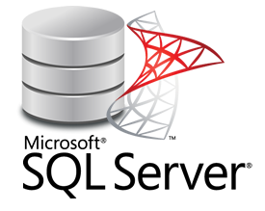


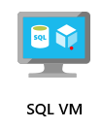
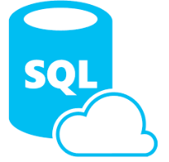

Database Migration Assistant (DMA)
SQL to SQL Migrations
1. Assess and identify issues
3. Migrate schema,
data, and logins
DMA
Legacy SQL Server Instance
2. Fix issues

Slide 22
Demo: SQL Server Database Migration Assistant

Slide 23
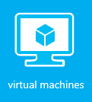
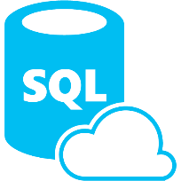

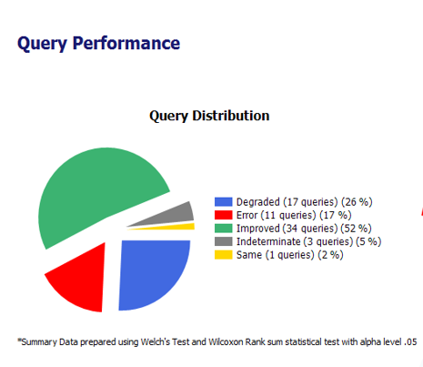
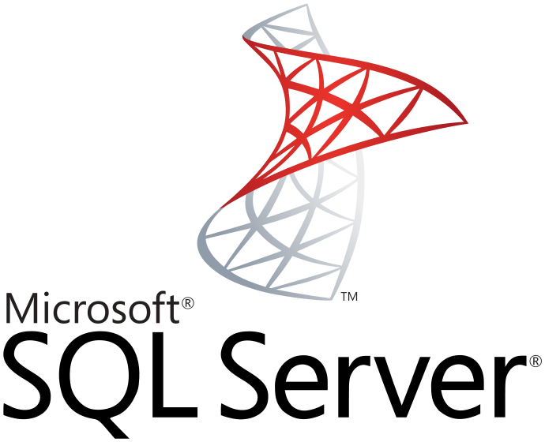
Database Experimentation Assistant (DEA)
SQL to SQL A/B testing
Target 1
SQL 2008 Instance
Statistical
analysis
Comparison reports
Extensive tracing
On-premises
SQL 2008 instance
Replay Workloads
capture prod workload
Analyze results
Target 2
SQL 2014 Instance
Extensive tracing
Capture
Replay
Analyze
Compare

Slide 24

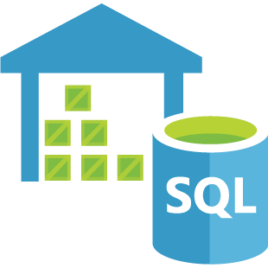


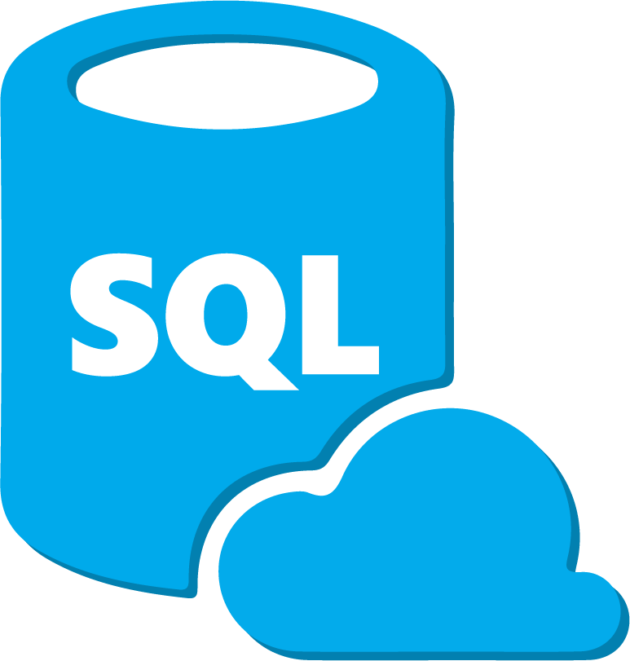

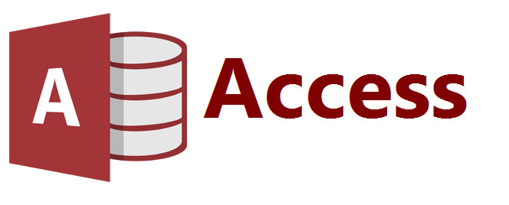
SQL Server Migration Assistant (SSMA)
<other> to SQL Migrations
SQL Server | SQL VM | Azure SQL Database | Azure SQL Data Warehouse

Slide 25
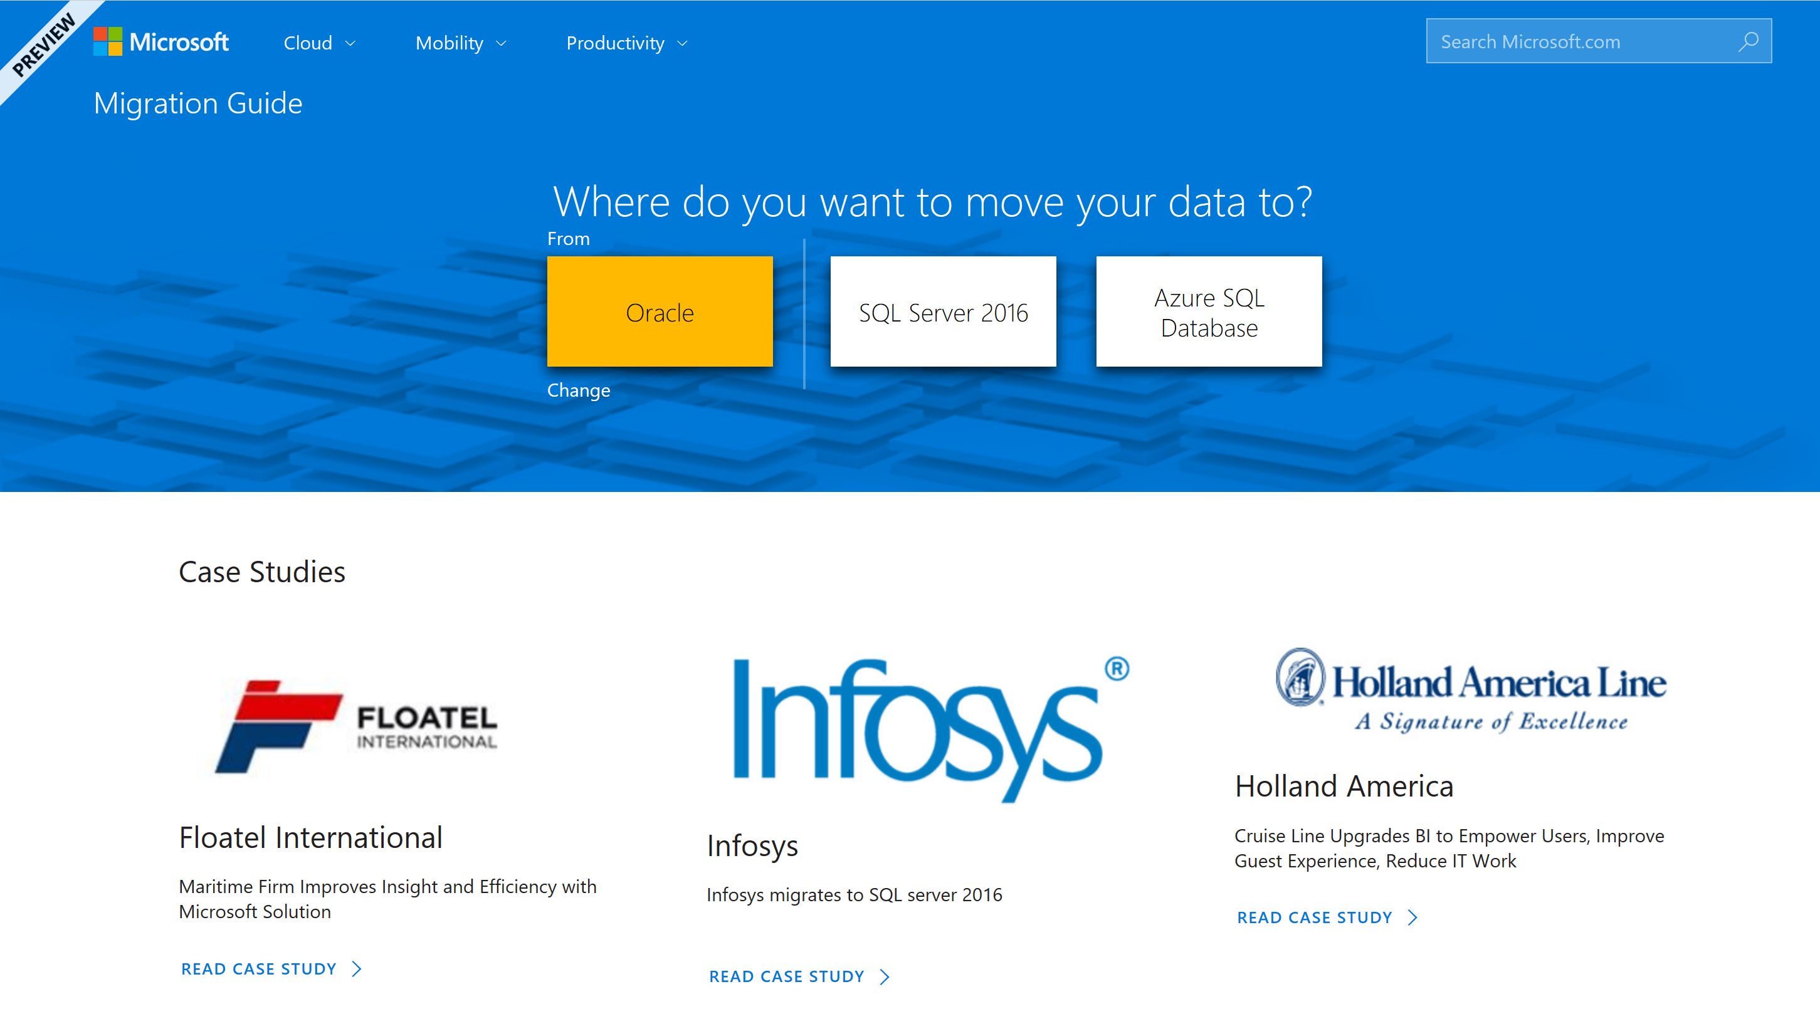
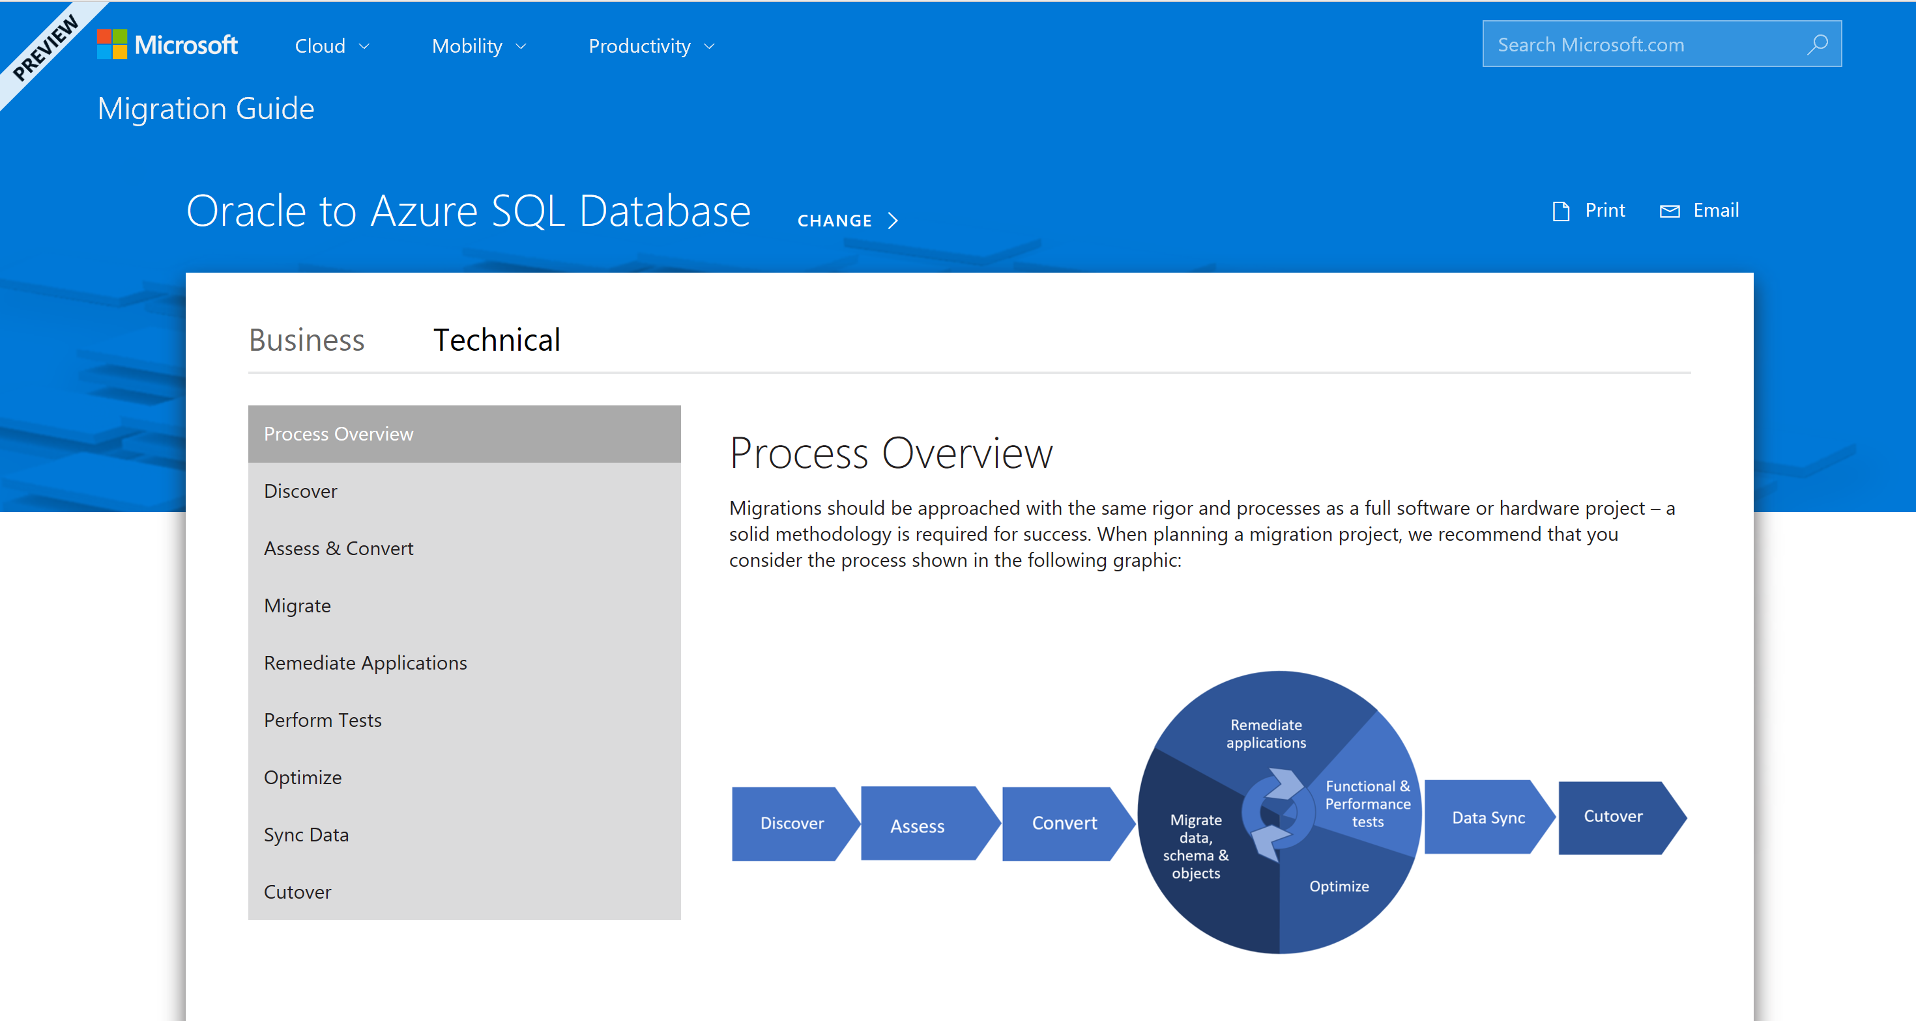
Database Migration Guide
One-stop-shop guide for database migrations
Step-by-step guidance from by source and target
Recommended Partners, Customer case studies
http://datamigration.microsoft.com

Slide 26
Action Steps
Categorize your application/database pairs by core count, complexity and decom schedule
Review the findings with your key stakeholders to refine the timeline and plan – i.e., are any applications out of scope due to complexity or impending retirement
Explore expanded solution areas across Data and AI platform
Validate your results with your stakeholders

