Slide 1
Application Migration​ & Modernization
Digital Transformation

Slide 2
Cloud Maturity Model
Existing apps
on-prem
Lift and Shift
Cloud optimized
App modernized
Lift & Shift
Minimal code-changes
Architected for the cloud
modernized/refactor/rewrite

Slide 3
Transforming the datacenter
Old IT
New IT reality
Implementation
Workload placement
Physical servers and virtual machines
On-premises, non-cloud
Hybrid cloud
Public cloud
off-premises
Commodity
SaaS: Microsoft Dynamics,
Office 365
Investment
PaaS: Microsoft Azure
Existing
IaaS: Microsoft Azure
Agility
Private cloud
on-premises
Optimize large/unique
workloads for
Windows Server
Hyper-V virtual machines
Windows Azure Pack
Workloads

Slide 4
Cloud Maturity Model
Existing apps
on-prem
Lift and Shift
Cloud optimized
Lift & Shift
Minimal code-changes

Slide 5
Cloud Maturity Model
Cloud Journey
Existing apps
on-prem
Lift and Shift
Cloud optimized
App modernized
Lift & Shift
Minimal code-changes
Architected for the cloud
modernized/refactor/rewrite

Slide 6
Top Triggers Transformation
Cost Model
Transformation
Security &
Compliance
CAPEX to OPEX.
DC modernization
Increasing DC operational costs
Modern security for modern threats
Regulatory compliance requirements
Business continuity
Need for Business
Agility
Contracts, Licenses
up for Renewal
New capabilities – e.g. adv. analytics
Time to value –build, deploy, manage
Availability of skills
Retain relevance of internal IT through higher value to business
Expiring co-location contracts
End of support of Software
End of support contracts

Slide 7
Transformation covers….
People
Process
Technology
Change is required across all 3….

Slide 8
Migrating / Modernizing existing apps, with ROI at every stage
1
2
3
4
APP
Containerize the app
Modern infrastructure
Modern methodologies
Modern microservices
10X
OpEx time savings
50%
Infrastructure consolidation
27%
More testing automation
13X
Deployment frequency
99%
Faster security VULN MTTR
99%
Deployment time savings
30%
More deployment automation
65%
Reduce dev onboarding time
5 min
Average new time to scale apps
99%
Portability/Cloud migrations
27%
More change approvals
Notes:
A microservices architecture takes a monolithic application and breaks it into a collection of modular services, each of which operates independently. The benefit is these microservices can be deployed and managed more easily, and they can be deployed either locally or in the cloud. A first step in moving to this application is containerizing applications, allowing them to run on virtual machines. By containerizing apps and/or transforming them into microservices, the migration to the cloud becomes much easier. Companies that have at least partially adopted this architecture can more easily begin to migrate to the public cloud.

Slide 9
The Azure Virtual Datacenter (VDC)
An Azure analog to your on-premises data center
Isolates multiple workloads with structured policy
Extends across regions including Azure Stack
Foundation based on Software Defined Networking
Underpinned by an extensive Azure Control Set
Compliance Frameworks such as PCI & HIPAA
Blueprint’s where external audits are involved

Slide 10
Benefits of a Virtual Data Center
  The cloud was great for individual workloads
  That lead to many isolated workloads
  We can get more efficient
  We can apply isolation policy
  We can make the cloud more analogous to your datacenters
  Common Components:
  - Infrastructure
  - Perimeter Networks
  - Security Policy
  - Monitoring
Notes:
Azure is really good for hosting workloads. As you get more and more workloads into Azure you need to get more efficient and need to do more cost saving and consolidation. And your moving from traditional monolithic IT and dev/ops but you still have a centralized security team. The question is how to you make everyone happy in this world? And that where we start to look for the things that are command and start to look at this, holistically. The gives rise to the Virtual Data Center. On the far right you have teams that just through things out on the open internet with no firewall leaking corporate information, how do you get these guys under control? That’s where that holistic thinking comes into play.
Software Defined Networks and Azure Resource Management are the keys that allow us to unlock the Virtual Data Center.

Slide 11
The Azure Blueprint
Architecture
Architecture Diagrams: Technical architecture overview of Azure Public, Government and National Clouds that represents core components in IaaS, PaaS and SaaS nodes
Deployment
Images & ARM Templates: Automated deployments for VMs and common architectures that meet baselines for security and regulatory compliance
Certification
Certification Templates: Regulatory documentation pre-filled with Azure information and pre-approved by regulators
Process Workflow: Customer guide to using Blueprint components to complete certification package for audit
Expertise
Certified Partners: Consultants, Auditors, and Integrators certified by Microsoft to assist customers with architecture, deployment, and certification of applications built on Azure
Customer Responsibilities Matrices (CRM): Outlines security controls – those of undertaken by Azure, joint controls, and those the customer must implement on their own – cross referenced in the deployment guides
Service List: Azure Services available in each cloud and certification scope
Deployment Guides: Deployment instructions for use of ARM templates, VM images, or manual configurations; including mapping of settings to security controls

Slide 12
Virtual Data Center Emerges
  RBAC allows segregation of duties between centralized and specialized teams
  Common components are minimized (reduced cost and complexity)
  DevOps is enabled where possible (workload subscriptions)
  Centralized IT is enabled at the Security and Infrastructure components
  Central security/infra team manage the edges (Internet and to on-premises)
  Guidance and Templates to enable Quick Start
Notes:
Centralizing there is really an advantage for your deployments in Azure. Instead of treating multiple work loads, treat them as a holistic environment.
You can consolidate, you can also do RBAC. So with your security, you cloud put your DMZ in that top hub Vnet. This could be a different resource groups, different subscriptions. Essential however you define your Security Policy and grant authority. If we use the different Subscriptions your can have your Dev/Ops on the bottom in a different one from the Security teams on top. If they want to get to the Internet, or if they want to use ExpressRoute, and get back to the on-premise, they need to come through the top hub Vnet, which again is controlled by the security team. This is an easy control point for the security team or network team. And it can be their responsibility to lock down the network per corporate policy in a consolidated way. While each Dev/Ops team has complete control over their environment and subscriptions. Because I known that the network layer in locked down in a isolated Vnet hub and the spokes are allowed to innovate and do whatever they need to do as fast as they need to do it.
This is good way to bridge the central IT works and the Dev/Ops worlds.
Lastly the ultra-performance Gateway is a big enabler of this pattern because it allow very large hubs to talk to the Internet or ExpressRoute to on-premise.

Slide 13
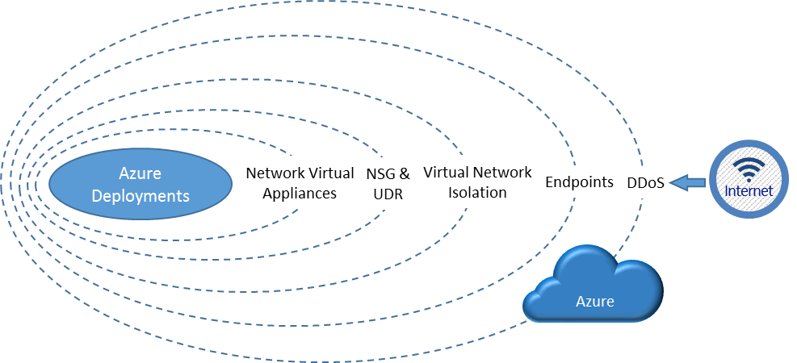
Logical Layered Isolation

Slide 14
Digital Transformation approaches

Slide 15
Migration/Modernization Options (5 r’s + 2)
Rehost
Refactor
Revise
Rebuild
Replace/
Retire/Retain
i.e. discard completely or do not move. Some applications may not be used by anyone or others may be simply impossible to move!
i.e. modify or extend the existing code base to support modernization requirements, then use rehost or refactor options to deploy to cloud.
i.e. redeploy applications to a different (newer) hardware environment. Rehosting an application without making changes to its architecture can provide a fast cloud migration solution.
i.e. rearchitect the solution. Discard code of existing application/solution and leverage newer and innovative cloud services (like PaaS).
i.e. run applications on a cloud provider’s infrastructure. Applications/workloads may need to be modified slightly to run on the cloud provider’s platform.
Notes:
Rehost:
i.e. redeploy applications to a different (newer) hardware environment. Rehosting an application
without making changes to its architecture can provide a fast cloud migration solution.
Refactor:
i.e. run applications on a cloud provider’s infrastructure. Applications/workloads may need to be
modified slightly to run on the cloud provider’s platform.
Rebuild:
i.e. rearchitect the solution. Discard code of existing application/solution and leverage newer
and innovative cloud services (like PaaS).
Revise:
i.e. modify or extend the existing code base to support modernization requirements,
then use rehost or refactor options to deploy to cloud.
Replace:
i.e. discard an existing application (or set of applications) and use commercial software
delivered as a service (SaaS)
Retire/Retain:
i.e. discard completely or do not move. Some applications may not be used by anyone or
others may be simply impossible to move!

Slide 16
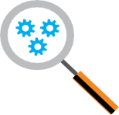
A Typical On-Premises to Cloud Migration
MIGRATION PROCESS
DECOMMISSION
Azure
Hybrid
Partner cloud
Customer Cloud
1.
1
Discover customer’s
on-prem footprint (VMs, networks, apps etc.) and gap analysis on people process and technology
2
Map dependencies and determine network topology, Educate Customer
3
Recommend optimization path for workloads, cost modeling,
Processes
4
Determine best cloud computing service model
5
Provide cloud migration strategy and plan

Slide 17
A Tactical approach to app migration/modernization
From…
  Office servers
  Portals and SPS
  Any relationship mgmt
  Active source control
  Data warehouses
  Industry standard verticals
…To
  Office 365
  SharePoint Online
  CRM Online
  VSTS
  ADL + PowerBI
  Best 3rd-party SaaS
Retire it, right-size, eliminate environments
30%
Use or convert to a SaaS
(1st or 3rd party) solution
15%
Use or convert to a SaaS
(1st or 3rd party) solution
Expose functionality in
existing SaaS/PaaS solution
Azure IT roadmap
Convert to Azure PaaS solution
First to move
  Basic web apps
  Advanced portals
  Any new solutions
  Any re-architected solutions
Next to move
  High I/O OLTP
  Regulatory and
  high business impact
50%
Optimize for and move
to Azure IaaS VM
No change, lift ‘n
shift to IaaS
Remain
on-premises
  PKI systems
  Legacy source control
5%

Slide 18
3 Phases to Transformation
Discover
Migrate
Optimize
Assess
Target
Build
Cutover
Stabilize
Manage
Portfolio Assessment
TCO Analysis
Security Requirements
Dependency Mapping
Grouping and Prioritization
Design& Architecture
Detailed Migration Schedule
Tool Selection
Create Azure environment
Replicate via ASR
Integrate applications and networks
Verification
POC Test and QA
User Acceptance
Staging
Cutover and Decommission
Training
Configuration management
ID Management
DevOps Automation
Cloud Monitoring
Cost/Use Optimization
Assessment & Migration tools, Monitoring, Management, Optimization, ITSM & Automation tools
Services Provider Billing and Operations Management & Automation, CSP integration

Slide 19
The Migration Factory
Functional and performance tests
Optimize
Remediate applications
Migrate data & schema objects
Discover
Assess
Target
Data Sync
Cutover
Notes:
As with the application and VM migration discussed earlier, data migration includes a discovery/assessment stage, then the migration itself, which includes conversion of the data, remediating any compatibility issues, migrating the data and scheming, then optimizing. After testing, the data can be synced and then the organization can cut over to the Azure database.

Slide 20
The Migration Factory – Automation Mix
Functional and performance tests
Optimize
Remediate applications
Migrate data & schema objects
Discover
Assess
Target
Data Sync
Cutover
People
Tooling
People
Tooling
People
Tooling
People
Tooling
People

Slide 21
The Migration Factory – Workshop Mapping
Functional and performance tests
Optimize
Remediate applications
Migrate data & schema objects
Discover
Assess
Target
Data Sync
Cutover
Day 1
Day 1
Day 2
Day 3
Notes:
As with the application and VM migration discussed earlier, data migration includes a discovery/assessment stage, then the migration itself, which includes conversion of the data, remediating any compatibility issues, migrating the data and scheming, then optimizing. After testing, the data can be synced and then the organization can cut over to the Azure database.

