Slide 1
Application Migration​ & Modernization
Application inventory

Slide 2
The Migration Factory
Functional and performance tests
Optimize
Remediate applications
Migrate data & schema objects
Discover
Assess
Target
Data Sync
Cutover
Notes:
As with the application and VM migration discussed earlier, data migration includes a discovery/assessment stage, then the migration itself, which includes conversion of the data, remediating any compatibility issues, migrating the data and scheming, then optimizing. After testing, the data can be synced and then the organization can cut over to the Azure database.

Slide 3
Application Migration​ & Modernization:
Discovery

Slide 4
Methods to build your inventory
1
2
3
Discover
Catalog servers and software - Overview
Assess
Categorize applications – Basis for decisions
Target
Identify your destination(s)
Scan existing infrastructures and combine with business application information to build a view of the application landscape.
Bottom-up assessment analysis and categorization of applications to determine approach and size.
Identify target hosting locations and target hosting approach.

Slide 5
Discovery Methods
Base Info
Name of App
Owner (Business and Tech)
Application Makeup
Frameworks
Language
Source Code
MiddleWare
Workshops
Tools
Sample of Info Required
Integration
Connected Systems
Ports / Protocols
Questionnaire
Methods of Collection
Infrastructure Makeup
No of Systems (Prod / NonProd)
Performance
Operating Systems
Security

Slide 6






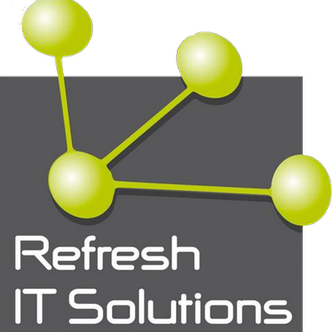






Automated Tools Landscape
Discover
Migrate
Optimize
Microsoft
^{Limited Preview}
Azure Migrate
Database Migration
Assistant
Azure Site
Recovery
Database Migration
Service
Operations
Management Suite
^{Public Preview}
Partners

Slide 7
Inventory Source Applications
Assessment Factors
Prioritization
Application Demographics
Score
Segment
Priority
Recommended ID
Actual ID
Application Name
Performance
Architecture
Financial
Risk
Performance
Architecture
Financial
Risk
Operations
Security & Compliance
UI
Application
Data
Infrastructure
Rehost
(IaaS)
1
23
App 23
3.00
3.67
4.00
2.50
Application Name
Hardware Life Expectancy
2
17
App 17
2.80
3.33
3.50
3.00
Include
Capability Type
Technical
Tools/Integration
Organizational
Business Continuity
Regulation
Business Value
Jurisdiction
Complexity
Complexity
Operating Cost
Structured mag.
Elasticity
App 6
4.75
Scalability
Latency
Throughput
Size
Complexity
App ID
3
6
Life Expectancy
3.60
3.00
1.00
Encryption
Refactor
(PaaS)
1
20
App 20
5.00
3.67
3.65
3.46
2
1
App 1
1.00
2.50
3.50
3.00
1
App1
Yes
5
5
5
5
5
5
5
5
5
5
5
5
5
5
5
5
5
5
5
5
3
14
App 14
3.80
3.00
1.00
3.92
2
App2
Yes
1
1
1
1
1
1
1
1
1
1
1
1
1
1
1
1
1
1
1
1
3
App3
Yes
3
3
3
3
3
3
3
3
3
3
3
3
3
3
3
3
3
3
3
3

Slide 8
Application Migration​ & Modernization:
Assess

Slide 9
Prioritization Methods
By type
  Microsoft
  applications and server roles
  Third-party platforms
  Custom
  applications
  Commercial Off The Shelf applications
By business value and criticality
  Mission critical
  Important
  Marginal
  Can be retired
By complexity and risk
  Low
  Medium
  High

Slide 10
Application selection criteria
Business factors
Not mission critical
Mission critical
No regulatory exposure
Regulatory exposure
Low-impact content
High-impact content
Complexity/importance
Technical factors
Not cross-premises
Cross-premises
Low monitoring needs
High monitoring needs
Custom app integration
Packaged app integration
Medium database storage
Large database storage
Not chatty
Very chatty
Latency insensitive
Highly latency sensitive

Slide 11
Re-Prioritize Source Applications
Assessment factors
 |  |  |  | Performance |  |  |  | Architecture |  |  |  |  |  |  | Financial |  | Risk |  | Operations |  | Security and compliance
 |  |  |  |  |  |  |  | UI | Application |  |  | Data |  | Infrastructure
App ID | Application name | Include | Capability type | Elasticity | Scalability | Latency | Throughput | Complexity | Size | Complexity | Life expectancy | Structured mag. | Complexity | Hardware life expectancy | Operating cost | Business value | Organizational | Technical | Business continuity | Tools/integration | Jurisdiction | Regulation | Encryption
1 | App1 | Yes |  | 5 | 5 | 5 | 5 | 5 | 5 | 5 | 5 | 5 | 5 | 2 | 5 | 5 | 5 | 5 | 5 | 5 | 5 | 5 | 5
5 | App2 | Yes |  | 4 | 3 | 5 | 5 | 4 | 3 | 2 | 2 | 3 | 4 | 5 | 4 | 3 | 4 | 3 | 3 | 3 | 4 | 5 | 1
2 | App3 | Yes |  | 3 | 3 | 3 | 3 | 3 | 3 | 3 | 3 | 3 | 3 | 3 | 3 | 3 | 3 | 3 | 3 | 3 | 3 | 3 | 3
1
T: 97
2
3
Notes:
Speaker Notes:
Teams within Microsoft IT have used a methodology to quantify the complexity and benefits of the cloud migration for their application portfolio. This example shows 20 factors that were considered and weighted to enable data-driven decisions about cloud migrations.
The factors include the benefits of cloud migration based on the type of application and its workload:
Performance factors: How variable are workloads, and will the application benefit further from cloud migration?
Architecture factors: How complex is an application’s architecture? This is the most heavily weighted factor that determines the technical difficulty of migration.
Financial: Are there quantifiable financial benefits from moving this application to the cloud?
Risk: What is the business-critical scale of this application?
Operation: Are there provisions for a redundant system, and is the application integrated into IT monitoring?
Security and compliance: Are there financial or other regulations required for this application or data?

Slide 12
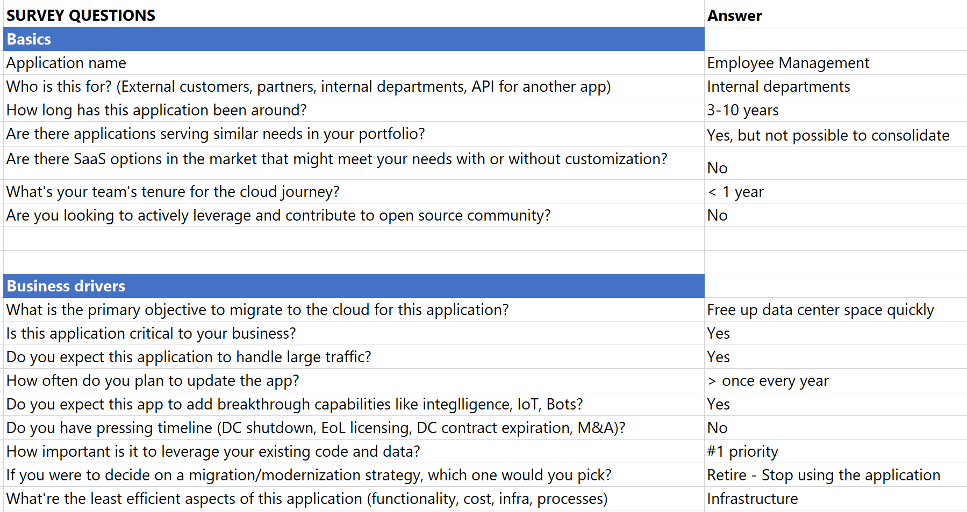
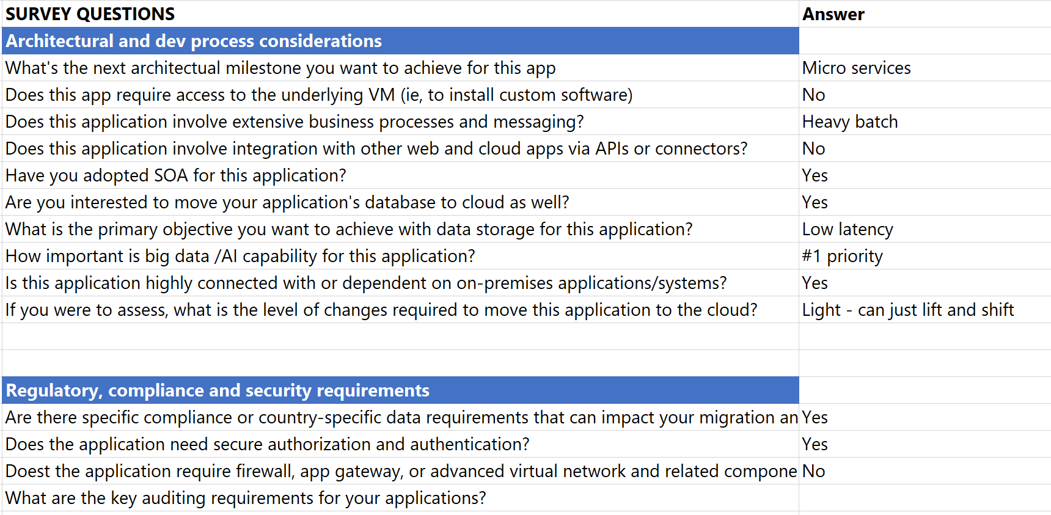
App Modernization | assessment tool
Free survey to help customers evaluate a portfolio of apps and advise on how to move
Sales stage: “Azure is our path forward. But I've no clue how to get there. Help me create a roadmap for my application portfolio”
Ideal Format: customer representative to sit down with consultant (TSP/CSA/SI partners) and evaluate multiple representative apps
Audience: Portfolio owners who may also distribute the survey to individual teams who have more hands on information for the app
30 questions to collect information on business drivers and technical architecture

Slide 13
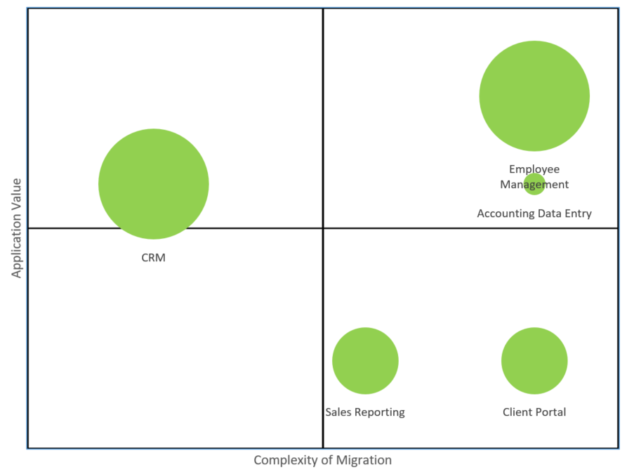
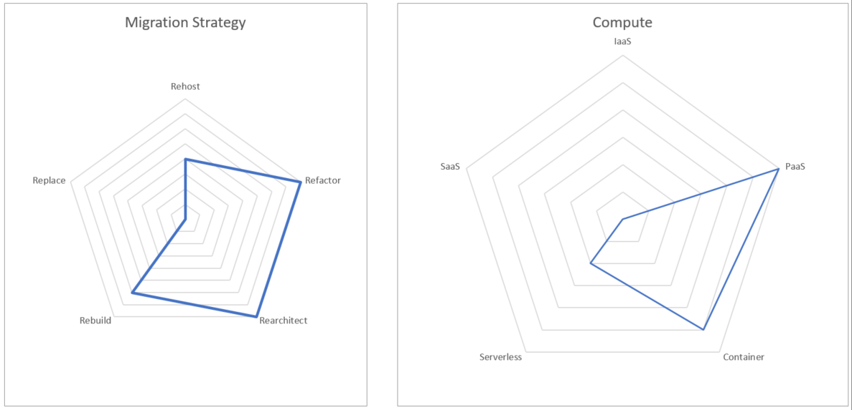
App Modernization | assessment tool
Automatic report to
Create clarity of migration roadmap
Accelerate decision making on strategy and compute options
Which one(s) to move first
  Type #1 - High impact: applications that have significant strategic value (Y axis) and big cloud ROI (size of the bubble)
  Type #2 - Quick wins: applications that does not involve too much complexity of migration (X Axis)
How to move for each individual app
  Which migration strategy should you choose (5Rs)
  Which compute option should you consider
  What are the relevant technologies and services
High impact
Quick Win

Slide 14
Demo: MTA Assessment Kit
Notes:
Open the MTA assessment spreadsheet
Go over the scoring model
View the sample assessments

Slide 15
Project Execution Options
Top down
Modernizing applications
  PaaS
  SaaS
Tactical/
cost-effective
Opportunistic
Evolve applications
to Azure
  Migrate applications
  in the course of other projects
  Build new functionality or components in Azure
Bottom-up
Environment rationalization
  Hardware inventory
  Network or workload dependencies?
  Business compliance requirements
Strategic/ evaluative
On-the-fly/flexible

Slide 16
HOL Activity – Inventory and Assessment of Source Applications
Use the sample applications or use one of yours
  Login to the source environment
  Configure source applications
  Inventory and assess the applications
  Fill out the MTA spreadsheet or create your own
For discussion
  How will you prioritize migration projects?
  What tools do you think you will need?
  What are the biggest blockers you see?

Slide 17
Inventory Hints
Gather technical information, includes but limited to:
  SSL Certificates
  SPN/Kerberos
  App Pool IDs
  Delegation Information
  Ports and Protocols
  Security information
  Source operating systems
    Versions and support information
    Hardware life expectancy
  DB Versions and settings
  Dependencies

