Slide 1
Application Migration​ & Modernization
Migration Patterns and Approaches

Slide 2
Application Migration​ & Modernization:
Target

Slide 3
The Journey to the cloud
Migrate
Application Modernization
SaaS
Rehost
Refactor
Rearchitect
Rebuild
Replace
On-Premises
Infrastructure Platform
IaaS
Infrastructure Platform
“lift & shift”
Containers
Managed Container Platform
PaaS
Application Platform
Serverless
Notes:
Legacy Apps
Monolithic - Built as a single unit with few separate services or components. Any services which are used tend to be custom built for the App.
Tightly Coupled - Tend to have internal and external dependences that impact both reliability and development agility.
Long Delivery Cycle - Slow to test, deploy, and scale. Making iteration difficult.
IT Dependent - Dependent on long lead time bare metal provided by IT. With complicated patching and update process.
Internet Apps
Service Oriented - Build modularly using packaged middleware, common services, and SOA architectures.
Loosely Coupled - Technology like messaging stacks and queues used to disintermediate apps. Management and diagnostic tools integrated into Apps.
Agile Delivery - Dependency management and disintermediation allows software to be built incrementally. Shortening delivery times from years to months.
Virtualized - Software hosted on virtualized infrastructure that reduces IT dependencies, improves delivery time, and simplifies update process.
Cloud Apps
Cloud Based Service - Applications built using API’s, SaaS Services, and independently scaling Microservices. With custom code only needed for core business logic.
Distributed - Applications use cloud services and API’s, further disintermediating tiers. Often taking advantage of on demand services that are not instantiated when not in use.
DevOps - Continuous Integration, Continuous deployment, and Testing in Production used to shorten delivery and scale times from months to days or hours.
Platform Based - Applications written to PaaS or IaaS based cloud platforms. Reducing scale times to minutes or even seconds and simplifying the patching and deployment process.

Slide 4
Breaking down the Azure migration journey
Migrate*
Rehost
(lift and shift)
Refactor
Assess
Optimize
Rearchitect
Rebuild
*These migration strategies are adopted from Gartner research. Gartner also calls out a 5th strategy called “Replace” which is about SaaS. We won’t focus on that here..
Notes:
Replace – consider for completeness. [Azure Migrate discovers for O365?]
Let’s talk about the various paths along your migration journey.
It all starts with discovering your on-prem applications, data, and infrastructure, assessing them for migration readiness and determine the mix of tactics that you will use during the move – ranging from simple lift and shift to various levels of modernization during migration (i.e., refactor, rearchitect, rebuild). And then once in Azure, how do you keep your workloads optimized continuously (e.g., security, monitoring, backups, opex spends).
Note: In some cases you might just retire the workload or replace it with a SaaS solution – we won’t cover those aspects in detail here

Slide 5
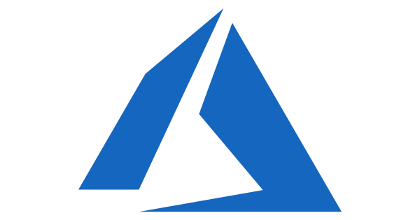

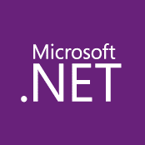
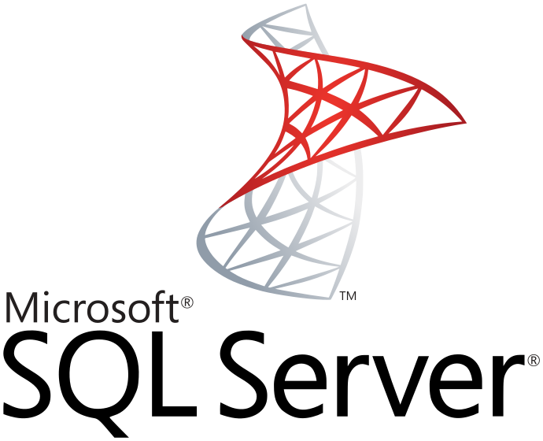

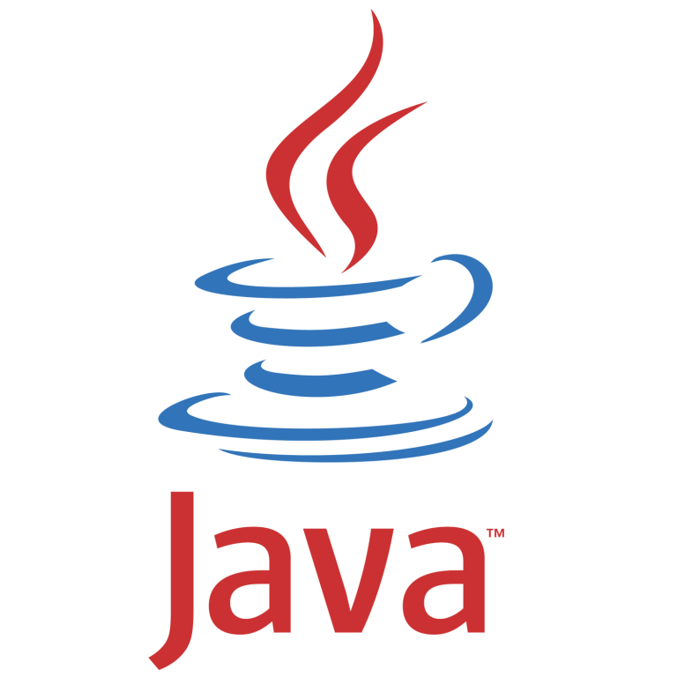
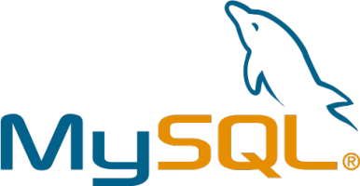
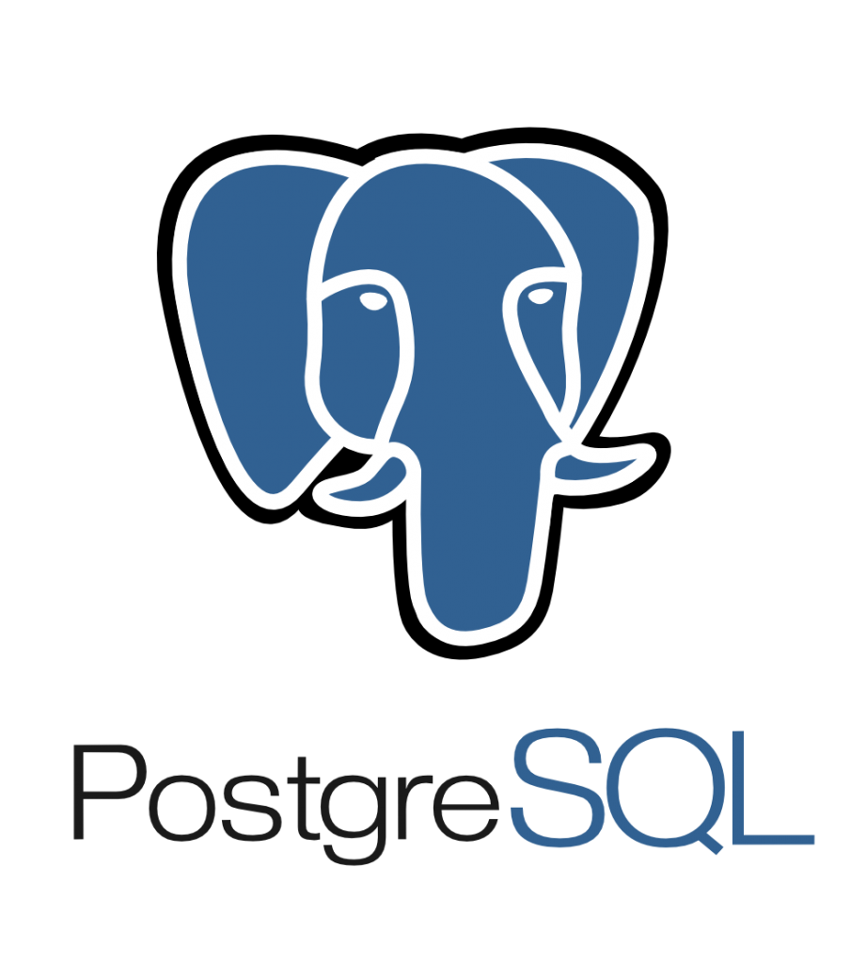
Lift and Shift (Migrate)
Migrate your on-premises application to IaaS on Azure
Pros
Existing Apps
Web apps (on-prem.)
Lift & Shift
Web apps (Cloud)
No re-architect or new code
Least effort for quick migration
Supported on the least common denominator
On-Premises
IaaS Cloud (VMs)
Cons
Smaller cloud value
Manual patching, upgrades
Limited automated app scaling and high availability
Monolithic architecture
Monolithic architecture

Slide 6
Lift and Shift (Apps, Virtual Machines, Workloads)
Lift and shift when
Take advantage of cloud native resilience
Want to have data disaster recovery in cloud
No longer want to own on-premises servers and datacenters (Opex vs CapEx)
Need a scale-on-demand capacity with no change in application environment needed
Want to begin the move to cloud quickly
Notes:
There are many scenarios under which Lift and Shift is the best approach:
Want to move to Cloud as-is to lower your maintenance costs taking advantage of cloud infrastructure
Want to avoid the burden of owning on-premises servers and data centers.
Need a scale-on-demand capacity with no change in application environment needed.
Need disaster recovery

Slide 7
Understand Technical Blockers and Mitigation Techniques
Networking
  DNS, IP Addresses, VLANS, custom ports
Security
  Authentication, Authorization
Legacy code
  Source
  Skill set
Legacy OS
  Hypervisor
Dependencies
  Frameworks, Database, Connectivity, shared storage, scale

Slide 8
Understand Non-technical Blockers and Mitigation Techniques
Compliance
  SOX, HIPPA
Owners
Cost and effort
Risk
Priority
Latency/Regions

Slide 9
Azure Supported distributions and Versions (March 2018)
Distribution | Version
CentOS | CentOS 6.3+, 7.0+
CoreOS | 494.4.0+
Debian | Debian 7.9+, 8.2+
Oracle Linux | 6.4+, 7.0+
Red Hat Enterprise Linux | RHEL 6.7+, 7.1+
SUSE Linux Enterprise | SLES/SLES for SAP 11 SP4 12 SP1+
openSUSE | openSUSE Leap 42.2+
Ubuntu | Ubuntu 12.04+ 1
Windows 7 x64
Windows 8/8.1 x64
Windows 10 x64
Windows Server 2008 x64
Windows Server 2008 R2 x64
Windows Server 2012 x64
Windows Server 2012 R2 x64
Windows Server 2016 x64
Notes:
https://docs.microsoft.com/en-us/azure/virtual-machines/linux/endorsed-distros?toc=%2Fazure%2Fvirtual-machines%2Flinux%2Ftoc.json

Slide 10



VMware and Physical Servers
Enhanced Architecture
443 (HTTPS)
Config
Server
Process
Server
9443 (HTTPS)
Azure Site Recovery
443 (HTTPS)
Microsoft Azure
Data Channel
Public Internet or ExpressRoute with Public Peering
Source: VMware VMs
& Physical Servers
Process Server
Used for caching, compression, and encryption
Configuration Server
Used for centralized management
Mobility Service Captures all data writes from memory

Slide 11
Hyper-V
With or without System Center
System
Center
443 (HTTPS)
Hyper-V
Server
Azure Site Recovery
443 (HTTPS)
Microsoft Azure
Data Channel
Public Internet or ExpressRoute with Public Peering
Source: Hyper-V VMs
Microsoft Azure Recovery Services Agent
Replicates data to Azure
Microsoft Azure Site Recovery DRA
Centralized Management

Slide 12
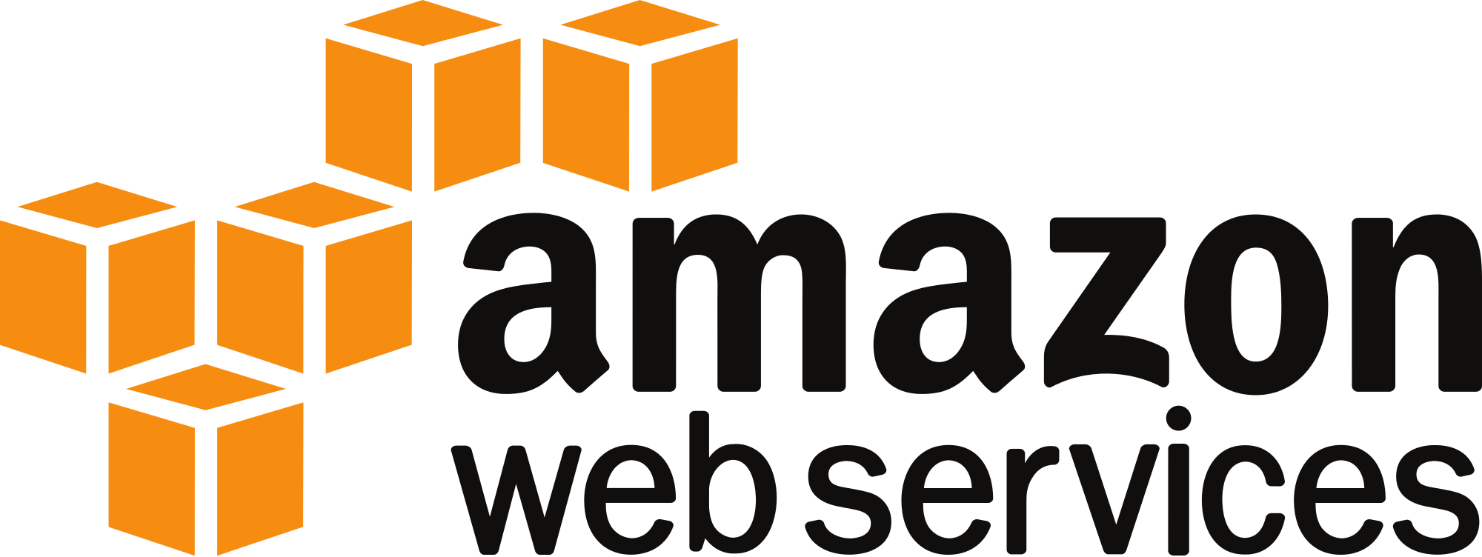
Migrate AWS AMIs to Azure
Enhanced Architecture
Config
Server
Process
Server
OMS Site Recovery
443 (HTTPS)
Microsoft Azure
Data Channel
Public Internet or ExpressRoute with Public Peering
Source: AWS AMIs
Process Server
Used for caching, compression, and encryption
Configuration Server
Used for centralized management
Mobility Service Captures all data writes from memory

Slide 13
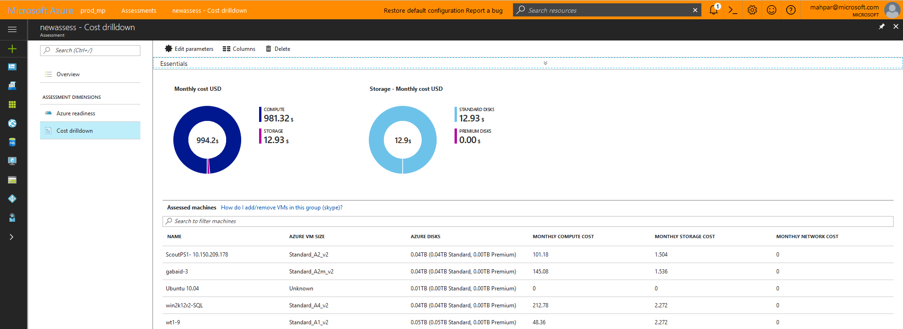
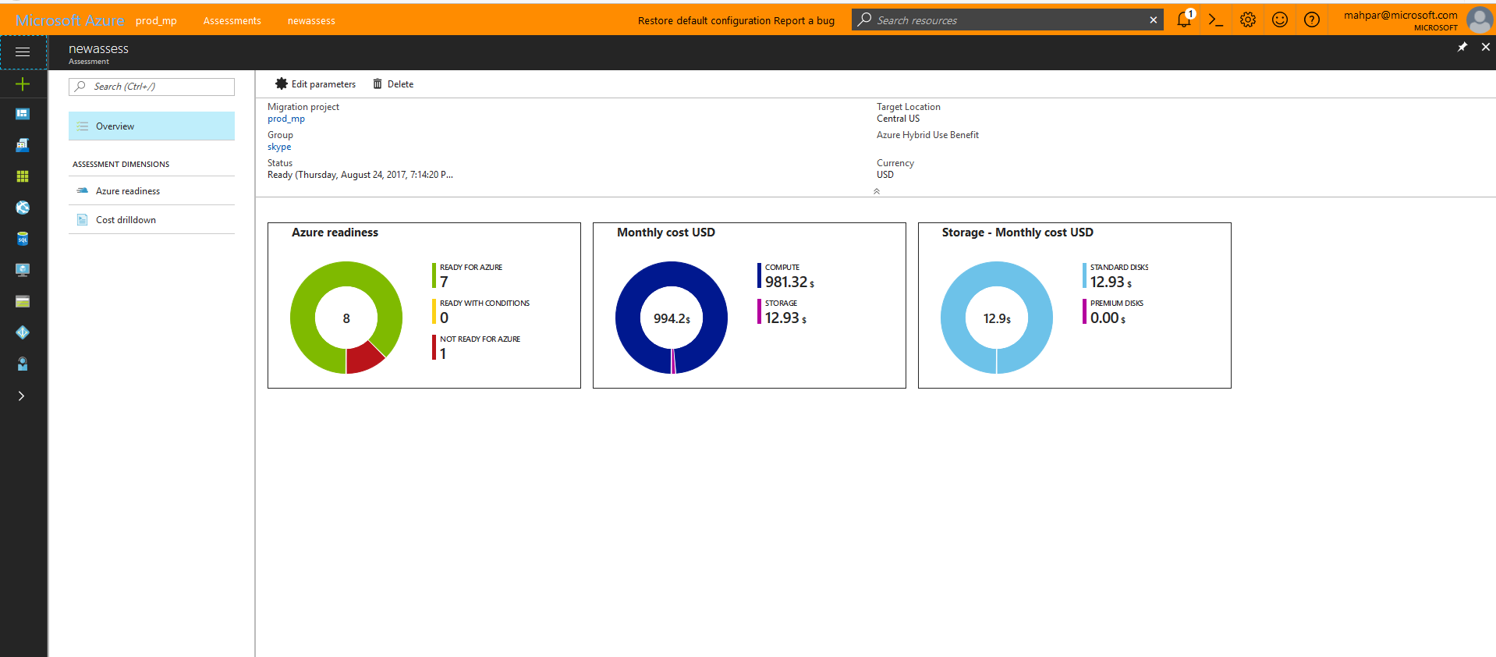
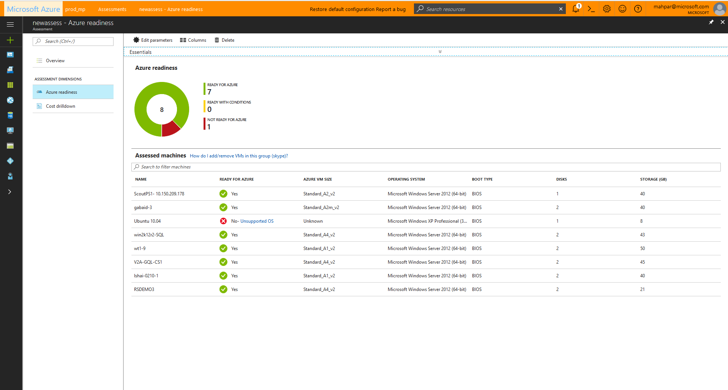
Azure Migrate
Discover and assess on-premises virtual machines and servers
Inbuilt dependency mapping
Intelligent rightsizing for Azure virtual machines
Compatibility reporting with guidelines for remediating potential issues
Migrate through seamless workload replication
Integrates with Database Management Service for DB discovery and migration

Slide 14
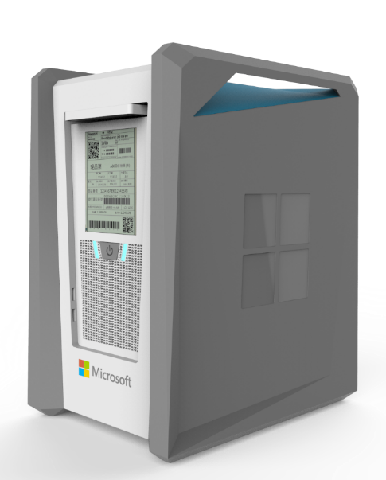
Azure Data Box (In preview)
What does it do?
Transfer up to 100 TB of data in 7-10 days when network isn’t an efficient option
Key features
Familiar Azure portal interface, support for Azure data types such as blobs and files
Human scale, tamper-evident case; Secure AES-256 encryption
Integrates seamlessly with CommVault, Netapp,
Veritas, Veeam, others
Roadmap
Data Box (100 TB) – expanded to EU in Q1 CY18, GA in Q3 CY18

Slide 15
Deployment Planning
Estimate network bandwidth required for initial and delta replication
Identify Azure storage type (standard or premium) required for virtual machines
Estimate the total number of standard and premium storage accounts that need to be provisioned
Estimate the total number of Configuration and Process Servers that need to be deployed when protected VMware workloads
Estimate additional on-premises storage requirement for Hyper-V workloads
Virtual machine eligibility assessment based on number of disks, size of the disks and IOPS
Profile the actual churn on the source virtual machine without any impact to the production workload

Slide 16
Migrations – Considerations/Time/Cost
Assume: @ (1) TB of Data / Month (IaaS) /ASR Migrations
Baseline Costs
Determine priority order
TCO for move to cloud
Bandwidth
Data Center Contracts:
  Early departure clauses
Seasonality of Apps / Business Cycles
  Black-out periods
Migration Resourcing (Partners)
Application owners
PCI/Regulatory requirements

Slide 17
Modernize/Optimize (PAAS, Containers, Serverless)

Slide 18
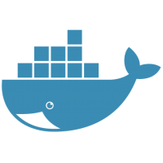
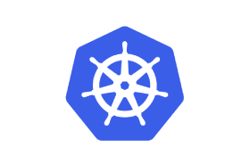
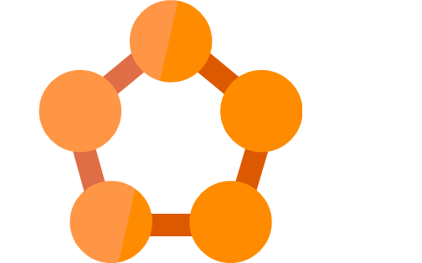
Cloud Optimized
Get more Cloud benefit by Containerizing your app
Lift & Shift
Web apps (Cloud)
Pros
Existing apps
Web apps (on-prem.)
Orchestration and Managed Services
No re-architect or new code
Increased density & lower deployment cost
Improved productivity and DevOps agility
Portability of apps and dependencies
High availability with Orchestrators
On-Premises
Cons
Containerization is an additional step
Monolithic architecture

Slide 19
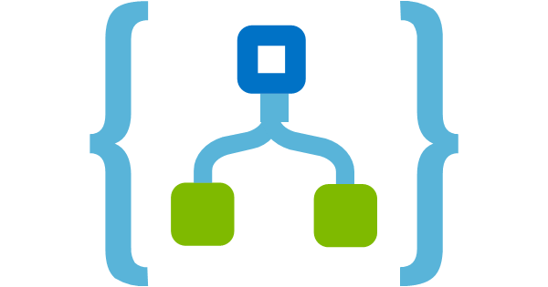
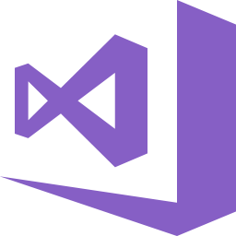

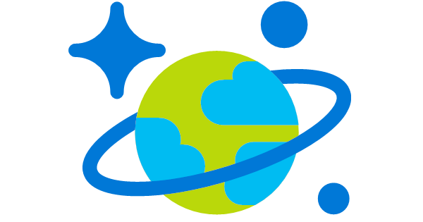
App Modernized
Extend your apps with new cloud native services including serverless, microservices and PaaS.
Cloud-optimized
full PaaS
Pros
Existing apps
Web apps (on-prem.)
Optimized for long term agility
Optimized for scale and high availability
Modern Architecture with Microservices
On-Premises
Cons
Requires significant code refactoring or rewriting
Monolithic architecture
Microservice architecture

Slide 20

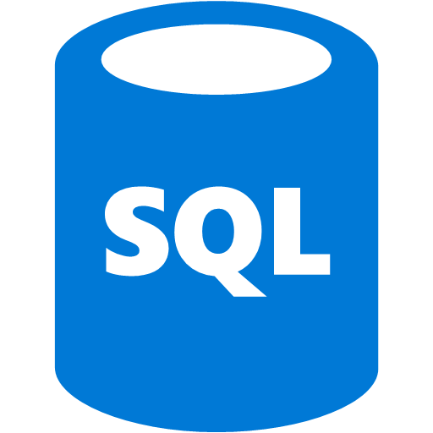

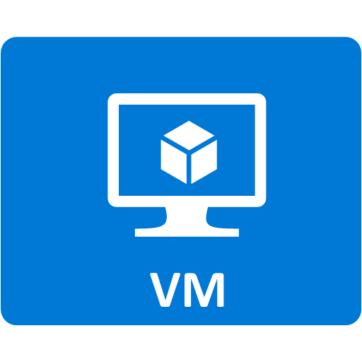
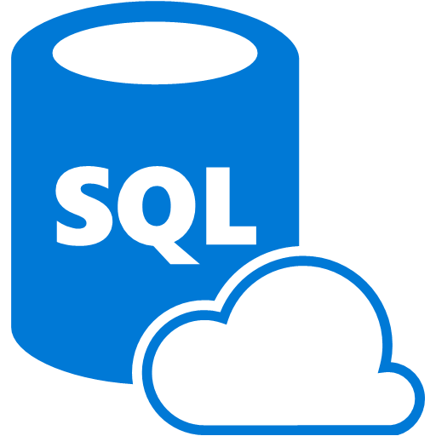


Select App - Choose: Path
Modernization of Infrastructure typically requires the rehosting (lift-and-shift) of 1st and 3rd party applications and data which may require simple remediation and reconfiguration.
Modernization of Applications & Data Platform typically is focused on revise, refactor, or rebuild of applications and data and requires a higher degree of analysis, design, and custom implementation
Infrastructure Modernization
Application & Data Platform Modernization
Rehosting
App & Data Layer
Revise, Refactor or Rebuild
Virtual Layer
Modernization
App & Data Layer
Physical Layer
Sales and Delivery:
Cloud Infrastructure
Sales and Delivery:
Modern Applications
Data Insights / Advanced Analytics
It is common for opportunities to span both of these scenarios. Competitive migrations typically span Infrastructure, Data and Applications.

Slide 21

Choosing migration strategy and technology
Objectives |  | Migrate |  | Modernize |  |  |  | Options to consider
 |  | Rehost | Refactor |  | Rearchitect | Re-build | Replace
1 | Deliver new capabilities faster |  |  |  |  |  |  | PaaS, Serverless
 | Optimize for developer productivity, build apps faster
2 | Provide multichannel access, including mobile |  |  |  |  |  |  | PaaS, Serverless
 | Enable wider, secure access to applications, support range of devices
3 | Enable business agility with continuous innovation |  |  |  |  |  |  | PaaS, Containers
 | Increase DevOps agility
4 | More easily integrate with other web and cloud apps |  |  |  |  |  |  | PaaS, Serverless
 | Leverage PaaS, increase productivity with Serverless
5 | Infuse intelligence into processes leveraging existing investments |  |  |  |  |  |  | PaaS, Serverless
 | Across dev/ops, developer experience, tooling, and infrastructure
6 | Increase agility & support scalability requirements of existing applications more cost effectively |  |  |  |  |  |  | PaaS, Containers
 | Optimize application architecture for cloud scale and continuous innovation
7 | Free up data center space quickly |  |  |  |  |  |  | VMs, SaaS
 | Free up or consolidate resources for apps that must reside on-premises
8 | Reduce capital expenditure of existing applications |  |  |  |  |  |  | VMs, SaaS
 | Switch to pay-as-you-go model, realize better budget forecasting
9 | Achieve rapid time to cloud |  |  |  |  |  |  | VMs
 | Allow migration with minimal architectural impact
Note: Some of the objective might apply to more than one category of applications
Notes:
Test RedHat or MTA

Slide 22
Map Application Targets
 | ASP | .NET | Java | PHP | IAAS | PAAS | Containers | ASR | Hybrid
ASP | X |  |  |  | X | X*
Access |  |  |  |  | X |  | X
VB6 |  |  |  |  | X
.NET |  | X |  |  | X | X | X | X | X
Java |  |  | X |  | X | X* | X* | X | X
Mainframe |  |  |  |  | X* |  | X* |  | X*
PHP |  |  |  | X | X | X | X | X | X
SQL |  |  |  |  | X | X* | X* | X | X
Oracle |  |  |  |  | X |  |  | X | X
DB2 |  |  |  |  | X* |  |  | X* | X*
Notes:
X = Most cases are straightforward
X* = Treatment with caveats as some treatments are not straightforward

Slide 23
MoveMeToTheCloud.net (Web apps on Windows)
“Azure Websites Migration Assistant”
1st use = Assessment
2nd use = Migration tool (if no errors)
Supports IIS 7 and higher (2008, ASP.net 2.0,…)
Supports Linux Apache webserver
Free assessment & migration tool
Open Sourced on GitHub

Slide 24
App Service Migration Assistant Scope
Port Bindings
IIS7 Authentication
Usage of assemblies in the GAC
IIS5 Compatibility Mode
IIS7+ Schema Compliance
Single Application Pool Per Site
COM and COM+ components
ISAPI Filters
HTTPS Bindings
Web site size
Database size
Azure Active Directory (AAD) Integration
Notes:
Azure App Service Migration Assistant
https://www.movemetothecloud.net/
Migrate an enterprise web app to Azure App Service
https://azure.microsoft.com/en-us/documentation/articles/web-sites-migration-from-iis-server/

Slide 25
Application Patterns

Slide 26
Use these pillars of quality as Guidelines
Scalability
Availability
Resiliency
Management and DevOps
Security
Cloud Application Architecture Guide
  https://azure.microsoft.com/en-us/campaigns/cloud-application-architecture-guide/

Slide 27
Logical Architecture
For a typical web application
USERS
EXTERNAL SYSTEMS
Service Consumers
PRESENTATION LAYER
BUSINESS LAYER
DATA LAYER
DATA SOURCES
SERVICES
Notes:
Here are all layers that can be distinguished in a typical web application. Please note that some tiers—the business layer, for example—might be missing with the presentation layer communicating directly to the backend repository.

Slide 28
Presentation Layer
For delivery and formatting of data from the backend repository
USERS
PRESENTATION LAYER
CROSS-CUTTING
ASP.NET Web Forms, MVC
ASP.NET Web API, WCF Services
Security
BUSINESS LAYER
WCF Services, .NET Remoting, RPC, Sockets
Operational Management
WF
DCOM/COM+
MSMQ
DATA LAYER
Communication
ADO.NET
ODBC
Oracle
Data Sources
Services
Notes:
The presentation layer is responsible for the delivery and formatting of data ultimately obtained from the backend repository. It contains the components that implement and display the user interface and manage user interaction. This layer includes controls for user input and display, in addition to components that organize user interaction.
WCF: Windows Communication Foundation
WF: Windows Workflow Foundation
ODBC: Open Database Connectivity
MSMQ: Message Queueing

Slide 29
Presentation Layer
Migration path for Microsoft technologies
Web Tier
With Web Logic Only
YES
Architecture
Assessment
Architecture
Refactoring Light
App Modernization Essentials
App Modernization Essentials
OR
Azure PaaS
Web Apps
Azure PaaS
SQL DB
Azure PaaS
Web Apps
Azure PaaS
Storage
Notes:
We’ll now cover possible implementation options of the existing web application presentation tier and provide recommendation on migrating it to the Microsoft Azure cloud platform.
What you see here is the relevant subset of the migration decision tree referenced in the companion Visio diagram.
PaaS: Platform as a Services

Slide 30
Presentation Layer
Migration strategies for Microsoft technologies
Windows Forms
Web-based application
Based on ASP.NET Web Forms or ASP.NET MVC technology.
Windows Presentation Foundation
ASP.NET Web Forms
Azure
ASP.NET MVC Web Apps
Minimal changes to existing code
ASP.NET HTTP handler
Azure App Service Web Apps PaaS
Azure Virtual Machines IaaS
Azure
ISAPI Extension
.NET Platform
Based on ASP.NET Web Forms or ASP.NET MVC technology
Classic ASP App
Notes:
WINDOWS FORMS
Windows Forms is a smart client technology for the .NET Framework, a set of managed libraries that simplify common application tasks such as reading and writing to the file system. Using a development environment like Visual Studio, a developer can create Windows Forms smart-client applications that display information, request input from users, and communicate with remote computers over a network.
Migration recommendation: An Windows Forms application is recommended to be migrated to Microsoft Azure environment as a web-based application, based on ASP.NET Web Forms or ASP.NET MVC technology.
Technology Options: The resulting web-based application can be hosted in Microsoft Azure using the following options:
Azure App Service Web Apps PaaS Offering can be used to host the target web-based applications. The Azure Portal or the command-line tools can be used to set up a website with .NET configured as a target. ASP.NET framework is already deployed and does not require more installation steps. Azure App Service Web Apps eliminates the need to manage the physical hardware, and it also provides several scaling options, from a shared multitenant model to a standard mode where dedicated machines service incoming traffic.
Authentication considerations: Consider using Azure Active Directory for authentication using SAML, OAuth 2.0, and OpenID Connect. Consider migrating ASP.NET authentication infrastructure to ASP.NET Identity system to be compliant with OAuth and Open Web Interface for .NET (OWIN) protocols, using Azure SQL Database or Azure Table Storage as an underlying repository. If legacy form-based authentication is required, migrate the ASP.NET Membership or Role provider infrastructure to Azure-compliant storage repository such as Azure SQL Database.
Caching considerations: To provide high-throughput, low-latency access to commonly accessed application data, we recommend migrating the applications to use ASP.NET Cache provider for Azure Redis Cache.
Session state considerations: While modern web applications ideally follow a stateless pattern, if session state is required for the migrated application, we recommend using Azure Redis Cache session state provider.
Persistent repository considerations: The type of existing storage medium used by the on-premises application—whether a local file system, a network share, or a proprietary storage mechanism—helps determine which Azure data services to consider:
Use Azure Blobs when an application needs to support streaming and random access scenarios to store unstructured binary and text data.
Use Azure Queues to provide effective messaging between application instances.
Use Azure Tables to store non-relational structured data.
For unstructured data where manipulated information cannot be described by specific schema, or if the underlying data structure might change over the application’s lifetime, Azure DocumentDB can be used to host such datasets while still providing the atomic transaction support and backend stored procedures invocation features.
Search capabilities: Given the requirement to implement search capability in the web application, consider using Azure Search to add full-text search scoped over the web application content and search behaviors, such as type-ahead, spelling corrections, and matches based on near synonyms.
ASP.NET MVC WEB APPS
ASP.NET MVC web applications follow Model-View-Controller (MVC) architectural pattern and allows the building of dynamic websites that provide a clean SoC and full control over underlying markup. The MVC architectural pattern separates an application into three main components: the model, the view, and the controller:
Models implement the logic for the application data domain, for example, often, retrieving and storing model state in a database.
Views display the application user interface.
Controllers handle user interaction, work with the model, and ultimately select a view to render that displays in the UI.
Migration recommendation: An ASP.NET MVC application can be run in Azure with minimal changes to the existing source code.
Technology options: Azure App Service Web Apps PaaS Offering can be used to host ASP.NET MVC applications. The Azure Portal or the command-line tools can be used to set up a website with .NET configured as a target. ASP.NET MVC framework is already deployed and does not require more installation steps. After creating a site, an existing IIS 7.5 web application or IIS 7.5 website can be moved to be hosted in the newly created website. Azure App Service Web Apps eliminates the need to manage the physical hardware, and it also provides several scaling options—from a shared multitenant model to a standard mode where dedicated machines service incoming traffic. For a simple ASP.NET MVC application, Azure App Service Web Apps is the recommended option.
Authentication considerations: Consider using Azure Active Directory for authentication using SAML, OAuth 2.0, and OpenID Connect. Consider migrating ASP.NET authentication infrastructure to ASP.NET Identity system to be compliant with OAuth and OWIN protocols, using Azure SQL Database or Azure Table Storage as an underlying repository. If legacy form-based authentication is required, migrate the ASP.NET Membership or Role provider infrastructure to Azure-compliant storage repository such as Azure SQL Database.
Caching considerations: To provide high-throughput, low-latency access to commonly accessed application data, we recommend migrating the applications to use ASP.NET Cache provider for Azure Redis Cache.
Session state considerations: While modern web applications ideally follow a stateless pattern, if session state is required for the migrated application, we recommend using Azure Redis Cache session state provider.
Persistent repository considerations:
The type of existing storage medium used by the on-premises application—whether a local file system, a network share, or a proprietary storage mechanism—helps determine which Azure data services to consider:
Use Azure Blobs when an application needs to support streaming and random access scenarios to store unstructured binary and text data.
Use Azure Queues to provide effective messaging between application instances.
Use Azure Tables to store non-relational structured data.
For unstructured data where manipulated information cannot be described by specific schema, or if the underlying data structure might change over the application’s lifetime, Azure DocumentDB can be used to host such datasets while still providing the atomic transaction support and backend stored procedures invocation features.
Search capabilities. Given the requirement to implement search capability in the web application, consider using Azure Search to add full-text search scoped over the web application content and search behaviors, such as type-ahead, spelling corrections, and matches based on near synonyms.
ASP.NET HTTP HANDLER
An ASP.NET HTTP handler is the process (frequently referred to as the "endpoint") that runs in response to a request made to an ASP.NET Web application. A common handler is an ASP.NET page handler that processes .aspx files. When users request an .aspx file, the request is processed by the page through the page handler. You can create your own HTTP handlers that render custom output to the browser.
An HTTP module is an assembly that is called on every request that is made to your application. HTTP modules are called as part of the ASP.NET request pipeline and have access to lifecycle events throughout the request. HTTP modules let you examine incoming and outgoing requests and take action based on the request.
Migration recommendation: There is a set of options applicable to migrating ASP.NET HttpHandlers and HttpModules to the Azure platform:
Azure App Service Web Apps Offering can be used to host ASP.NET HttpModules. However, while Azure App Service Web Apps runs ASP.NET sites in full trust, there is additional security-enhanced hardening done on the servers, and that will limit whether some application programming interfaces (APIs) invoked by specific HttpModule would work. Azure App Service Web Apps eliminates the need to manage the physical hardware, and it also provides several scaling options—from a shared multitenant model to a standard mode where dedicated machines service incoming traffic. For a simple ASP.NET MVC application, Azure App Service Web Apps is the recommended option.
For complex HttpHandlers and HttpModules ISAPI components Azure Virtual Machines might also be an option. IaaS virtual machines offer control over the operating system, configuration, and installed software and services. This is a good option for quickly migrating complex on-premises web applications to the cloud, because the machines can be moved as a whole.
Caching considerations: To provide high-throughput, low-latency access to commonly accessed application data, we recommend migrating the applications to use ASP.NET Cache provider for Azure Redis Cache.
Session state considerations: While modern web applications ideally follow a stateless pattern, if session state is required for the migrated application, we recommend using Azure Redis Cache session state provider.
Persistent repository considerations: The type of existing storage medium used by the on-premises application—whether a local file system, a network share, or a proprietary storage mechanism—helps determine which Azure data services to consider:
Use Azure Files when an application already uses the native file system APIs and will have to share data with other Azure-run systems.
Use Azure Blobs when an application needs to support streaming and random access scenarios to store unstructured binary and text data.
Use Azure Queues to provide effective messaging between application instances.
Use Azure Tables to store non-relational structured data.
Internet Server Application Programming Interface (ISAPI_EXTENSIONS
ISAPI extensions are native applications that run on Internet Information Services (IIS) 7.5 and have access to all of the functionality provided by IIS 7.5. For example, the ASP.NET engine itself is implemented as an ISAPI extension aspnet_isapi.dll, while the classic ASP engine is implemented as an ISAPI extension ASP.DLL.
Migration recommendation: Consider migrating ISAPI extension to the managed .NET platform; for example, a combination of ASP.NET HttpHandlers or HttpModules and WebForms or MVC application if ISAPI extension generates a user UI. If you select this option, follow the migration guidance related to the chosen technology
For complex ISAPI components Azure Virtual Machines is a viable option. Azure IaaS Virtual Machines offers control over the operating system, configuration, and installed software and services. This is a good option for quickly migrating complex on-premises web applications to the cloud, because the machines can be moved as a whole.
CLASSIC ASP APPLICATIONS
Classic ASP application: ASP is a server-side scripting environment widely used before the release of ASP.NET based on .NET framework platform. ASP interpreter was well known to be the original IIS-based server-side script engine for dynamically generated web pages. It supported web page development using an Active Scripting engine such as VBScript, Jscript, or PerlScript. ASP pages are still supported by IIS 7.5 on modern Windows systems.
Migration recommendation: There is a set of options applicable to migrating classic ASP applications to the Azure platform:
Consider migrating classic ASP to the managed .NET platform, using ASP.NET WebForms or ASP.NET MVC. If you select this option, follow the migration guidance related to the chosen technology.
Azure App Service Web Apps Offering has classic ASP support activated by default and can be used to host the existing application.

Slide 31
Presentation Layer
Migration path for third-party technologies
Web Tier – Java:
Apache HTTP Server, Apache Tomcat, J2EE
or PHP Optional:
MVC: Spring, Struts
ORM: Hibernate
Azure Web Apps
Additional Work
Architecture
Assessment
Architecture
& Code Refactoring MEDIUM
YES
Azure IaaS
Linux VM
Windows Server
2012 Hyper-V /
Azure Pack
NO
Architecture
Assessment
Infrastructure
Refactoring

Slide 32
Presentation Layer
Migration strategies for third-party technologies
Oracle WebLogic Server
PHP
Applications
Spring MVC
Microsoft Azure Cloud
IBM WebSphere Application Server
Apache Tomcat
Apache Struts 2
Microsoft Azure App Service Web Apps
Windows or Linux Azure Virtual Machines
Red Hat JBoss
Apache Geronimo
Jetty
Notes:
ORACLE WEB LOGIC
Oracle WebLogic Server is an enterprise Java Enterprise Edition application server for developing and deploying applications across cloud and on-premises environments (Oracle).
Migration recommendation: The following option is recommended to migrate Oracle WebLogic Server applications to the Microsoft Azure platform:
Use Azure Virtual Machines to spin up a virtual machine with a license already included, utilizing the on-demand infrastructure scaling provided by Azure. IaaS virtual machines offer control over the operating system, configuration, and installed software and services. Oracle WebLogic Server software is available in the Azure image gallery. The image includes Oracle WebLogic Server 12.1.2.0.0, Oracle JDJK 1.7.0u25, and Oracle Linux 6.4.0.0.0.
IBM WEBSPHERE APPLICATION SERVER
WebSphere Application Server is Java-based web application server that supports distributed applications deployment (IBM)
Migration recommendation: The following option is recommended to migrate WebSphere Application Server applications to the Azure platform:
Use Azure Virtual Machines to spin up a virtual machine, utilizing the on-demand infrastructure scaling provided by Azure. Infrastructure as a Service (IaaS) virtual machines offer control over the operating system, configuration, and installed software and services. WebSphere Application Server software is available in the Azure image gallery.
PHP APPLICATIONS
PHP, which stands for “PHP: Hypertext Preprocessor,” is a widely-used, open source general-purpose scripting language used for web development. PHP can be embedded into hyper text markup language (HTML) and its syntax draws upon C, Java, and Perl programming languages (PHP).
Migration recommendation: Azure App Service Web Apps Offering provides the built-in PHP runtime, and a PHP website can be created in Azure either through regular portal or command-line tools. After the site is created, a wide spectrum of tools, including Git, file transfer protocol (FTP), WebMatrix, can be used to deploy PHP application code. Azure App Service Web Apps also allow plugging in a custom PHP runtime and implementing various PHP extensions.
For PHP applications hosted on Linux Azure Virtual Machines can be used to migrate the workload to Azure platform. A set of Linux distributions is available in the Azure gallery, including Oracle Linux, CentOS, Ubuntu, SUSE, Red Hat Enterprise Linux (RHEL) among others.
APACHE TOMCAT
Apache Tomcat is an open source software implementation of the Java servlet and JavaServer Pages technologies, and provides Java hyper text transfer protocol (HTTP) web server environment hosting Java components. In the simplest configuration, Tomcat runs in a single operating system process running within a Java virtual machine. (Apache).
Migration recommendation: The Microsoft Azure App Service Web Apps service provides built-in support within the portal user experience to activate the Tomcat 7.0.50 Java containers. In addition to the configuration user interface (UI), the web application gallery has complete installations available for Tomcat in cases where there is a need to modify and customize the Java web container.
To exert more control on the Tomcat installation, it can be deployed on Microsoft Windows or Linux Azure Virtual Machines. A choice of Microsoft Windows Server images and a set of Linux distributions is available in the Azure gallery, the latter including Oracle Linux, CentOS, Ubuntu, SUSE, RHEL among others.
JETTY
Jetty is a Java-based, open source web server implementing a HTTP server and servlet container that offers an ability to serve static and dynamic content (Eclipse).
Migration recommendation: Azure App Service Web Apps Offering provides built-in support within the Portal user experience to activate the Jetty 9.1.0 Java containers. In addition to the configuration UI, the web application gallery has complete installations available for Jetty in cases where there is a need to modify and customize the Java web container.
To exert more control on the Jetty installation, it can be deployed on Windows or Linux Azure Virtual Machines. A choice of Windows Server images and a set of Linux distributions is available in the Azure gallery, the latter including Oracle Linux, CentOS, Ubuntu, SUSE, RHEL among others.
RED HAT JBOSS
Red Hat JBoss is a web server combining Apache Web Server and Apache Tomcat to provide a single solution for large-scale websites and lightweight Java web applications. It is comprised of the Apache HTTP Server, Apache Tomcat servlet engine, load balancers, and the Tomcat Native middleware support library (RedHat).
Migration recommendation: JBoss support in Azure Virtual Machines is provided by Bitnami JBoss Stack which is available in the Azure gallery and includes ready-to-run versions of Apache, MySQL, JBoss, Java, and all of the other software required to run each of those components.
APACHE GERONIMO
Apache Geronimo is an open source server runtime that integrates various open source projects to create Java or OSGi server runtimes for enterprise software developers and system administrators. The modern Geronimo distribution is a fully certified Java EE 6 application server runtime (Apache, Geronimo).
Migration recommendation: Azure Virtual Machines Offering can be used to deploy Apache Geronimo on Windows or Linux Azure Virtual Machines. A choice of Windows Server images and a set of Linux distributions is available in the Azure gallery, the latter including Oracle Linux, CentOS, Ubuntu, SUSE, RHEL among others.
SPRING MVC
The Spring framework is an open-source library providing a programming and configuration model for modern Java-based enterprise applications. It focuses on the "plumbing" of enterprise applications and includes the following features:
Dependency Injection
Aspect-Oriented Programming, including Spring's declarative transaction management
Spring MVC web application and RESTful web service framework
Foundational support for JDBC, JPA, and JMS (Spring)
Migration recommendation: Jetty installation can be deployed on Windows or Linux Azure Virtual Machines. A choice of Windows Server images and a set of Linux distributions is available in the Azure gallery, the latter including Oracle Linux, CentOS, Ubuntu, SUSE, RHEL among others.
APACHE STRUTS 2
Apache Struts is an open-source MVC framework for creating Java web applications that is extensible using a plugin architecture and ships with plugins to support REST, AJAX, and JSON. This framework is designed around the MVC architectural pattern, which separates an application into three main components: the model, the view, and the controller:
Models implement the logic for the application data domain, for example, often, retrieving and storing model state in a database.
Views display the application user interface.
Controllers handle user interaction, work with the model, and ultimately select a view to render that displays in the UI. (Apache, Struts 2)
Migration recommendation: Java installation featuring Struts framework can be deployed on Windows or Linux Azure Virtual Machines. A choice of Windows Server images and a set of Linux distributions is available in the Azure gallery, the latter including Oracle Linux, CentOS, Ubuntu, SUSE, RHEL among others.

Slide 33
Business Layer
For delivery and formatting of data from the backend repository
USERS
PRESENTATION LAYER
CROSS-CUTTING
ASP.NET Web Forms, MVC
ASP.NET Web API, WCF Services
Security
BUSINESS LAYER
WCF Services, .NET Remoting, RPC, Sockets
Operational Management
WF
DCOM/COM+
MSMQ
DATA LAYER
Communication
ADO.NET
ODBC
Oracle
Data Sources
Services
Notes:
This layer implements the core functionality of the system and encapsulates the relevant business logic. It generally consists of components, some of which may expose service interfaces that other callers can use. Figure 6 depicts various components that belong to the application.
The application layer will usually include the following:
Application façade. This optional component typically provides a simplified interface to the business logic components, often by combining multiple business operations into a single operation that makes it easier to use the business logic. It reduces dependencies because external callers do not need to know details of the business components or the relationships between them.
Business Logic components. Business logic is defined as any application logic that is concerned with the retrieval, processing, transformation, and management of application data; application of business rules and policies; and helping to make sure data consistency and validity. To make use of reuse opportunities, business logic components should not contain any behavior or application logic that is specific to a use case or user story. Business logic components can be further subdivided into the following two categories:
Business Workflow components. After the UI components collect the required data from the user and pass it to the business layer, the application can use this data to perform a business process. Many business processes involve multiple steps that must be performed in the correct order, and can interact with each other through an orchestration. Business workflow components define and coordinate long running, multistep business processes and can be implemented using business process management tools. They work with business process components that instantiate and perform operations on workflow components.
Business Entity components. Business entities, or—more generally—business objects, encapsulate the business logic and data necessary to represent real world elements, such as customers or orders, within your application. They store data values and expose them through properties, contain and manage business data used by the application, and provide stateful programmatic access to the business data and related functionality. Business entities also validate the data contained within the entity and encapsulate business logic to maintain consistency and implement business rules and behavior.

Slide 34
Business Layer
Migration path for Microsoft technologies
Application Modernization
Essentials
Architecture
Assessment
Embedded
Business Logic Simple?
Architecture
& Code Refactoring SIMPLE
Azure PaaS
Web Apps
Azure PaaS
Web Jobs
YES
Azure PaaS
SQL Database
Azure PaaS
Storage
Application Modernization
Essentials
Hybrid Integration
Solution (NEXUS)
NO
Architecture
& Code Refactoring MEDIUM
Azure PaaS
Web Apps
Azure PaaS
Web Jobs
Azure IaaS
VM Instances
Windows
Server 2012
VM Instances
Azure PaaS
SQL Database
Azure PaaS
Storage
Notes:
VM: Virtual Machine

Slide 35
Business Layer
Migration strategies for Microsoft technologies
ASP.NET Web
API service
Minimal changes to existing code
WCF Service
COM+ serviced components
.NET remoting components
Azure
.NET Platform
Based on ASP.NET Web Forms or ASP.NET MVC technology
ASMX Web Service
Azure App Service Web / API Apps PaaS
Azure Virtual Machines IaaS
Remote Procedure
Call server
Azure
Socket network apps
Azure platform
messaging services
Message Queuing apps
Notes:
ASP.NET Web API service
ASP.NET Web API is a framework that makes it easy to build HTTP services that reach a broad range of clients, including browsers and mobile devices and used as a platform for building RESTful applications on the .NET Framework.
Migration recommendation: An ASP.NET Web API application can run in Azure with minimal changes to the existing source code.
Technology options:
Azure App Service Web and API Apps PaaS Offering can be used to host ASP.NET Web API applications. The Azure Portal or the command-line tools can be used to set up a an App Service deployment with .NET configured as a target. ASP.NET Web API framework is already deployed and does not require more installation steps. After creating a site, an existing IIS 7.5 web application or IIS 7.5 website can be moved to be hosted in the newly created App Service instance. Azure App Service Web and API Apps eliminates the need to manage the physical hardware, and it also provides several scaling options—from a shared multitenant model to a standard and premium modes where dedicated machines service incoming traffic. For a simple ASP.NET Web API application, Azure App Service Web and API Apps is the recommended option.
Authentication considerations: Consider using Azure Active Directory for authentication using Open Web Interface for .NET (OWIN), OAuth 2.0, and OpenID Connect. Consider migrating ASP.NET authentication infrastructure to ASP.NET Identity system to be compliant with OWIN protocols, using Azure SQL Database or Azure Table Storage as an underlying repository.
Caching considerations: To provide high-throughput, low-latency access to commonly accessed application data, we recommend migrating the applications to use ASP.NET Cache provider for Azure Redis Cache.
Session state considerations:
While modern web applications ideally follow a stateless pattern, if session state is required for the migrated application, we recommend using Azure Redis Cache session state provider.
Persistent repository considerations:
The type of existing storage medium used by the on-premises application—whether a local file system, a network share, or a proprietary storage mechanism—helps determine which Azure data services to consider:
Use Azure Blobs when an application needs to support streaming and random access scenarios to store unstructured binary and text data.
Use Azure Queues to provide effective messaging between application instances.
Use Azure Tables to store non-relational structured data.
For unstructured data where manipulated information cannot be described by specific schema, or if the underlying data structure might change over the application’s lifetime, Azure DocumentDB can be used to host such datasets while still providing the atomic transaction support and backend stored procedures invocation features.
Available Offerings: App Modernization Essentials
WCF service
WCF is a framework for building service-oriented applications. Using WCF, data can be sent as asynchronous messages from one service endpoint to another. A service endpoint can be part of a continuously available service hosted by IIS 7.5, or it can be a service hosted in an application. An endpoint can be a client of a service that requests data from a service endpoint. The messages can be as simple as a single character or word sent as extensible markup language (XML), or as complex as a stream of binary data.
Migration recommendation: A WCF service can run in Azure with minimal changes to the existing source code.
Technology options:
Azure App Service Web and API Apps PaaS Offering can be used to host WCF service exposing HTTP(S)-based endpoints. The Azure Portal or the command-line tools can be used to set up an App Service deployment with .NET configured as a target. .NET framework is already deployed and does not require more installation steps. After creating a site, an existing IIS 7.5 web application or IIS 7.5 website hosting WCF service can be moved to be hosted in the newly created App Service deployment. Azure App Service Web and API Apps eliminates the need to manage the physical hardware, and it also provides several scaling options—from a shared multitenant model to a standard or premium mode where dedicated machines service incoming traffic. For a simple WCF service exposing HTTP(S) endpoints, Azure App Service Web and API Apps is the recommended option.
Authentication considerations: Consider using Azure Active Directory for authentication using OAuth 2.0 and OpenID Connect. Consider migrating ASP.NET authentication infrastructure to ASP.NET Identity system to be compliant with OWIN protocols, using Azure SQL Database or Azure Table Storage as an underlying repository.
Caching considerations: To provide high-throughput, low-latency access to commonly accessed application data, we recommend migrating the applications to use ASP.NET Cache provider for Azure Redis Cache.
Persistent repository considerations: The type of existing storage medium used by the on-premises application—whether a local file system, a network share, or a proprietary storage mechanism—helps determine which Azure data services to consider:
Use Azure Blobs when an application needs to support streaming and random access scenarios to store unstructured binary and text data.
Use Azure Queues to provide effective messaging between application instances.
Use Azure Tables to store non-relational structured data.
For unstructured data where manipulated information cannot be described by specific schema, or if the underlying data structure might change over the application’s lifetime, Azure DocumentDB can be used to host such datasets while still providing the atomic transaction support and backend stored procedures invocation features.
API management: Consider using Azure API Management service to expose set of operations that can be invoked by client applications and implement authentication, rate limit, and quota policies.
Available Offerings:
App Modernization Essentials
COM+ serviced components
COM+ was an evolution of Microsoft Component Object Model (COM) and Microsoft Transaction Server (MTS). COM+ acted as a middleware application service to handle resource management tasks, such as thread allocation and security. COM+ also provided thread pooling, object pooling, and just-in-time object activation and transaction support.
Migration recommendation: There is a set of options applicable to migrating COM+ applications to the Azure platform:
For out-of-process COM+ servers, consider migrating the underlying business logic to modern development stack, such as .NET services. If you select this option, follow the migration guidance related to the chosen technology. In-process COM+ services components can be redeployed as regular .NET assemblies and invoked directly by the calling party.
Azure IaaS Virtual Machine offering can be used to host a COM+ serviced component and can be scaled out via ARM VM ScaleSets as required. There is also an increased level of control over the underlying web application infrastructure, for example, there is the ability to remote desktop onto the machines running VM instances. All required COM+ registration procedures can be carried out at role initialization using the custom script extension functionality.
.NET remoting components
.NET remoting is a legacy technology that facilitates building distributed applications, whether the application components are all on one computer or spread out across the entire world. .NET remoting can also be used to communicate with other application domains in the same process.
.NET remoting provides an abstract approach to interprocess communication that separates the remotable object from a specific client or server application domain and from a specific mechanism of communication. In addition, the remoting system assumes no particular application model, whether the origin of communication is a web application, a console application, or a Windows service. Any application can host remoting objects and provide its services to any client on its computer or network.
Migration recommendation: There is a set of options applicable to migrating .NET remoting applications to the Azure platform:
Consider migrating the application to the modern development stack, such as .NET managed services, for example, using ASP.NET Web API. If you select this option, follow the migration guidance related to the chosen technology. In-process .NET remoting components can be redeployed as regular .NET assemblies and invoked directly by the calling party.
To temporarily migrate (“lift and shift”) a legacy application into the Azure environment, you can use an Azure IaaS Virtual Machines offering. .NET remoting is a legacy technology that is retained in the latest versions of Windows Server operating system for backward compatibility with existing applications, and as such, the existing .NET remoting application will work on Windows Server 2012 R2 virtual machines.
ASMX Web Service
ASMX Web Service is a legacy technology provided by ASP.NET to create Simple Object Access Protocol (SOAP) XML web services. An ASP.NET XML web service is implemented in a file with an .asmx file name extension, which has a web service declaration and followed by web service methods. Such web service automatically supports clients communicating using the SOAP, HTTP-GET, and HTTP-POST protocols.
Migration recommendation: There is a set of options applicable to migrating ASMX Web Service applications to the Azure platform:
Consider migrating the application to the modern development stack, such as .NET managed services, for example, using ASP.NET Web API. If you select this option, follow the migration guidance related to the chosen technology.
Azure App Service Web Apps PaaS offering can be used to host ASMX Web Service which exposes HTTP(s)-based endpoints. The Azure Portal or the command-line tools can be used to set up a App Service deployment with .NET configured as a target. .NET framework is already deployed and does not require more installation steps. After creating a site, an existing IIS 7.5 web application or IIS 7.5 website hosting ASMX Web Service can be moved to be hosted in the newly created App Service deployment . Azure App Service Web Apps eliminates the need to manage the physical hardware, and it also provides several scaling options—from a shared multitenant model to a standard or premium mode where dedicated machines service incoming traffic. For a simple ASMX service exposing HTTP(S) endpoints, Azure App Service Web Apps is a viable deployment vehicle if migration to current technologies is not an option.
Message Queuing applications
Microsoft Message Queuing (MSMQ) technology allows applications running at different times to communicate across heterogeneous networks and systems that may be temporarily offline. Applications send messages to queues and read messages from queues. The following illustration shows how a queue can hold messages that are generated by multiple sending applications and read by multiple receiving applications.
Message Queuing provides message delivery, efficient routing, improved security, and priority-based messaging. It can be used to implement solutions to both asynchronous and synchronous scenarios requiring high performance.
Migration recommendation: There is a set of options applicable to migrating MSMQ applications to the Azure platform:
Consider migrating applications communicating with MSMQ to utilize the Azure platform messaging services—such as Azure Storage Queues, Azure Service Bus Queues, Topics, and EventHubs.
Use the following recommendations when determining which queuing technology fits the purpose for a given Solution:
Azure Queues should be used when an application:
Must store over 80 gigabytes (GB) of messages in a queue, where the messages have a lifetime shorter than seven days.
Needs to track progress for processing a message inside of the queue. This is useful if the worker processing a message crashes. A subsequent worker can then use that information to continue from where the prior worker left off.
Requires server-side logs of all of the transactions performed against your queues.
Service Bus queues should be used when a Solution:
Must be able to receive messages without having to poll the queue. With Service Bus, this can be achieved through the use of the long-polling receive operation, using the transmission control protocol (TCP)-based protocols that Service Bus supports.
Requires the queue to confirm first-in-first-out (FIFO) ordered delivery.
Must be able to support automatic duplicate detection.
Needs to process messages as parallel, long-running streams (messages are associated with a stream using the SessionID property on the message). In this model, each node in the consuming application competes for streams, as opposed to messages. When a stream is given to a consuming node, the node can examine the state of the application stream state using transactions.
Requires transactional behavior and atomicity when sending or receiving multiple messages from a queue.
Has a time-to-live (TTL) characteristic that can exceed the seven-day period.
Handles messages that can exceed 64 kilobytes (KB) but will not likely approach the 256 KB limit.
Has a requirement to provide a role-based access model to the queues and different rights or permissions for senders and receivers.
Does not expect the queue size to grow larger than 80 gigabyte (GB).
Needs to use the Advanced Message Queuing Protocol 1.0 standards-based messaging broker.
Is expected to eventually migrate from queue-based point-to-point communication to a message exchange pattern that allows virtually seamless integration of additional receivers (subscribers), each of which receives independent copies of either some or all messages sent to the queue. The latter refers to the publish and subscribe capability natively provided by Service Bus.
Must support the “at-most-once” delivery guarantee without the need to build the additional infrastructure components.
Needs to publish and consume batches of messages.
Requires full integration with the WCF communication stack in the .NET framework.
Azure App Service Web Jobs and Azure Functions PaaS offerings can be used to host highly-available, scalable applications that utilize Azure messaging services provided by Azure Storage and Azure Service Bus. Such application can be deployed within Azure App Service PaaS offering and can be scaled out as required.
To temporarily lift and shift a legacy application that uses MSMQ to communicate within the single virtual machine deployment, you can use the Azure IaaS Virtual Machines offering. IaaS virtual machines offer control over the operating system, configuration, and installed software and services. This is a good option for quickly migrating complex on-premises applications to the cloud, because the machines can be moved as a whole.
Remote Procedure Call server
A Remote Procedure Call (RPC) server is a communications interface provided by an application or service that allows remote clients to connect, pass commands, and transfer data using the RPC protocol. An application will register its RPC server with the operating system’s Endpoint Mapper (EPM) service so that the remote client can locate the RPC server. When the application registers with the EPM, it will indicate the IP address and TCP port that it is listening on
Migration recommendation: There is a set of options applicable to migrating RPC server applications to the Azure platform:
Depending on latency and absolute performance requirements, consider migrating the application to the modern development stack, such as .NET managed services, for example, using ASP.NET Web API. If you select this option, follow the migration guidance related to the chosen technology.
Azure Virtual Machines IaaS Offering can be used to create highly-available, scalable applications and can be used to host a RPC Server application; An RPC Server can be deployed within a backend Azure IaaS Virtual Machine and can be scaled out via ScaleSets as required. There is also an increased level of control over the underlying infrastructure; for example, there is the ability to remote desktop onto virtual machine instances. Finally, machine-wide configuration changes can be applied at virtual machine startup, including tasks that require administrator control. Azure IaaS Virtual Machines offering offers control over the operating system, configuration, and installed software and services.
Socket network applications
A network socket is an abstraction used in the interprocess communication pattern completion flow in distributed computer environments. The contemporary network communication is based on the TCP/IP open protocol. A socket API support is provided by all modern operating systems to allow software applications to communicate through network sockets. Historically, such socket API frameworks have been based on the Berkeley sockets standard. A typical socket address is the coupling of an IP address and a port number. Using such an address, network sockets deliver data packets to the appropriate application process.
Migration recommendation: There is a set of options applicable to migrating socket-based networking applications to the Azure platform:
Depending on application requirements, consider migrating the application to the modern development stack, such as .NET-based services. If you select this option, follow the migration guidance related to the chosen technology.
Azure Virtual Machine IaaS Offering can be used to create highly-available, scalable applications and can be used to host a socket application; especially if it acts as a presentation tier for a complex, multitier architecture. A socket application can be deployed within a backend virtual machine in Azure IaaS service and can be scaled out as required using VM ScaleSets. There is also an increased level of control over the underlying infrastructure; for example, there is the ability to remote desktop onto the virtual machines. Finally, machine-wide configuration changes can be applied at virtual machine startup, including tasks that require administrator control.

Slide 36
Business Layer
Migration path for third-party technologies
Business or Messaging Tier Oracle WebLogic Oracle JRockit
Azure IaaS
Oracle on
Azure Partnership
YES
YES
Oracle
WebLogic 12
Architecture
Assessment
Infrastructure
Refactoring
Azure IaaS
Oracle
Linux VM
YES
NO
BEA
WebLogic 8.1
on unsupported Windows platform
Architecture
Assessment
Infrastructure
Refactoring
Azure IaaS
Linux VM
YES

Slide 37
Business Layer
Migration strategies for third-party technologies
GlassFish
Azure Virtual Machines
Red Hat
JBoss
Azure Virtual Machines
Notes:
GlassFish
GlassFish Server implements a server for the development and deployment of Java platform, Enterprise Edition (Java EE platform) applications and web technologies based on Java technology. GlassFish Server 4.0 provides the following:
A lightweight and extensible core based on Open Services Gateway Initiative (OSGi) Alliance standards
A web container
An easy-to-use administration console for configuration and management
Update tool connectivity for updates and add-on components
Support for high-availability clustering and load balancing. (GlassFish)
Migration recommendation: Azure IaaS Offering can be used to create highly-available, scalable applications and can be used to host a GlassFish deployment. Such a Solution can be deployed within a backend virtual machine in Azure IaaS service and can be scaled out as required using ScaleSets. There is also an increased level of control over the underlying infrastructure; for example, there is the ability to remote desktop onto the machines running the VM instances. Finally, machine-wide configuration changes can be applied at virtual machine startup, including tasks that require administrator control.
GlassFish is deployed in Azure IaaS Virtual Machines using a corresponding operating system, including Windows Server 2012 R2 or a Linux flavor such as Ubuntu.
Red Hat JBoss
Red Hat JBoss Enterprise Application platform is a Java EE 6 container to build, run, and manage Java-based services. (RedHat)
Migration recommendation: JBoss support in Azure Virtual Machines is provided by Bitnami JBoss Stack, which is available in the Azure gallery and includes ready-to-run versions of Apache, MySQL, JBoss, Java, and all of the other software required to run each of those components.

Slide 38
Data Migration
Migrate data and virtual machines for scalability and performance
Continue using instance level capabilities without changing application design with Azure SQL Database Managed Instance
Scale performance of data workloads by shifting apps to the cloud on Azure SQL Database.
Shift OSS VMs and apps to the cloud using Azure Database for PostgreSQL and Azure Database for MySQL.
Shift MongoDB, Graph, Cassandra apps to the cloud using Azure Cosmos DB.

Slide 39
Data Layer
For delivery and formatting of data from the backend repository
USERS
PRESENTATION LAYER
CROSS-CUTTING
ASP.NET Web Forms, MVC
ASP.NET Web API, WCF Services
Security
BUSINESS LAYER
WCF Services, .NET Remoting, RPC, Sockets
Operational Management
WF
DCOM/COM+
MSMQ
DATA LAYER
Communication
ADO.NET
ODBC
Oracle
Data Sources
Services
Notes:
This layer implements the core functionality of the system and encapsulates the relevant business logic. It generally consists of components, some of which may expose service interfaces that other callers can use. Figure 6 depicts various components that belong to the application.
The application layer will usually include the following:
Application façade. This optional component typically provides a simplified interface to the business logic components, often by combining multiple business operations into a single operation that makes it easier to use the business logic. It reduces dependencies because external callers do not need to know details of the business components or the relationships between them.
Business Logic components. Business logic is defined as any application logic that is concerned with the retrieval, processing, transformation, and management of application data; application of business rules and policies; and helping to make sure data consistency and validity. To make use of reuse opportunities, business logic components should not contain any behavior or application logic that is specific to a use case or user story. Business logic components can be further subdivided into the following two categories:
Business Workflow components. After the UI components collect the required data from the user and pass it to the business layer, the application can use this data to perform a business process. Many business processes involve multiple steps that must be performed in the correct order, and can interact with each other through an orchestration. Business workflow components define and coordinate long running, multistep business processes and can be implemented using business process management tools. They work with business process components that instantiate and perform operations on workflow components.
Business Entity components. Business entities, or—more generally—business objects, encapsulate the business logic and data necessary to represent real world elements, such as customers or orders, within your application. They store data values and expose them through properties, contain and manage business data used by the application, and provide stateful programmatic access to the business data and related functionality. Business entities also validate the data contained within the entity and encapsulate business logic to maintain consistency and implement business rules and behavior.

Slide 40
Mapping to the Cloud-Database
 | Azure Target
Source | Azure SQL DB | Azure SQL DB-MI | Azure DB for Postgres | Azure DB for MySQL | Azure DW | Azure Cosmos DB
SQL Server 2005+
Oracle
SAP ASE/Sybase
DB2
MySQL
PostgreSQL
Oracle Exadata
Teradata
Netezza
Amazon Redshift
MongoDB
Other NoSQL

Slide 41
Data Layer
Migration path for Microsoft SQL Server
Are any of the following requirements true?
Common code base between on and off premises.
Feature dependency on SQL Server that is not available yet on SQL DB.
Stronger isolation needs than what is available in SQL DB
(eg. Domain join!
Migrate
Existing or Developing new application /service
START
EXISTING
NEW
Can you (re)architect or partition your app/service to be scale-out aware (database sharing)
Database
size >
4TB
NO
YES
NO
YES
YES
Azure SQL Database
NO
SQL Server in a Azure VM
Notes:
Microsoft SQL Server
Microsoft SQL Server is a relational database management system. The latest version of SQL Server 2016 facilitates building mission-critical applications and big-data solutions using high-performance and in-memory technology across online transaction processing (OLTP), data warehousing, business intelligence, and analytics workloads without having to buy expensive add-ons or high-end appliances. SQL Server 2016 uses a common set of tools to deploy and manage databases both on-premises and in the cloud, which makes it easier for customers to use the cloud with existing skills.
Criteria and decision-making points:
New or existing application or service. Migrating existing applications (“lift and shift”) typically has a greater requirement to emulate on-premises application behavior than generating new applications.
Application and service requirements. This decision point checks for any compatibility, networking or security requirements that might require SQL Server in a virtual machine. See SQL Server in Azure Virtual Machine vs. SQL Database for more details. For a full list of feature compatibility differences between SQL Database and SQL or virtual machines, refer to the Microsoft developer network (MSDN) article Azure SQL Database Guidelines and Limitations.
Database size. SQL Database editions have size constraints. The current maximum size of a single Azure SQL Database is 4 TB. For SQL or virtual machines, the current maximum virtual machine size is G5 (32 CPU cores, 448 GB RAM, and up to 64 terabytes of disk space). See the Azure documentation article How to Configure Virtual Machine Sizes for more details on virtual machine sizes.
Willingness to redesign or partition for economies of scale. This decision point checks for elasticity and scale-out requirements, which can be met using SQL Database scale-out technologies. To fully utilize the economies of scale and elasticity features offered by SQL Database typically requires a degree of redesign Beyond migration to an equivalent SQL relational database, other considerations for choosing a persistent repository might include:
Depending on the constraints enforced for the prospective storage medium:
Use Azure Files when an application already uses the native file system APIs and will have to share data with other Azure-run systems.
Use Azure Blobs when an application needs to support streaming and random access scenarios to store unstructured binary and text data.
Use Azure Queues to provide effective messaging between application instances.
Use Azure Tables to store non-relational structured data.
For unstructured data where manipulated information cannot be described by specific schema, or if the underlying data structure might change over the application’s lifetime, Azure DocumentDB can be used to host such datasets while still providing the atomic transaction support and backend stored procedures invocation features.

Slide 42
Data Layer
Migration strategies for third-party technologies
Oracle Database
Azure
Virtual Machines
Notes:
Oracle Database
Oracle Database is a relational database management system manufactured by Oracle Corporation. (Oracle, Oracle Database)
Migration recommendation: The following option is recommended to migrate Oracle Database server applications to the Azure platform:
Use Azure Virtual Machines to spin up a virtual machine with a license already included, using the on-demand infrastructure scaling provided by Azure. IaaS virtual machines offers control over the operating system, configuration, and installed software and services.

Slide 43
Application Modernization

Slide 44
Add content about modernizing
Add content about modernizing

Slide 45
Building a Migration Factory

Slide 46
Application Migration / Modernization Factory Building
Entry Point
Hybrid Cloud Readiness
Discovery
Assessment
Planning
Target Validation
Modernization / Migration
Completed
Factory
Application Inventory
Design & Implement target platform (or assess existing)
Discover Servers and Workloads
Define Business Systems, Determine Workstreams and Scope
Cloud Modernization
Server Migration
Workload Migration
(Apps, Data and DBs)
Program Delivery Service

Slide 47

Customer journey to Modernize Internal Applications
Build an Application Inventory
Partner-led Application Assessment
Option A: “lift & shift” monolithic apps to modern platform
Move an
existing
App
to Azure
On-Premises
Little or no code re-write
Containers
Container Platform
PaaS
Application Platform
Deliverable
Option B: Refactor, Rearchitect, Rebuild Applications
Pilot minimal viable app in production-like environment
Azure consumption spend estimate
Address risk areas & complexities
Build roadmap for
next steps
Add new services or re-write code from monolith code base
IaaS VMs/ Servers
“lift & shift”
Containers
Container Platform
PaaS
Application Platform
Serverless
Serverless Platform
Option C: Build a new or extend existing app
Build a new or extend existing
apps features
Mobile
Bot
IOT
Web
Business
Intelligence
Media
Cast Highlight, UnifyCloud Recon
MAPS
App Cloud Readiness Assessment Template
UnifyCloud CloudPilot (sponsored application scans)
Azure App Service Migration Assistant
Azure Quick Starts - .NET with SQL and Node.js with Cosmos DB
Tools to assess
& accelerate migration
Notes:
Legacy Apps
Monolithic - Built as a single unit with few separate services or components. Any services which are used tend to be custom built for the App.
Tightly Coupled - Tend to have internal and external dependences that impact both reliability and development agility.
Long Delivery Cycle - Slow to test, deploy, and scale. Making iteration difficult.
IT Dependent - Dependent on long lead time bare metal provided by IT. With complicated patching and update process.
Internet Apps
Service Oriented - Build modularly using packaged middleware, common services, and SOA architectures.
Loosely Coupled - Technology like messaging stacks and queues used to disintermediate apps. Management and diagnostic tools integrated into Apps.
Agile Delivery - Dependency management and disintermediation allows software to be built incrementally. Shortening delivery times from years to months.
Virtualized - Software hosted on virtualized infrastructure that reduces IT dependencies, improves delivery time, and simplifies update process.
Cloud Apps
Cloud Based Service - Applications built using API’s, SaaS Services, and independently scaling Microservices. With custom code only needed for core business logic.
Distributed - Applications use cloud services and API’s, further disintermediating tiers. Often taking advantage of on demand services that are not instantiated when not in use.
DevOps - Continuous Integration, Continuous deployment, and Testing in Production used to shorten delivery and scale times from months to days or hours.
Platform Based - Applications written to PaaS or IaaS based cloud platforms. Reducing scale times to minutes or even seconds and simplifying the patching and deployment process.

Slide 48




Building a Factory - Deep Dive
Discovery (Previously Completed)
Assessment
Customer
Data Collection
Organize into Business Systems
Identification of Business Systems and Stakeholders
Tooling available to help identify unknown Business Servers & Applications
On site Services
Customer Catalog
Data Uploaded
Pre-Assessment Data Collection
Add servers to Systems
Identify Highly Complex workloads
Out-of-Scope Business Systems and Servers
Vendor-managed
Other projects
Obsolete/Retire
Business System
Workstream Assignment
Infrastructure Modernization
  Server Migration
  Workload Migration
Data Processing
Global Catalog Normalization and filtering
“Noise” applications tagged
Project Management Workflows
Prioritize & Rationalize
Local -> Regional -> Enterprise Consolidation
Version Consolidation
Vendor-managed upgrades

Slide 49

Building a Factory - Deep Dive (cont.)
Target Validation
Modernization / Migration
Post Support
Customer
UAT Testing
Testing, sign-off and Production Cutover
On site Modernisation Services
Verify Target Environment matches Deployment Plan
Business System Migration Activities
Modernization Process In-Flow/Out-Flow Management
Project Milestone Gate Tracking & Reporting
Execute Communications Plan
Post-Migration Support Services
Support Services for Customer-led User Acceptance Testing (UAT) and Time boxed Cut-Over Activities from UAT Handoff
Configure/Test VM Replication Tooling
Migration Activities
Execute on Deployment Plan
Infrastructure Modernization
Perform Post-Migration Support
Support for Customer-led User Acceptance Testing (UAT) and Cut-Over Activities for Ten Business Days from UAT Handoff

Slide 50
Building a Factory: Build PODS
DEV
Migration Team
JAVA
Infra
Security
PODS Scale Up and Down as Required
PODS Dynamic Switch into the Migration Team

Slide 51
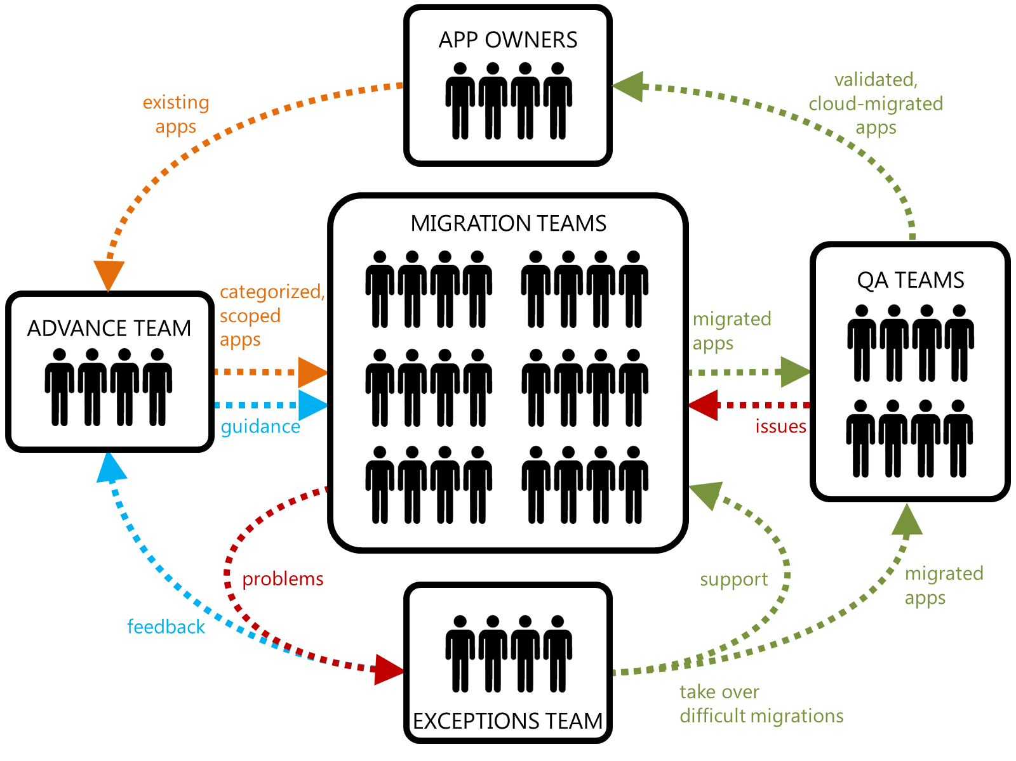
Building a Factory: Building Teams
Notes:
The Factory: Migration Teams Performing Repeatable Technical Work
The “factory” is one or more technical teams who are able to rapidly perform migration tasks. The high velocity is due to repeatable work of the same nature (“cookie cutter” jobs), steered by concrete guidance. This type of work favors a heavy offshore component to keep costs down. Migration tasks could be complete migrations (e.g. “migrate a PHP web site”) or assembly-line style partial tasks (e.g. “update this application to use a cloud-based caching service“).
Like a physical factory, one or more supervisors are needed to oversee how things are going and ensure the factory is humming along as it should be. Problems that stop the assembly line need to be dealt with swiftly.
The Advance Team: Equips the Factory for New Kinds of Work
The factory only knows how to manufacture what is has been configured to make. Someone needs to teach it new tricks to handle new kinds of applications or variations on past patterns. The Advance Team consists of architects and technology subject matter experts who analyze applications before they are handed off to the factory, categorizing them as previously-encountered types or something new. New kinds of applications are studied, and updated migration guidance for the factory is created. If the new tasks are significantly novel, factory members may need to be formally trained on the new pattern. The advance team also sizes the migration effort required.
The Advance Team receives feedback from the Exceptions Team on how migration work is going. This feedback loop drives continual improvements into the guidance based on experiences using it.
The Exceptions Team: Supports the Factory and Takes Over Difficult Migrations
The factory model is all well and good, but occasional surprises and difficulties are inevitable. The Exceptions Team supports the migration teams and helps them through problems with support. If necessary, the Exceptions Team will take over a difficult migration directly. Unusual, one-of-a-kind, or highly complex migrations will be handled by the Exceptions Team.
The QA Teams: Validation of Completed Migrations
The quality assurance teams test migrations produced by the factory to confirm quality requirements are met and the migrated apps have fidelity to the original apps. Often this will consist of a cursory check (performed by the integration partner) followed by user acceptance testing (performed by the owner organization). In the case of simple web site migrations, the first-level quality check might consist of side-by-side comparisons of the original and migrated web site, walking through the site by following its navigation and ensuring pages display and interact identically.

Slide 52
HOL Activity - Choose Application Migration Paths
For discussion
  Choose an application (sample app or your app)
  Choose potential treatment(s)
  Identify the dependencies, blockers and prerequisites
Identify components and for building the migration factory
Considerations
  How will you baseline performance?
  How will you prioritize treatment options?
  What tools do you need for a given treatment?

Slide 53
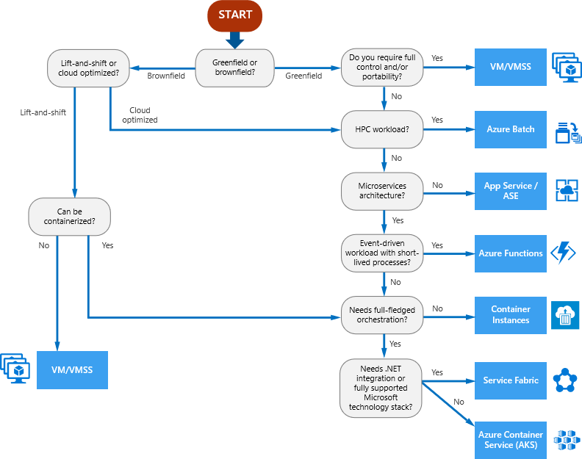
https://docs.microsoft.com/en-us/azure/architecture/guide/technology-choices/compute-decision-tree

