Slide 1
Application Migration​ & Modernization
DevOps

Slide 2
Why DevOps?

Slide 3
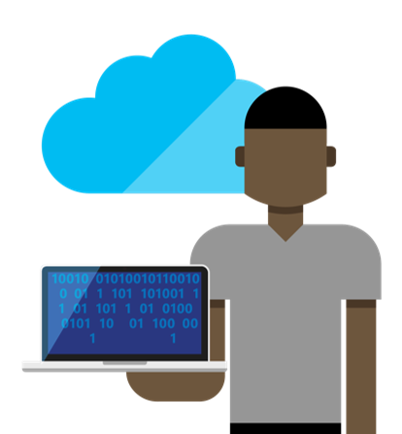





The consequences of inefficiency
40
%
… of implementations end up getting reworked because they don’t meet the users’ original requirements
IT drives business
success!
High IT performance correlates with strong business performance,
helps boost productivity,
market share and profit.
Outperforming
teams are
collaborate
54
%
extensively
more
likely to
41
%
… of development budgets for software, IT staff and external professional services will be consumed by poor requirements
with their
Collaboration blockers
counterparts
80
%
failure rate …
26.7%
No executive support
56.7%
Cultural inhibitors
43.3%
Fragmented processes
… for companies that try to adapt their existing tools for DevOps practices
Developers
IT Ops
%
Business
70
o
f
CIOs
Would
increase
risk
1 in
6
It takes on average 200 minutes to diagnose and repair a production issue
IT decision
makers is still
unfamiliar with
the term DevOps
to reduce
IT costs
and accelerate
business agility
3/4
of teams
DevOps was being initiated by
more development teams than IT Ops
teams by about a 40% to 33% margin
The average hourly cost of infrastructure failure is $100,000 per hour
100x more
Responding to
ongoing needs for
efficiency and growth
A bug caught in production ends up costing
than if the same bug was found earlier in the development cycle
have adopted
Agile methodologies
dual goals
Always keeping all
systems safe and secure
Notes:
In the real world, there are real consequences if you are unable to deliver high-quality software quickly or build the wrong thing to begin with:
40% of implementations end up getting reworked because they don’t meet the users’ original requirements
The average cost of one hour downtime of a customer-facing app is calculated at 100.000 dollars per hour – and this does not take into account the damage to reputation, which can be even greater.
Fixing such production issues takes on average 200 minutes per incident
Three quarters of development teams have adopted Agile methodologies today, enabling them to develop faster.
While this is a great number, it does not help if a development team is Agile but deployment still takes weeks or months because IT Ops is perceived as not being Agile
These are just 3 very high-level examples but all the data we have today points toward the same conclusion – this is about more than just frustration or minor delays. Lack of collaboration between dev and ops can have substantial impact on a company’s bottom line and success

Slide 4
DevOps Goals & Changes

Slide 5
Goals
Improve Engineering Agility
Encourage Data-Driven Decision Making
Scale-up Customer Obsession
Notes:
Same graphics as people

Slide 6
Product Changes to Support DevOps
Light weight and fast install
Isolated and non-impactful
Enable Experimentation
Built-in Feedback mechanism
Notes:
Talk about workloads , talk about incremental installs
Talk about Preview channel , dogfood channel etc.
Talk about – feature flags, experimental extensions (/alpha packs) ,
Talk about Report a problem - connection to developer community

Slide 7
Starting the Conversation

Slide 8
The Shift to DevOps
Old World
Focus on planning
Compete, not collaborate
Static hierarchies
Individual productivity
Efficiency of process
Assumptions, not data
New World
Focus on delivering
Collaborate to win
Fluid and flexible teams
Collective value creation
Effectiveness of outcomes
Experiment, learn and respond
Notes:
This slide provide some examples of what will shift in the world of DevOps, all related to more flexible and agile creation of business value.
EXAMPLES
Delivering: Backlog items are not activities, but deliverables
Collaborate: Different roles have to work together to achieve the mutual definition of success
Teams: Cross functional teams with flexible memberships depending on the required skill level
Value: All the backlog items must create value in one way or another
Outcomes: Minimal viable product in order to be effective on the outcomes
Experiment: Gather data, short cycles and prioritize often to experiment, learn and respond quickly

Slide 9






DevOps: the three stage conversation
1
Culture
2
Process
3
Products
Notes:
“DevOps is the union of people, process, and products to enable continuous delivery of value to our end users.”
From Donovan Brown
DevOps is not just automating a pipeline so we can quickly deliver software. Our goal is to deliver value. The term end users was also very carefully chosen. The value we produce must reach our end users. If the value only reaches the Dev and QA environments but is held up before reaching production where it can be realized by our end users, we are still failing.
It is very important to realize that DevOps is not a product. You cannot buy DevOps and install it. DevOps is not just automation or infrastructure as code. DevOps is people following a process enabled by products to deliver value to our end users.
Change to Culture
Process
Product

Slide 10
How DevOps breaks down
Culture
Lifecycle responsibility
Failures are Opportunities
The Issue Counts
Business Value
Collaboration
Process
Operational Requirements
Continuously Evolve
Short Cycle Times
Simplicity over Elegance
Small increments
Technology
Automate
Environment is Code
Resiliency & MTTR
Standardize deployment
Instrument
Notes:
DevOps is a philosophy with many aspects. From research, we have distilled it’s practices into the People, Process, and Technology layers.
People
Most important in anything we do and influencing every decision made on the other layers, focus on delivering business value.
Collaboration throughout the lifecycle. Everyone is equal, quality delivery is a group effort.
Responsibility ends when application is decommissioned.
Failure is an opportunity to grow.
In case of issues, the business impediment counts, not who caused it.
Process
Operational (non-functional) requirements are equally important to functionality.
Continuously evolve from previous delivery of a solution and production feedback.
Maintain short cycle times, providing continuous improvement opportunities to stakeholders and/or customers.
Favor simplicity over elegance; simple scripts and logic is easy to understand and troubleshoot, allowing for quick fixes.
Develop in small increments; this enables continuous improvement, keeps cycle times short and ensures changes have minor impact in both functionality and integration with other components within the solution.
Technology
Automate as much as possible to shorten cycle times and increase predictability in the build pipeline. Beware of remembering the way your build pipeline works.
Application = code + configuration + infrastructure. Manage configuration and infrastructure topology as source code where possible.
Model, Develop and Operate for resiliency, focusing on Mean Time To Repair.
Instrument to ensure production insights can be captured and actionable feedback is available for improving the solution.
Deploy in the same manner and the same solution to each environment. This ensures what is developed is tested, what is tested is brought into production.
Implementing DevOps might seem easy, but in practice, it really depends on the organization it is implemented in. Typically, large Enterprises tend to have vested interests in the divided parts of the organization carrying out development vs. IT operations. These interests and the sheer size of the undertaking of removing barriers within large organizations can make it a daunting task to execute on. Our advice: seek out the “innovators” within the organization and together champion practicing DevOps for a single work stream to gather proof points and influence the change needed.

Slide 11
List of DevOps Practices
Infrastructure as Code (IaC)
Continuous Integration
Automated Testing
Continuous Deployment
Release Management
App Performance Monitoring
Configuration Management
Availability Monitoring
Load Testing and Autoscale
Feature Flags
Automated Environment De-Provisioning
Self Service Environments
Automated Recovery (Rollback & Roll-Forward)
Hypothesis Driven Development
  Testing in Production
  Fault Injection
  Usage Monitoring/User Telemetry
http://www.itproguy.com/devops-practices/

Slide 12
Continuously Iterating
Development
Feedback
Delivery
Real world feedback - early, often and actionable
Faster release cadence with customer engagement on early bits.
Small iterative code changes – maintain quality, continuous dogfooding
Planning
Integrated plan on what we build, who we build for and why
Notes:
Improve the slide – readability….
Make it counterclock wise.

Slide 13
Tools Ecosystem

Slide 14
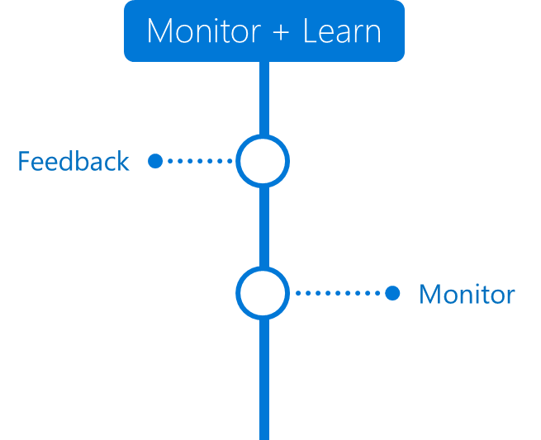
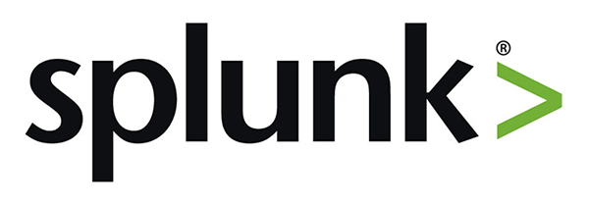
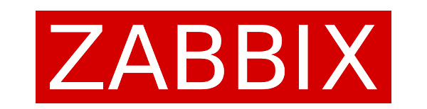
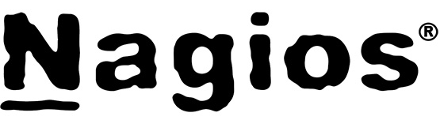


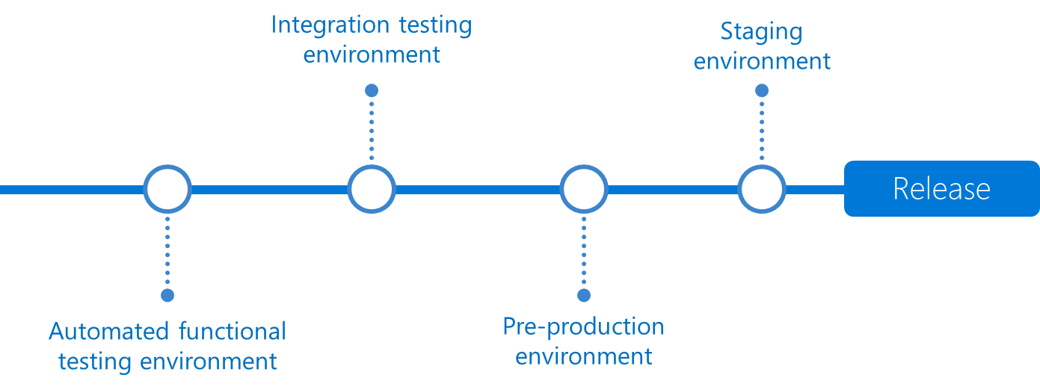
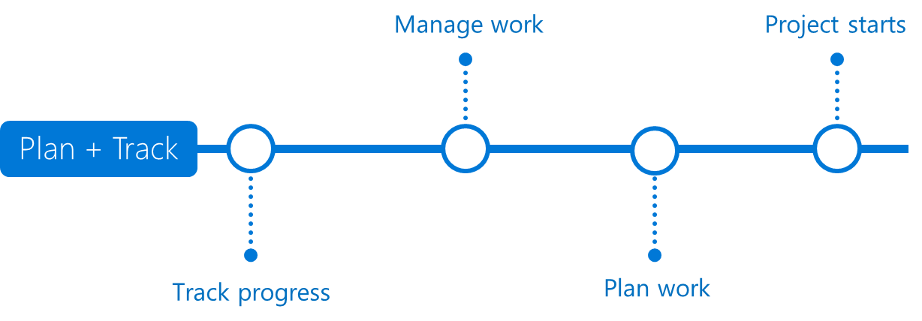
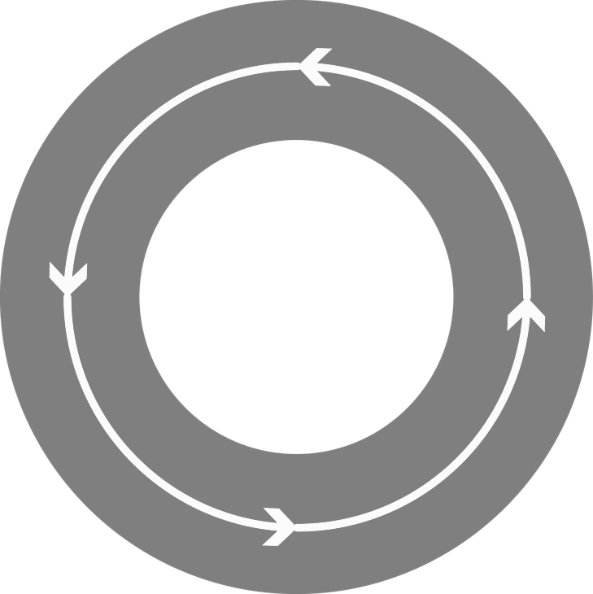
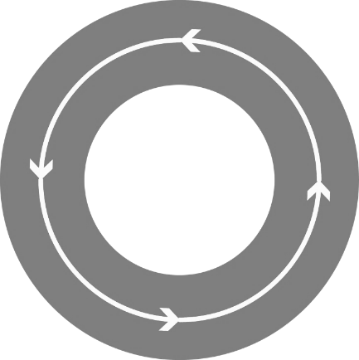

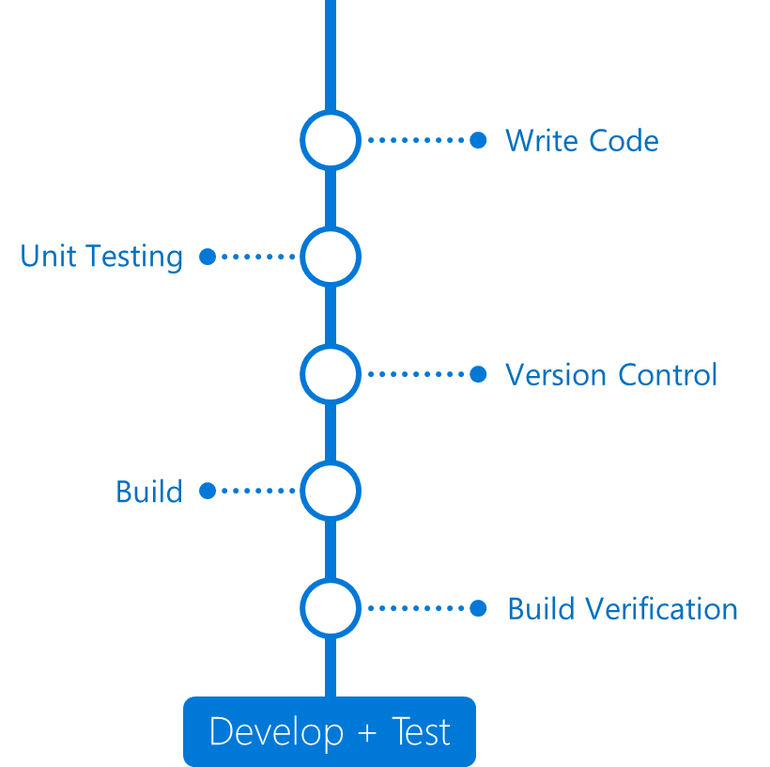
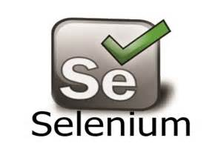
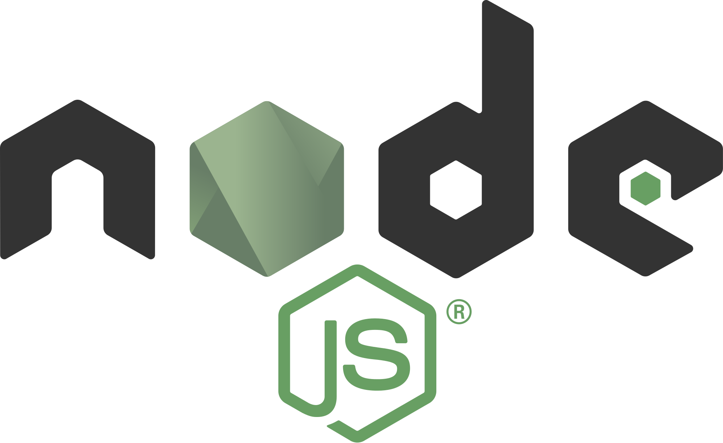
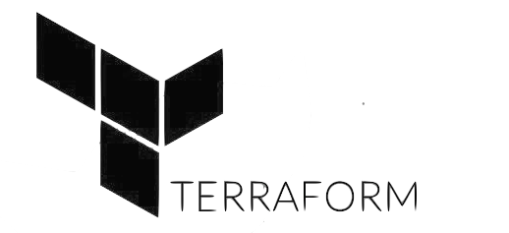
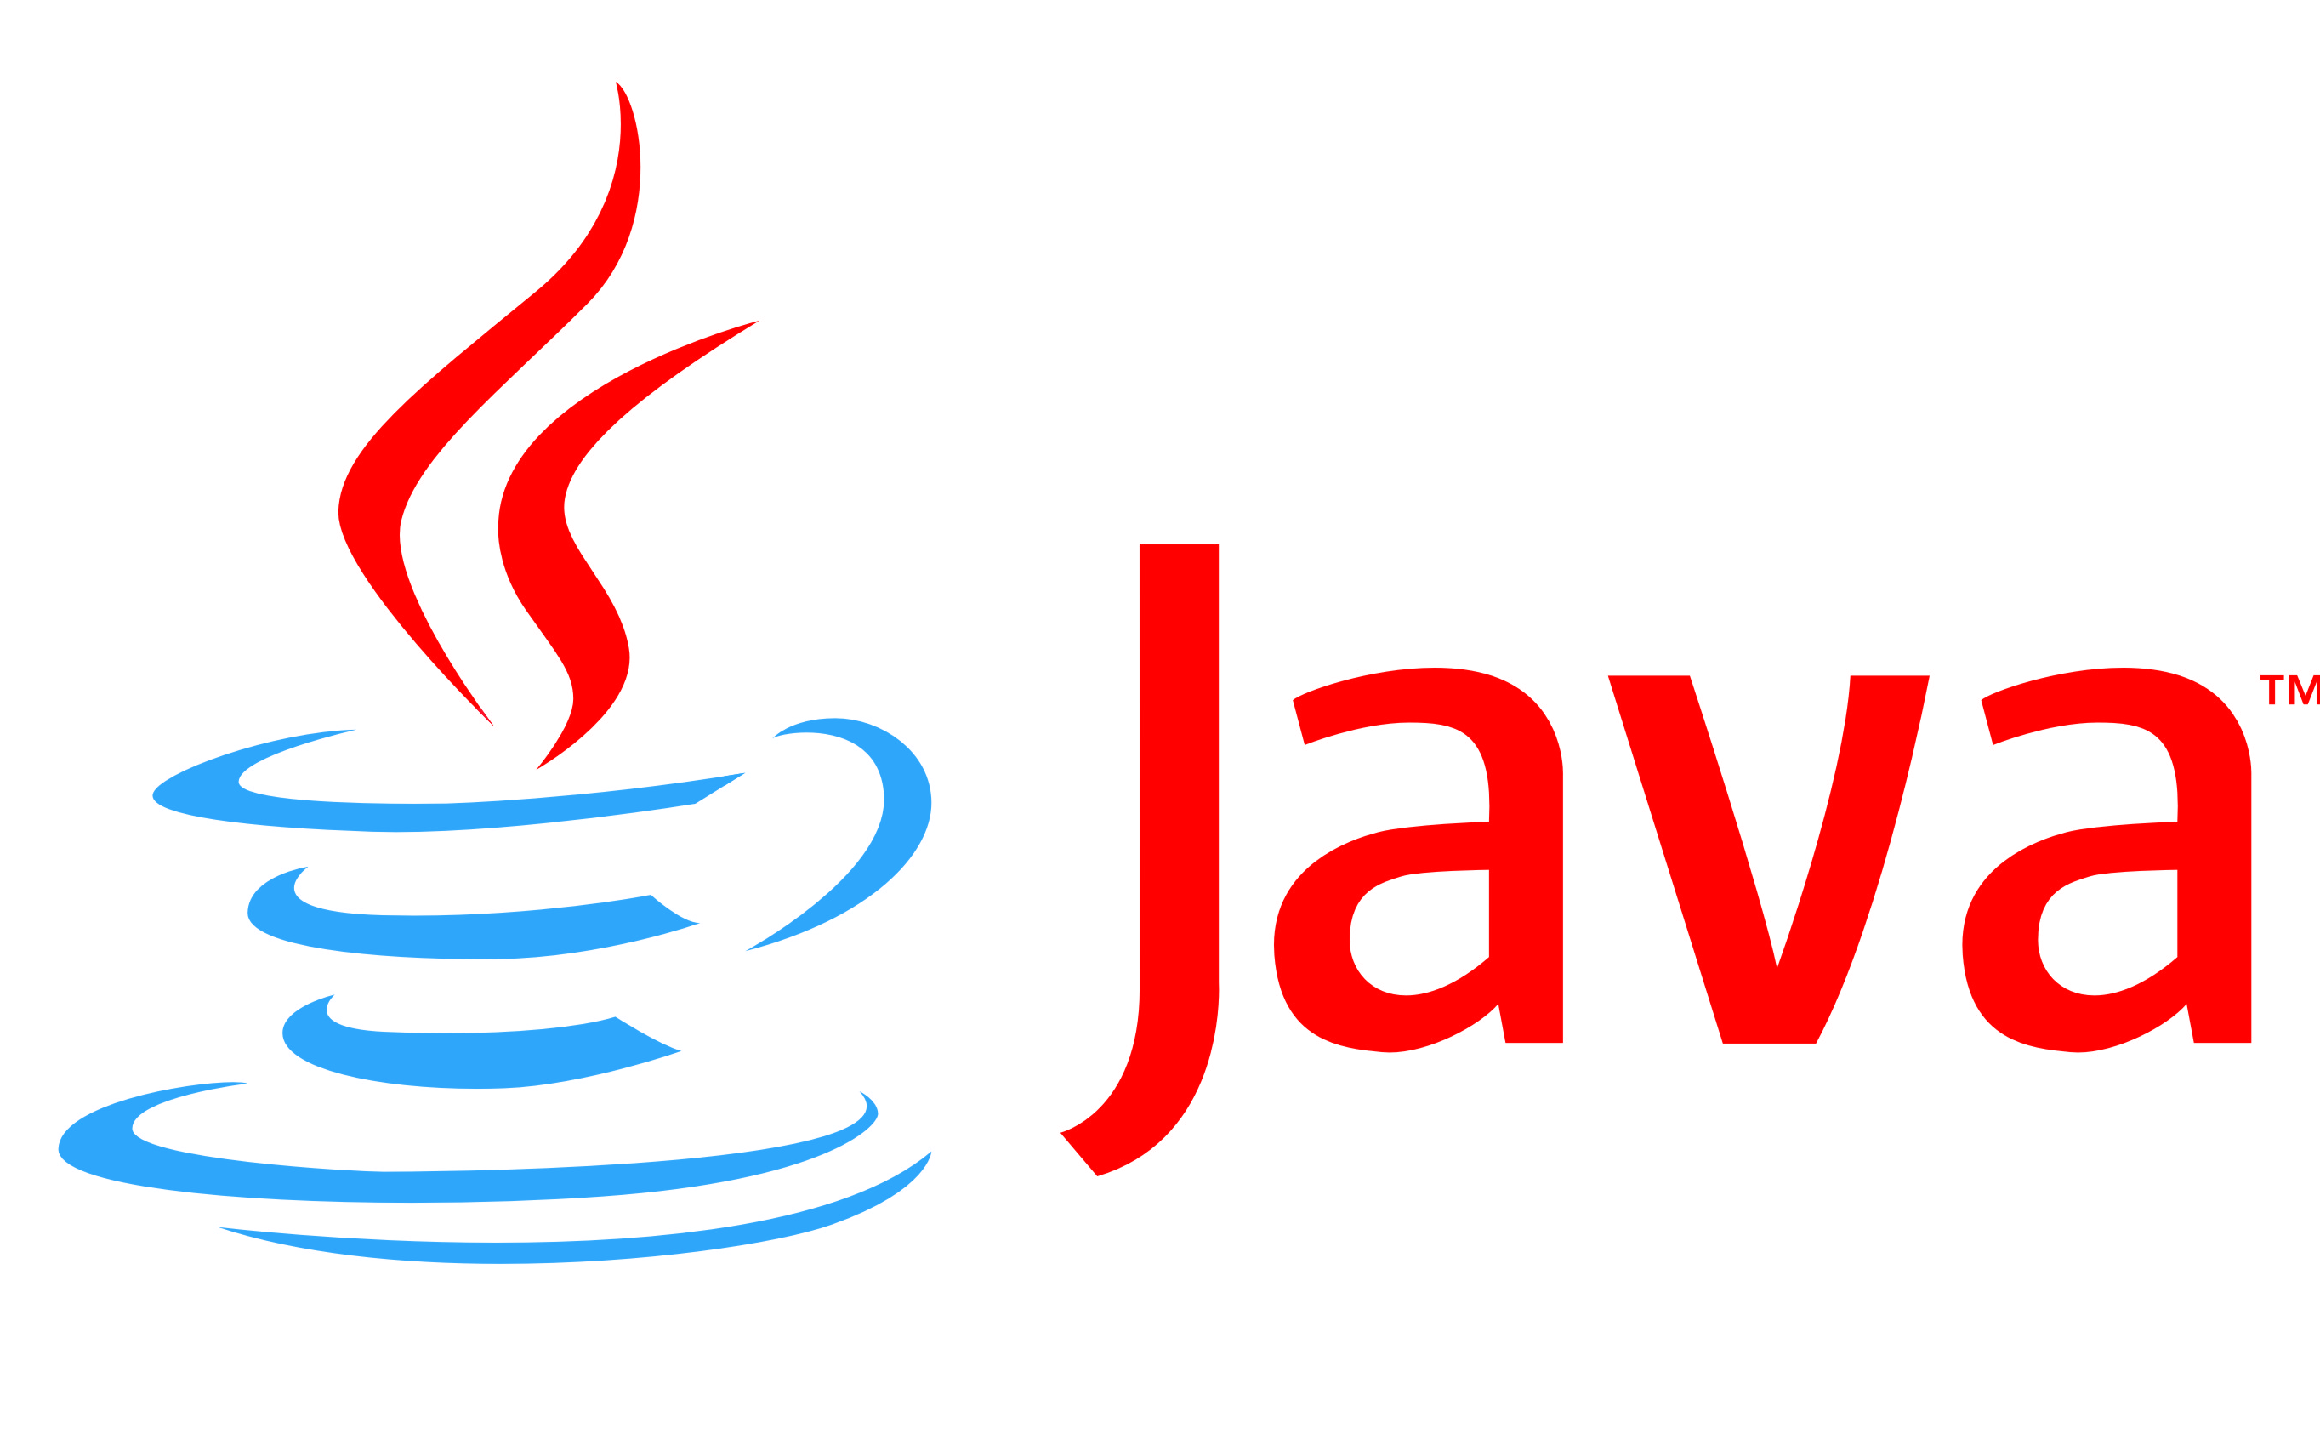







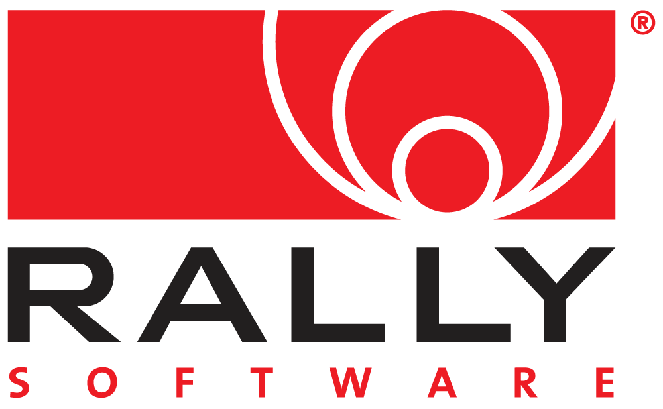
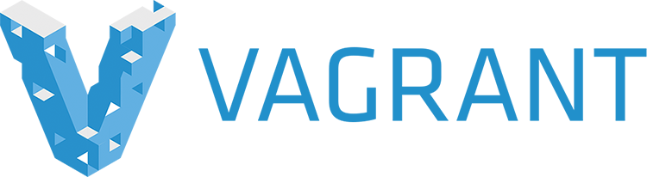

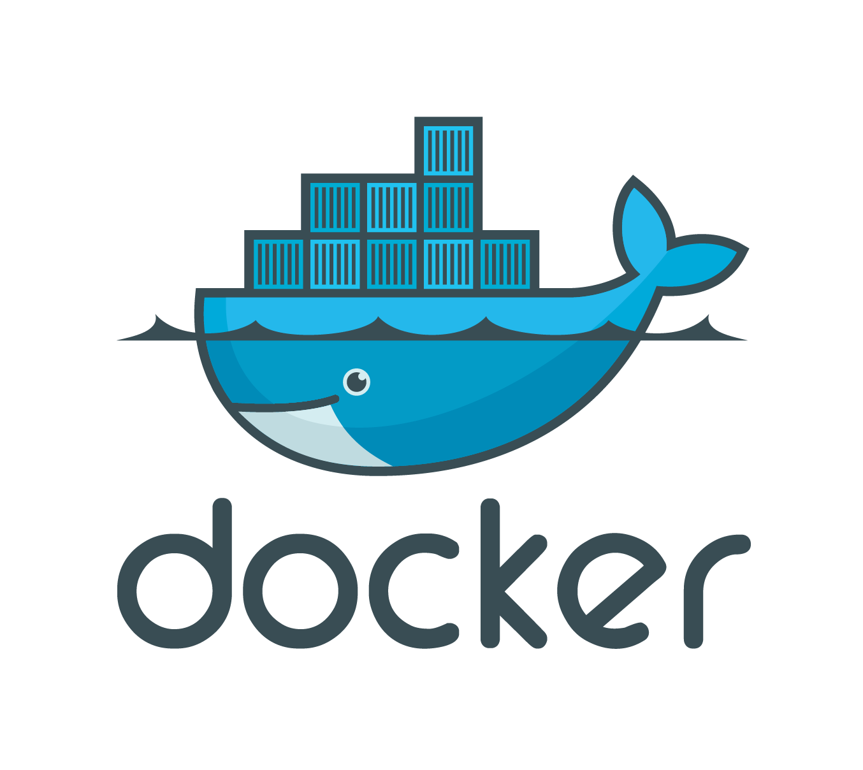
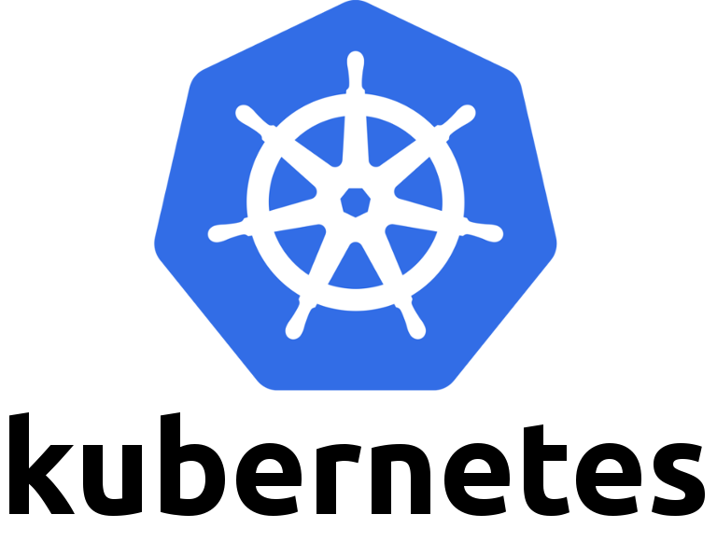
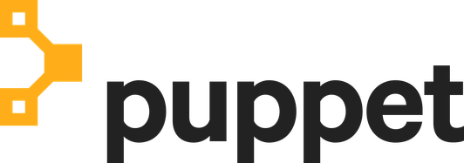
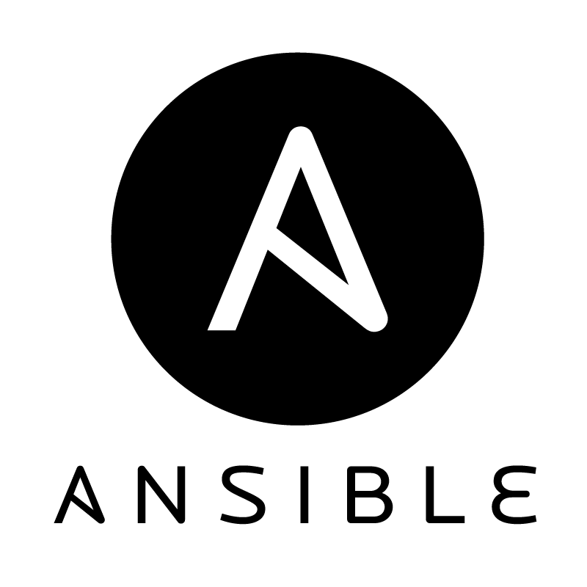
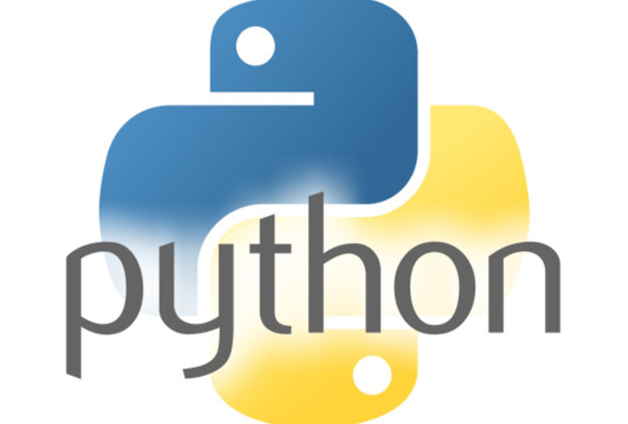


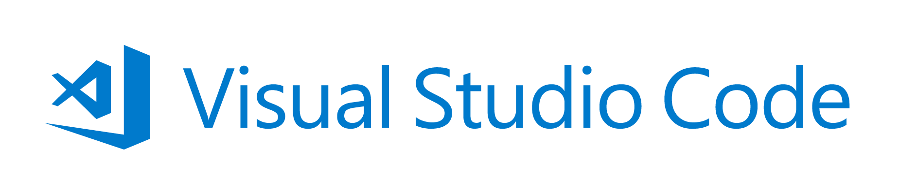




DevOps with VSTS
DevOps
Application Insights
DevOps is the union of people, process, and products to enable continuous delivery of value to our end users.
DevOps
DevOps
Visual Studio
Notes:
Continuously delivering value is about more than just automating deployments. You must start at the beginning of your development process - what you plan to deliver and how you plan to get there. In other words, planning and tracking.
[CLICK – Transition slide to show Planning phase]
Your project starts with an idea and a plan how to turn this idea into reality.
Agile approaches software development by emphasizing incremental delivery, team collaboration, continual planning, tracking and learning.
​
[CLICK – Transition slide to show development and test phase]
Although planning starts the process, the development team turns the ideas into features and capabilities during the development and testing phase.
Your development team will use the practice of continuous integration to merge code and automatically run a build process, including tests, whenever they commits a code change. ​
​
[CLICK – Transition slide to show release]
Continuous delivery will deploy your build to testing, pre-production, staging, and other environments in the release process.
It gives you quality gates throughout your release pipeline and increases confidence in your code long before production. ​
​
[CLICK – Transition slide to show monitor]
Lastly, you need to watch your solution in production. Effective monitoring delivers information about your solution’s performance, usage, and issues.
It’s essential to enable DevOps teams to deliver at speed, get feedback from production, and increase customers satisfaction, acquisition and retention.​
[CLICK – Transition slide to show other products and end with VSTS]
​Whether you are targeting the cloud, hybrid cloud, or an on-prem environment, Visual Studio Team Services, or VSTS, is the recommended Azure DevOps solution.
It allows you to plan, monitor, build and deploy to Windows, Unix, Android, or iOS, from .NET, Java, PHP, Python, Ruby, C++, and many other 3rd party and open source products such as Ant, Maven, Gradle, Junit, NUnit, xUnit, and Jasmine.
If you cannot find a task needed for your release pipeline, you can build custom tasks that integrate with VSTS and your continuous integration and continuous deployment.

Slide 15
DevOps with VSTS
DevOps
DevOps is the union of people, process, and products to enable continuous delivery of value to our end users.
Application Insights
DevOps
DevOps
Visual Studio
Notes:
Continuously delivering value is about more than just automating deployments. You must start at the beginning of your development process - what you plan to deliver and how you plan to get there. In other words, planning and tracking.
[CLICK – Transition slide to show Planning phase]
Your project starts with an idea and a plan how to turn this idea into reality.
Agile approaches software development by emphasizing incremental delivery, team collaboration, continual planning, tracking and learning.
​
[CLICK – Transition slide to show development and test phase]
Although planning starts the process, the development team turns the ideas into features and capabilities during the development and testing phase.
Your development team will use the practice of continuous integration to merge code and automatically run a build process, including tests, whenever they commits a code change. ​
​
[CLICK – Transition slide to show release]
Continuous delivery will deploy your build to testing, pre-production, staging, and other environments in the release process.
It gives you quality gates throughout your release pipeline and increases confidence in your code long before production. ​
​
[CLICK – Transition slide to show monitor]
Lastly, you need to watch your solution in production. Effective monitoring delivers information about your solution’s performance, usage, and issues.
It’s essential to enable DevOps teams to deliver at speed, get feedback from production, and increase customers satisfaction, acquisition and retention.​
[CLICK – Transition slide to show other products and end with VSTS]
​Whether you are targeting the cloud, hybrid cloud, or an on-prem environment, Visual Studio Team Services, or VSTS, is the recommended Azure DevOps solution.
It allows you to plan, monitor, build and deploy to Windows, Unix, Android, or iOS, from .NET, Java, PHP, Python, Ruby, C++, and many other 3rd party and open source products such as Ant, Maven, Gradle, Junit, NUnit, xUnit, and Jasmine.
If you cannot find a task needed for your release pipeline, you can build custom tasks that integrate with VSTS and your continuous integration and continuous deployment.

Slide 16











Microsoft Ecosystem
Test
Deploy
Environments
Monitor and Learn
Visual Studio Team Services
Team Foundation Server
Microsoft Test Manager
Microsoft Monitoring Agent
MICROSOFT AZURE
ONE
CONSISTENT PLATFORM
Release Management
for Visual Studio
ON-PREMISES
SERVICE PROVIDER
Visual Studio Team Services Application Insights
Operations Management Suite
Production / Stage
Automation Service
Developer Workstations
Develop
Build
PowerShell
DSC
Source
Visual Studio Team Services
Team Foundation Server
xPlat CLI
Visual Studio Team Services
Team Foundation Server
Release Management
for Visual Studio
Azure Resource Management
Dev/Test
Processes
Release Management
for Visual Studio
Team Foundation Server
Visual Studio Team Services

Slide 17

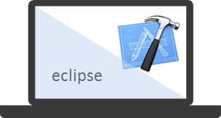


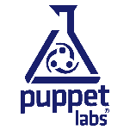


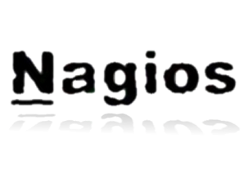

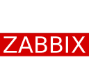






Mixed
Ecosystem
People | Process | Tools
01
02
03
Developer Workstation
Build/CI
04
Configuration
Develop
Monitor
Build & Test
Deploy
Team Collaboration
Release
Monitor & Learn
Test
This graphic shows OSS and partner products that are integrated with the Microsoft DevOps solution
Notes:
Develop
Git
TFVC
GitHub
Build and Test
VSTS
VSTest
Jenkins
Travis ?
<Maddog System>
Azure DevTest Lab
TeamCity
Deploy and Hosting solutions
RM
Cedexis
Monitor & Learn
App Insights
Catchpoint
Internal tools – Geneva ??

Slide 18
Application Lifecycle Evolution

Slide 19
ALM Process – DevOps approach
Focus on Business Value.
Business hypothesis
Define
Build
QA
Release
Measure & Evaluate
Continuous Integration.
1 to 3
months
Automated Release Pipeline.
Integrated Operations Management.
Notes:
This slide presents the core characteristics of a modern ALM process combining benefits of the Continuous Delivery process and DevOps mindset.
The following elements could be adapted to reflect the customer future state :
Name and duration of each phases and cycle
Focus on Business Value
The DevOps organizational mindset aims at focusing all cross-team collaborative ALM activities on providing value to the customer by either:
Shortening Time To Market
Increasing Market Shares or Revenue
Insuring regulatory compliance
Continuous Integration
It constitutes the foundational capability of the modern ALM Define & Build phases, by which new small-size defined feature derived from prioritized business hypothesis, as coded by developer and integrated into a central code trunk are automatically built as binaries and unit-tested in short cycle, maintaining the source code basis in an integrated state with a known level of source code technical quality.
Automated Release Pipeline
Subsequent steps of the modern ALM QA & Release activities will promote those newly built features as Minimum Valuable Products (MVPs) that can be quickly and progressively shipped to production through a coordinated cross-team release process with a good level of confidence on its functional and non-functional correctness, with minimized manual intervention and service interruption.
Integrated Operations Management
Those MVPs are then monitored and evaluated in the ultimate proof environment of production: giving rise to new actionable operation backlog in the event of malfunction as well as experimented knowledge of its true value.

Slide 20
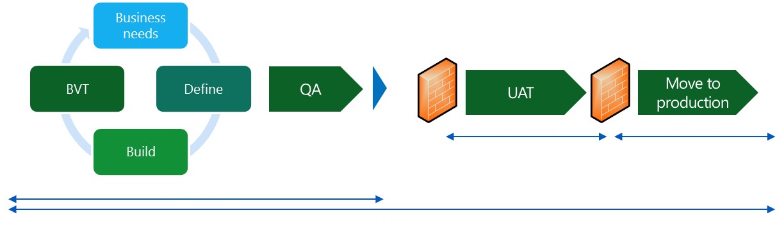
Transformation roadmap: the building blocks
TODAY
FUTURE
Performance & Exception Management
Business needs
Define
Build
QA
Release
Measure & Evaluate
1 to 3
months
Build Automation
Manual Testing
Manual Deployment
Build Automation
Automated Application Deployment
Manual Provisioning
Siloed Operation
Automated Acceptance Testing
Automated Provisioning
Notes:
This slide can be adjusted to align to the Customer’s current state and future state needs regarding ALM process.
The objective is to emphasis the key practices of the current Customer’s ALM process and the new one that have to be introduce to target a DevOps oriented ALM process.

Slide 21
ALM Process – Current State
Business needs
Define
Build
QA
UAT
Move to production
75% of
Projects
Waterfall
6 to 18 months
1 to 3 months
1 to 3 months
9 to 24 months
Business needs
Define
Build
BVT
QA
UAT
Move to production
20% of
Projects
CI
1 to 3 months
1 to 3 months
0,5 to 3 months
6 to 9 months
Target : 6 to 9 months for 50% of the applications
Notes:
This slide presents traditional software delivery processes (Waterfall and Continuous Integration) in a generic way.
The following elements could be adapted to reflect the customer current state :
Percentage of projects of each kind (current and/or target)
Name and duration of each phases
Waterfall lifecycle common pitfalls:
Define the complete feature set specs up front without business, QA and operation team involvement
Mismatch between features and evolving business needs
Non actionable requirements
Lack of focus on operational requirements
Build from specs on isolated source code branches
Code duplication
Merge and integration overhead
QA on out-of-sync builds and environments (non dedicated)
Manual QA environments provisioning and/or deployment overhead
Requirements to automated acceptance test translation overhead
Delayed bug fixing
Quality bar lowering to keep on schedule
UAT on out-of-sync “production” owned environment (non dedicated)
Manual UAT environment provisioning and/or deployment overhead
Handoff overhead between isolated teams
Significant rework due to divergent acceptance criteria and late error founding
Move to production
Waiting for the next available “release to production” slot
Significant rework due to late error founding on divergent pre-production environment
Lack of actionable application monitoring capacity for troubleshooting and optimizing purposes
Significant rework due to late operation team and user feedback
Continuous Integration practice addresses some but not all of those pitfalls:
Define, Build and (partially) QA cycle time is shortened
Code checking triggers automated and centralized binaries build and build verification tests
Binaries build break fixing is a development priority
Nevertheless other pitfalls remains impeding delivery cycle time
Manual QA/UAT/Pre-Production/Production environments provisioning and/or deployment
Divergent acceptance criteria among teams
Lack of early and actionable feedbacks from operation and users

Slide 22
ALM Process – Future State
Business needs
Define
Build
QA
UAT
0,5 to 3 months
4% of
Projects
CD
Move to production
0,5 to 3 months
1 to 3 months
Business hypothesis
Define
Build
QA
Release
Measure & Evaluate
3 to 6 months
1% of
Projects
DevOps
1 to 3
months
Target : 1 to 3 months for 50% of the applications
Notes:
This slide presents more advanced software delivery practices (Continuous Delivery and DevOps) in a generic way.
The following elements could be adapted to reflect the customer future state :
Percentage of projects of each kind (current and/or target)
Name and duration of each phases and cycles
Leveraging on Continuous Integration established practices Continuous Delivery addresses additional pitfalls:
Define, Build and QA activities are now integrated
QA and UAT environments can be automatically provisioned and deployed from a common binaries build set
Common acceptance criteria are translated in automated acceptance tests
Acceptance test break fixing is a development priority
UAT and Move to production phases can be parallelized still reducing delivery cycle time
Nevertheless other pitfalls remains impeding delivery and “repair” cycle time
Moving to production is still a specific and “all or nothing” process
Lack of early and actionable feedbacks from operation and users in production environment
DevOps approach aims at addressing those remaining pitfalls:
Define, Build, QA, Release and Measure & Evaluate activities are now integrated
Operational requirements are taken into account early in the development process
Deploying to production is a selective and non disruptive process
Both in term of feature activation and user/server targeting
Integrated application monitoring allows efficient production issue troubleshooting and fixing
User feedback and resiliency focus testing can be conducted in production
Where business hypothesis can be definitively validated

Slide 23
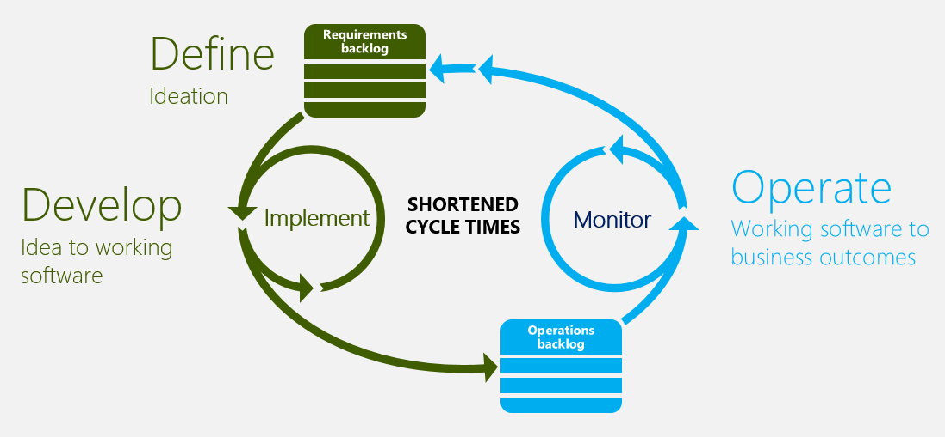

Continuous quality for continuous value delivery
Acceptance test planning
MTTR reduction
Team
Continuous quality
Shortened cycle times
Continuous acceptance testing
Testing in production
Team integration | Early detection of unmet requirements | Shortened cycle times | Reduced costs
Notes:
There are four key areas that we need to look at to enable our ability to continually deliver high quality working software; Acceptance test planning, Continuous acceptance testing, Testing in production & Reducing Mean-time to resolution.

Slide 24
DevOps Success

Slide 25
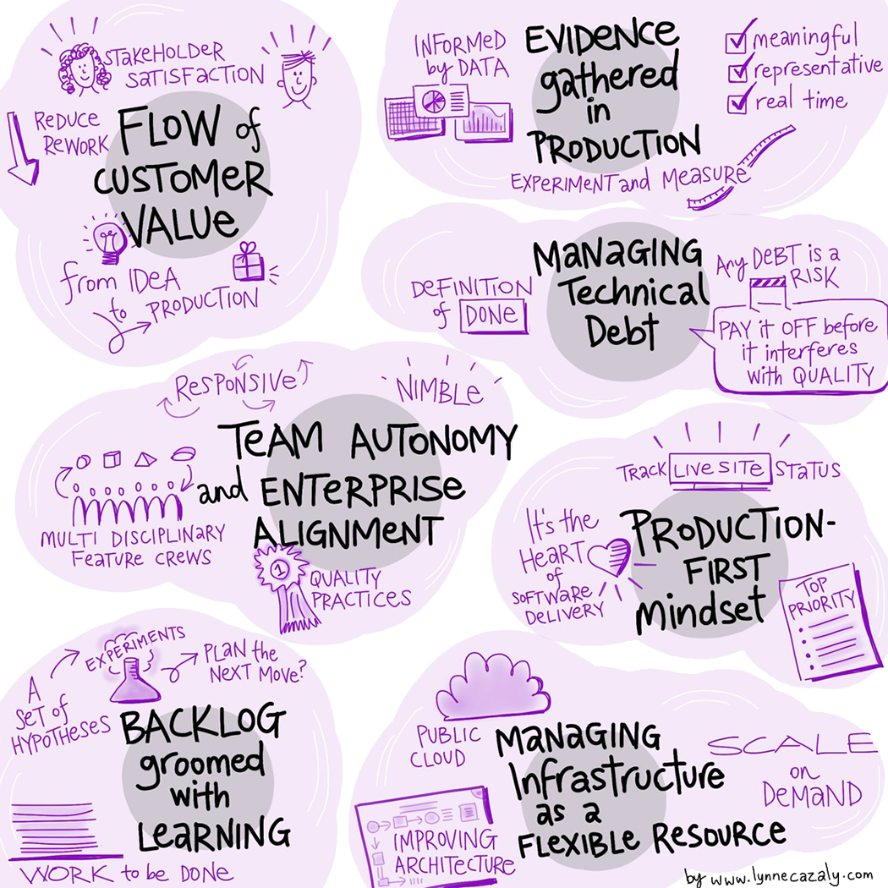
7 PRINCIPLES FOR DEVOPS SUCCESS
Based on Microsoft’s experiences with our own transformation to a DevOps culture, we have identified DevOps principles and related DevOps practices that will lead to a true shift to DevOps in organizations of any size.
Notes:
This slide will form the introduction of the 7 principles of DevOps success. They are based on Microsoft’s experience to develop a successful DevOps culture internally.

Slide 26
DevOps Strategic Assessment
  Backlog
  How an organization defines and manages requirements and how effective they are.
  Flow
  The flow of value as code moves through the system from developer environment to production, and the rate at which business value is delivered in the form of software.
  Technical Debt
  Behaviors and characteristics that define how an organization thinks about the decisions they make that incur technical debt and how they discover and manage technical debt that is accrued throughout the application lifecycle.
  Agile Schedule and Teams
  Behaviors and characteristics that reflect team organization and work schedule.
Flow of
Value
Hypothesis-
driven Backlog
  Evidence
  Characteristics and behaviors that demonstrate how an organization uses data in decision making, including code analysis, test results and real-world usage metrics.
  Production
  Refers to how an organization manages software in its production environment, including how it detects and responds to unexpected events.
  Cloud Infrastructure
  Refers to the behaviors and characteristics of how the organization approaches and manages the core infrastructure that their systems and apps run on.
Evidence
and Data
Technical Debt
Production-first
Mindset
DevOps
Agile Schedule
and Teams
Public and
Hybrid Cloud
Source: http://devopsassessment.azurewebsites.net/
Notes:
DevOps is an umbrella term for a number of process categories that define an organization’s ability to deliver value.
The seven practices on this slide can be addressed either individually or together, in any combination.
Establishing and evolving any of the practices in your development lifecycle will positively impact your organization.
Backlog - How do you currently manage requirements and change requests?
How are software requirements associated to business needs/value?
Schedule and team - How are your teams organized? Does every discipline report to the same executive? What is the typical team size and makeup (i.e. what disciplines are in a team)? How do these teams schedule their work? How long is a development iteration? How do development teams and IT Operations teams collaborate?
Technical debt - How do your teams think about and manage technical debt? What is the split in time spent on servicing existing code vs. new development activities and innovation? How do your teams ensure a common definition of done? How much of your resources are invested in engineering systems?
Flow - How does software flow through your delivery pipeline from build to production? How long does it take to provision a new dev/test environment? How frequently do you release per application? What is your release process?
Evidence - How are decisions made in software development? What data do you collect and use in decision making? How frequently do you use tools to validate software (code analysis, unit tests, functional tests, etc.)? How closely do your test environments mimic production? How do you use measure and react to how users interact with your software?
Production - How do you detect and respond to production incidents? What is your Mean-Time-To-Detection (MTTD)? What is your Mean-Time-To-Recovery (MTTR)?
Infrastructure - Describe the core infrastructure your applications run on? Are your dev/test environments hosted on-premises or in a public cloud? Are your production environments hosted on-premises or in a public cloud? Is your core infrastructure provided as a service either internally or by a third-party?

Slide 27

Production-First Mindset
Statement: We in most cases track the live site status, remediate any live site issues at root cause, and proactively identify any outliers in performance to see why they are experiencing slowdowns.
DEVOPS PRINCIPLES
Rationale: Production is the heart of any software delivery organization, and the recommended ones recognize that the real production should be top priority for every team member in every role, not just IT operations. Intermediate artifacts like documents and disconnected pre-prod environments are not enough.
Notes:
Implications:
Application Performance Management: We monitor and manage the performance and availability to maintain an expected level of service. We use multi-tier views of end-to-end transactions including processing and network combined.
Infrastructure as Code: We treat system configuration like source code to ensure that changes are tested, repeatable and transparent.
Continuous Delivery: We build software in such a way that it can be released to production at any time.
Release Management: We use a process of planning, scheduling and controlling a build through different stages and environments. Our release pipeline is fully automated to catch any side effect of a change.
Configuration Management: We record and track information that describes an application’s hardware and software.
Automated Recovery: We use a process that detects a deployment failure and attempts automated recovery to a working state.
Quick Production Fixes: To make a one-line change and deploy the new software to fix a critical production issue takes less than an hour.
Data Collection: We collect feature-level usage data from applications running in production.
Production Issue Reporting: Issues in production are reported to the development team via automated alerts and issue tracking tools, available to all teams.
Additional Best Practices: We see minimal time to repair (MTTR) and high degrees of automated response, are able to extend monitoring to real user metrics (RUM), and utilize flighting or testing in production.

Slide 28
Backlog (Backlog Groomed with Learning)
Statement: We treat the backlog as a set of hypotheses, which we need to turn into experiments, and for which they need to collect data that supports or diminishes the hypotheses. Based on that evidence they can determine the next move in the backlog and persevere (do more) or pivot (do something different)
DEVOPS PRINCIPLES
Rationale: Backlog is the stack of work to be done. Different organizations plan, define and manage requirements and projects differently. This can include how you engage with stakeholders and how you request, capture, and track work. It can also include how well you align, agree, and make decisions.
Notes:
Implications:
Usage Monitoring: We use automated recording and analysis of application usage in production.
Telemetry Collection: We use automated remote measurement and data collection of software applications in production.
Testing in Production: We use end-to-end test scenarios that run constantly in a predefined interval against software end points.
Stakeholder Feedback: We use pro-active, ongoing solicitation of input from application users during development, via customer outreach (UserVoice, web meetings, listserv, meetings or chat room), via direct email/phone/web contact from and via monitoring social media
Feature Flags: We use feature flags for turning individual feature on and off that allow many small incremental version of software to be delivered without the cost of constant branching and merging.
Backlogs: Work to be done is captured via backlogs that combine feature and live site work, and hypothesis are continually refined based on production evidence.
APIs: We use API access to promote single sign-on, data sharing, service hooks and easy access. Our APIs are monitored.

Slide 29
Evidence (Evidence Gathered in Production)
Statement: We instrument everything, not just for health, availability, performance, and other qualities of service, but to understand usage and to collect evidence relative to the backlog hypotheses.
DEVOPS PRINCIPLES
Rationale: Good decisions are informed by data. For example, they will experiment with changes to user experience and measure the impact on conversion rates in the funnel. They will contrast usage data among cohorts, such as weekday and weekend users, to hypothesize ways of improving the experience for each.
Notes:
Implications:
Description of Defects: Defects are described to the development team in multiple ways, including relevant logfile/dialogistic data automatically included in incident reports, unmet acceptance criteria, video of user interaction or action log of user gestures.
Code Quality Measurement: We measure code quality via pre-production code profiling, static code analysis or unit testing / code coverage.
Instrument Code: We instrument code for analysis directly in production.
Customer Self-Service: We encourage customer self-service when appropriate and consistent with policy around corporate data.
Production Release Data Output: The output of every production release is more data to inform the next cycle of development and delivery.

Slide 30
Flow (Flow of Customer Value)
Statement: Developed and COTS software move swiftly from initial idea through creation and validation into a production release, without impediments or rework loops.
DEVOPS PRINCIPLES
Rationale: Flow refers to an organization’s ability to move software swiftly. Reduced rework allows teams to focus on delivering more net-new value. Shorter cycle times support increased responsiveness, in turn fostering stakeholder satisfaction and trust.
Notes:
Implications:
Automated Testing: We use tools to execute pre-scripted tests on a software application before it is released into production.
Continuous Integration: Each check-in is verified by an automated build, allowing teams to detect problems early.
Continuous Deployment: Every change that passes all automated tests is deployed to production automatically.
Release Management: We plan, schedule and control a build through the different stages and environments.
Quality of Service: We ensure quality-of-service and/or non-functional requirements are met by automating all the testing for performance, security, localization, and other qualities of service.
Production Testing: We test in production against running services for views of our qualities of service and impacts upon end users.
Usage and Performance Data: Usage data is combined with performance data and treated as the results of experiments that are run in every release or A/B test
Storyboard Reviews: We validate user experience designs via storyboard reviews with product owner, internal stakeholders and uses and via A/B testing in production.

Slide 31
Schedule & Team (Team Autonomy and Enterprise Alignment)
Statement: We have multidisciplinary feature crews who pull from a common product-backlog, minimize work in process, and deliver work ready to deploy live at the end of each sprint.
DEVOPS PRINCIPLES
Rationale: The goal for modern application delivery is responsiveness, which relies on flexible scheduling, limiting long-term commitments in favor of iterative experiments, and close team collaboration to facilitate real-time communication and eliminate wasteful handoffs.
Notes:
Implications:
Release and Deployment: We will allow anyone to initiate a release; deployment will be exposed to increasing amounts of production traffic and if there is a problem, it will be remediated.
Team Dependency Management: To manage dependencies across teams, we maintain an artefact repository (Nuget, Nexus, Artifactory, etc.) with the latest binaries and all teams pull from there.
Scheduling Work: We plan and schedule work in sprints, using a release train.
Continuous Planning: We also promote continuous planning of single-piece items.

Slide 32
Technical Debt (Managing Technical Debt)
Statement: We pay continual attention to cleanliness through wide-ranging technical fundamentals, verifiability, traceability, security and awareness of the needs of production (quality of service and non-functional requirements) starting from day zero
DEVOPS PRINCIPLES
Rationale: The right behaviors need to be considered for strategically managing the impact of short-term and long-term technical decisions.
Notes:
Implications:
Code Reviews: We perform systematic examination and peer review of source code.
Automated Testing: We use tools to execute pre-scripted tests on a software application before it is released into production.
Continuous Measurement: We perform 360 degree, 24x7 data collection and analysis across application availability, performance and usage.
How We Build: We build continuously for every component/the entire application.
Parallel Development: We handle parallel development by architecting narrow, decoupled micro services with clear contracts.
Feature Flags: We use feature flags to control exposure.
Source Code: Our source code is managed and versioned by open source code sharing systems.

Slide 33
Cloud (Managing Infrastructure as a Flexible Resource)
Statement: We use flexible infrastructure of public cloud and continually improve architecture to refactor into more independent, discrete services.
DEVOPS PRINCIPLES
Rationale: Using the cloud provides scale on demand and makes it easy to stand up services for continuous feedback from constant usage.
Notes:
Implications:
Infrastructure as Code: We treat system configuration like source code to ensure that changes are tested, repeatable and transparent.
Devices Management: We allow every project or business unit to make decisions about application hosting within a framework than includes an actionable set of standards and guidelines to ensure appropriate use.
Client Device Grouping: We define environments for dev/test, release pipeline and production via Infrastructure as Code for IaaS, else PaaS which handles production images.
Inventory: We have a public cloud policy that ensures we have the supplier who can provide the best security, end-user experience and quality of service.

