Slide 1
Application Migration​ & Modernization
Authentication

Slide 2
Traditional Authentication

Slide 3
Traditional Authentication Patterns
Anonymous access
Forms
Basic
Digest
NTLMv2
  Never use NTLM unless there is no alternative
Kerberos via Kerberos Constrained Delegation (KCD)
**Claims Based Authentication is available on premises but is considered to be a Cloud Authentication Pattern

Slide 4
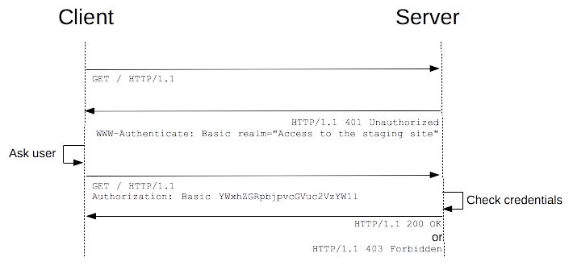
Basic Authentication
Pros
Implementation is pretty simple, as there is no encryption involved
Take relatively less time to respond as it has only one call
The lack of token creation and encryption method gives Client an advantage of using less code to call the API
The information is retrieved from the server with just one call, making it faster than other complex authentications
Cons
SSL takes time to run basic HTTP, so this will make the response time considerably slow
The lack of encryption makes the security risk fairly high

Slide 5
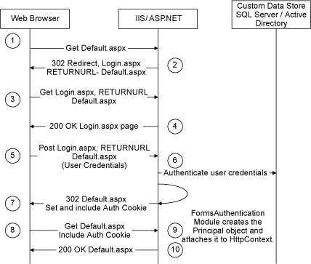
Forms Authentication
Pros
Full Control over Auth Code
Full Control over Login Form
Works in Any Browser
Cons
Have to create your own login Interface
Maintain a catalog of users credentials
You need to protect against credentials interception

Slide 6
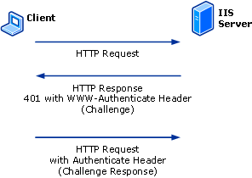
Digest Authentication
Pros
Secure without SSL when compared with Basic Auth without SSL due to the process of encryption.
As usernames and passwords are encrypted, the chance of cracking it is considerably less.
Cons
Client must make two calls to get the output response, so it is a bit slower than HTTP Basic Authentication
Password stored in the user DB is not strongly encrypted so there are chances that the data may be hacked

Slide 7
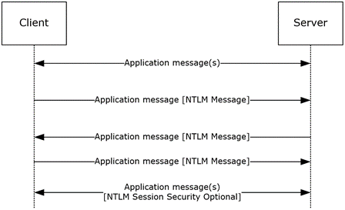
NTLM Authentication
Pros
Easy to configure
Typically requires no additional configuration
Works for non domain joined clients
Cons
Requires contact to a domain controller
Does not allow delegation of client credentials to back-end systems
It is a proprietary protocol.
It does not support server authentication.
It is considered less secure than Kerberos authentication

Slide 8
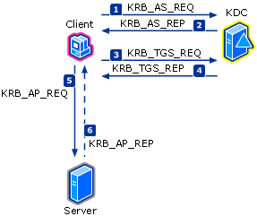
Kerberos
Pros
Most secure Integrated Windows authentication
Allows delegation of client credentials
Mutual authentication of clients and servers
Less traffic to domain controllers
Open standards protocol
Cons
Requires additional configuration
Requires clients have connectivity to the KDC

Slide 9
Cloud Authentication / Authorization

Slide 10
Authentication Protocols between Services
Browser
OpenID Connect
OAuth 2.0
Web Apps
Web APIs
Native app
OAuth 2.0
OAuth 2.0
Server app
Web APIs
OAuth2.0
Web APIs
OAuth 2.0

Slide 11
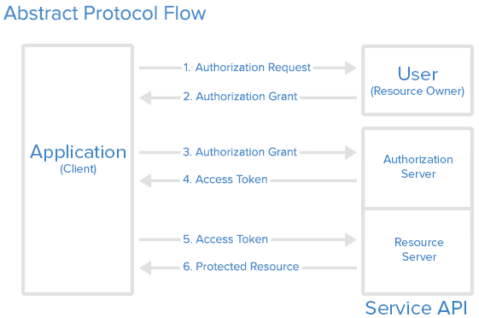
OAuth 2.0
Simple mechanism to grant a third party access to a user’s resources without sharing the user’s password
Cross platform app authorization
Internet Standard supported by Azure, Facebook, Google, Twitter, and more
Notes:
OAuth provides a simple mechanism for end-users to grant a third party access to their data and resources without sharing their passwords.
It also enables the user to grant access limited by scope and duration.

Slide 12
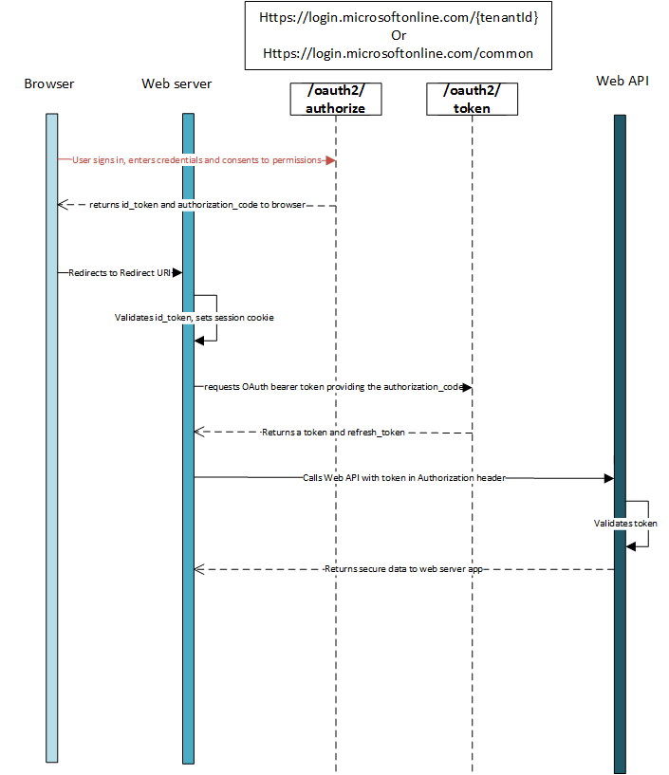
OpenID Connect
Simple identity layer built on top of OAuth2.0
Clients verify identity of end-user based on the authentication performed by an authorization server
End-user info passed via the id_token

Slide 13
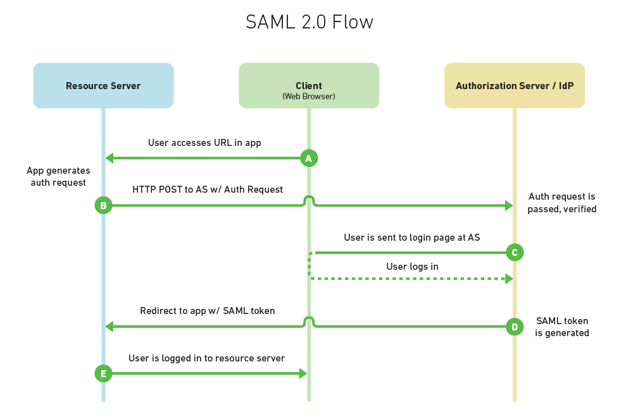
SAML 2.0
Enables Apps to provide SSO experiences
Requires identity provider (idP) and service provider to exchange info
Common in federated Identity scenarios

Slide 14
Migration Paths

Slide 15
Migration Paths for Authentication
Azure
Subscribe to SaaS applications
Switch to using SaaS versions of the app e.g. Office 365
Leverage Azure AD for SaaS app management
    SaaS application gallery
    Easy provisioning, conditional access control
Rewrite existing applications
Rewrite apps to leverage Azure PaaS
Leverage Azure AD
    OAuth/OpenID Connect for modern authz.
    Ubiquitous developer libraries
    Graph API – modern directory API
‘Lift-and-shift’ on-premises applications to IaaS
Move existing legacy ISV or LOB applications to Azure IaaS
May not have access to source code or vendor support
Requires Azure Active Directory Domain Services or deploy a Domain Controller in Azure VNET
Use Proxies

Slide 16
Separating the Authentication Landscape-Users
Basic
Forms
NTLM
Kerberos
SAML
NTLM
Kerberos (Delegation, impersonation)
NTLM
Kerberos/Passthrough
Service Account
Certificates
Server
Database
App
Service Account
Certificates
Keys
Database
Service
OAuth
Certificates
Keys
User
Server
OAuth
Certificates

Slide 17
Separating the Authentication Landscape-Servers & Apps
NTLM
Kerberos/Delegation
Service Account
Certificates
Basic
NTLM
Kerberos
SAML
OAuth
Certificates
NTLM
Kerberos (Delegation)
Service Account
Certificates
Server
Database
App
Service Account
Certificate
Keys
Database
Service
OAuth
Certificates
Keys
App
Server
OAuth
Certificates

Slide 18
Authentication Migration to Modern Patterns
App Services
OAuth with AAD
Proxies
AADDS
Management Domains
Keys
AAD Service Principals
User
Server
Database
App Services
OAuth with AAD
Proxies
Key
Service Principals
App
AADDS
Management Domains
Keys
AAD Service Principals
Database
Service
App
Server

