Slide 1
Application Migration​ & Modernization
Windows Containers

Slide 2
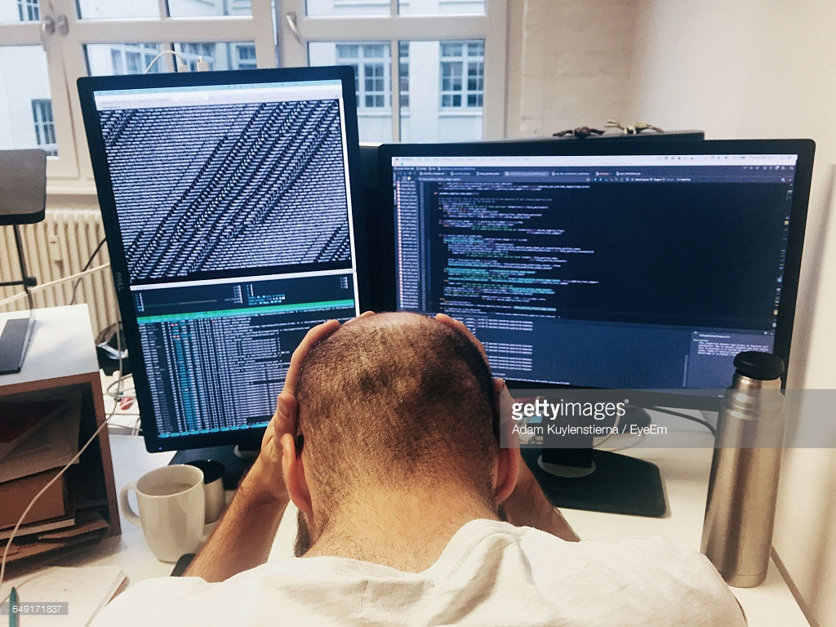
Where do developers spend time…
Maintaining existing applications
“Fixing” existing applications
Adding features to existing applications
Fixing the feature someone else added to the existing applications
Building a new application
(maybe… if there’s time)

Slide 3
Where do application admins spend time…
Maintaining existing applications
Re-deploying new versions
of existing applications
Diagnosing issues with
existing applications
Troubleshooting issues from feature additions to the existing applications
Building a new application
(maybe… if there’s time)

Slide 4
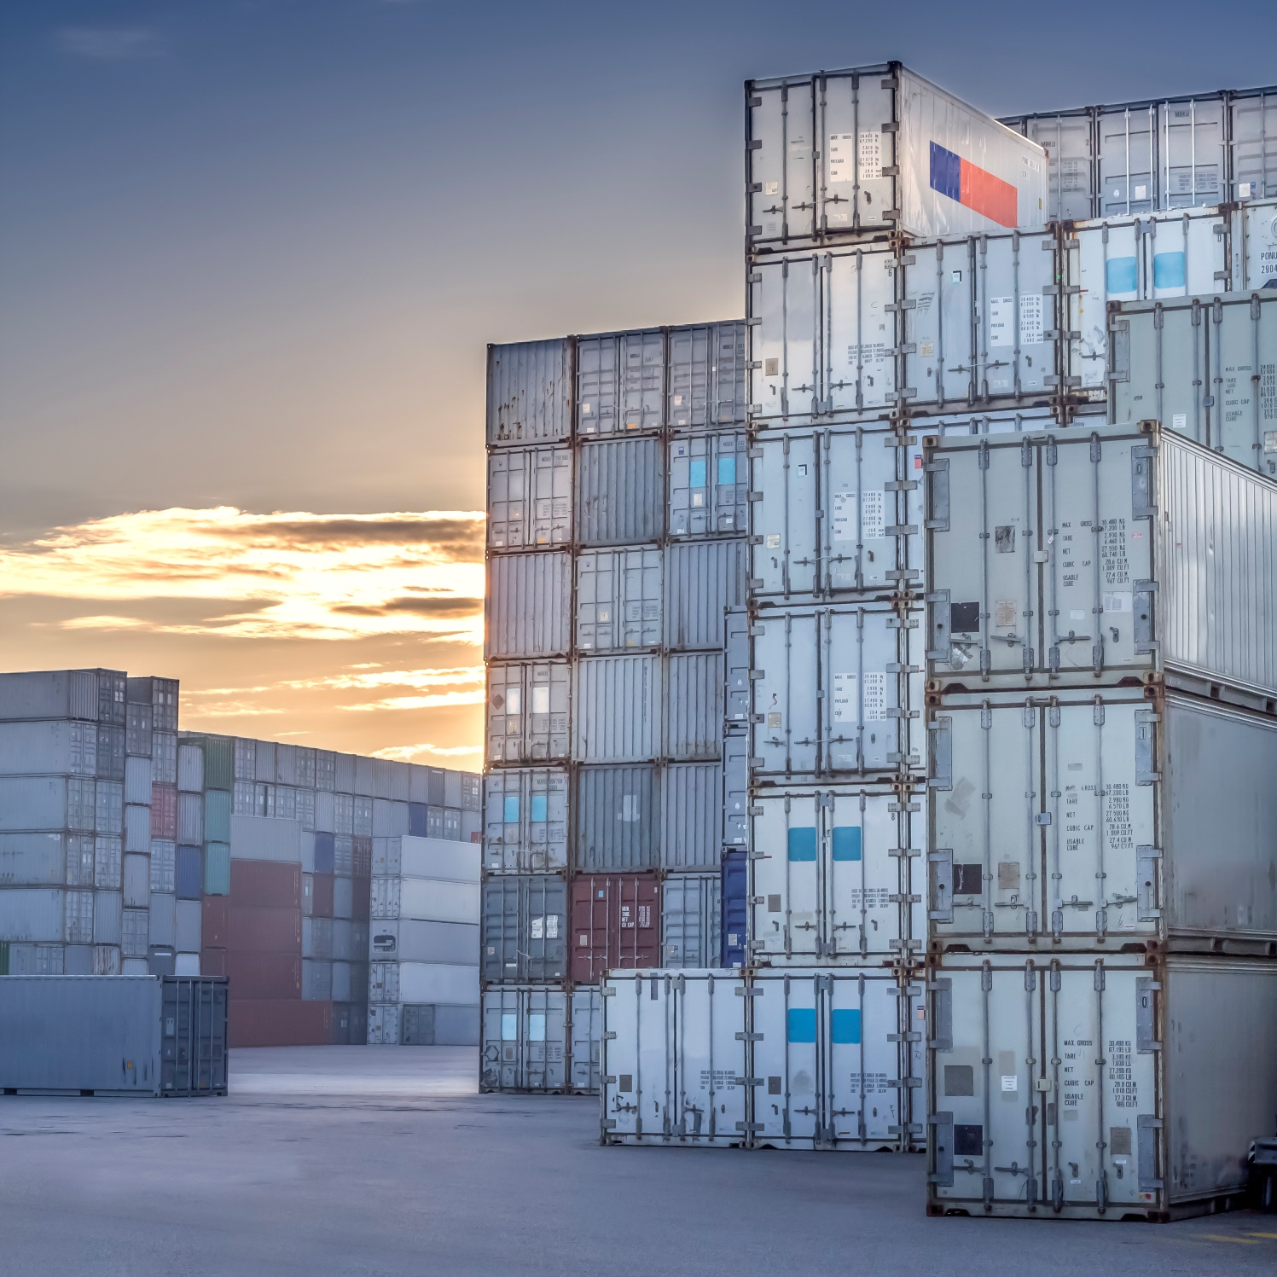
From legacy to cloud-ready to microservices
Existing
Application
Convert to container
Modern Methodologies
Modern Infrastructure
Modern Microservices
Integrate with DevOps and Agile programming
Move to cloud
or refresh HW
Add new services
or start peeling
off services from monolith code base

Slide 5
How do containers work?
Notes:
12 MIN

Slide 6
High Level Architecture
}
Docker
Universal Control Plane
Draft/Helm
Container
Development and
Management Toolset
Docker
CLI
Docker
Compose
Docker Image Registries
Microsoft Service Fabric
Kubernetes
Docker Engine
Operating System
Container Runtime

Slide 7
Windows Containers
Host User Mode
System Processes
Session Manager
Container Management
Local Security Authority
Docker Engine
Etc…
Windows Kernel

Slide 8
Windows Containers
Host User Mode
System Processes
Session Manager
Container Management
Local Security Authority
Windows Server Container
Docker Engine
Etc…
Windows Kernel

Slide 9
Windows Containers
Host User Mode
System Processes
Session Manager
Container Management
Local Security Authority
Windows Server Container
Docker Engine
Etc…
System Processes
Windows Kernel

Slide 10
Windows Containers
Host User Mode
System Processes
Session Manager
Container Management
Local Security Authority
Windows Server Container
Docker Engine
Etc…
System Processes
Application Process(es)
Windows Kernel

Slide 11
Windows Containers
Host User Mode
System Processes
Session Manager
Container Management
Local Security Authority
Windows Server Container
Docker Engine
Etc…
System Processes
Application Process(es)
Windows Kernel

Slide 12
Windows Containers
Host User Mode
System Processes
Session Manager
Container Management
Local Security Authority
Windows Server Container
Windows Server Container
Docker Engine
Etc…
System Processes
Application Process(es)
System Processes
Application Process(es)
Windows Kernel

Slide 13
Windows Containers
Host User Mode
System Processes
Session Manager
Container Management
Local Security Authority
Windows Server Container
Windows Server Container
Docker Engine
Etc…
System Processes
Application Process(es)
System Processes
Application Process(es)
Windows Kernel
Windows Kernel
Hyper-V Hypervisor

Slide 14
Windows Containers
Host User Mode
System Processes
Virtual Machine
Specifically Optimized To Run a Container
Session Manager
Container Management
Local Security Authority
Windows Server Container
Windows Server Container
Docker Engine
Etc…
System Processes
Application Process(es)
System Processes
Application Process(es)
Windows Kernel
Windows Kernel
Hyper-V Hypervisor

Slide 15
Windows Containers
Host User Mode
System Processes
Hyper-V Isolation
Virtual Machine
Specifically Optimized To Run a Container
Session Manager
Container Management
Local Security Authority
Windows Server Container
Windows Server Container
Docker Engine
Etc…
System Processes
Application Process(es)
System Processes
Application Process(es)
Windows Kernel
Windows Kernel
Hyper-V Hypervisor

Slide 16
Windows Containers
Introduced in Windows Server version 1709
Host User Mode
Hyper-V Isolation
Hyper-V Isolation
Container Runtime
Virtual Machine
Specifically Optimized To Run a Container
Virtual Machine
Specifically Optimized To Run a Container
Docker Engine
Windows Server Container
Windows Server Container
Linux
Container
containerD
System Processes
Application Process(es)
System Processes
Application Process(es)
System Processes
Application Process(es)
Windows Kernel
Windows Kernel
Linux Kernel
Hyper-V Hypervisor

Slide 17
What is a container image?
Notes:
23 MIN

Slide 18

Container Image
  Analogous to a VHD and config file to a virtual machine
  Created by running a container and capturing changes
  Changes include files and registry
Image
Metadata
Name,
Creation Data,
Command To Execute,
Dependences
Contents
Registry
Files
Folders

Slide 19
Container Images
My Website
Application
IIS
Application Framework
Base Image (OS)

Slide 20
Container Images
My Website
Application
IIS
Application Framework
Image Contents
Registry
Folders and Files
HKLM
HKCU
License.txt
PerfLogs
Program Files
Base Image (OS)
HKCR
HKU
Program Files (x86)
Users
Windows

Slide 21
Container Images
Image Contents
Registry
Folders and Files
My Website
Application
HKLM
inetpub
mysite.html
IIS
SOFTWARE/mykey
Application Framework
Image Contents
Registry
Folders and Files
HKLM
HKCU
License.txt
PerfLogs
Program Files
Base Image (OS)
HKCR
HKU
Program Files (x86)
Users
Windows

Slide 22
Automated Image Building
Docker Build and Dockerfiles
  Method for automated container image build
  Consumed when running “docker build”
  Caches unchanged commands
  Integrates into Docker Hub
Examples
  IIS
    FROM microsoft/windowsservercore
    RUN powershell –command Add-WindowsFeature Web-Server
  Website
    FROM iis
    ADD mysite.htm inetpub\mysite.htm
My Website
IIS

Slide 23
Tools to Build Container Images

Slide 24
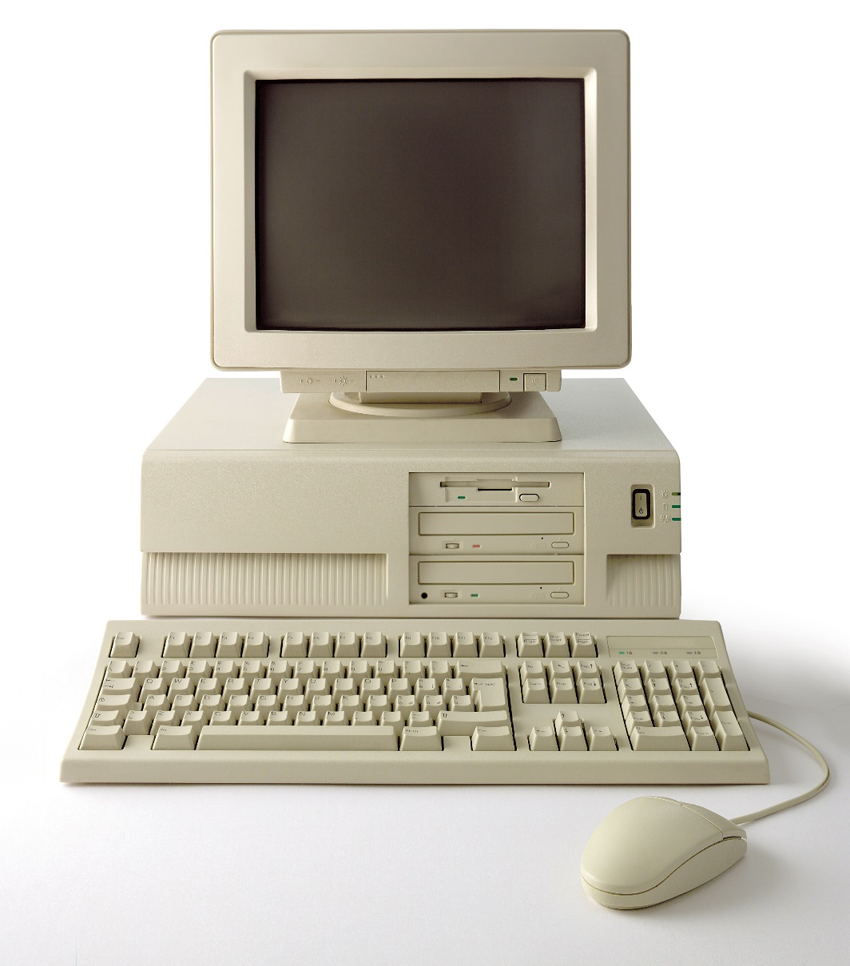
Image2Docker

Slide 25
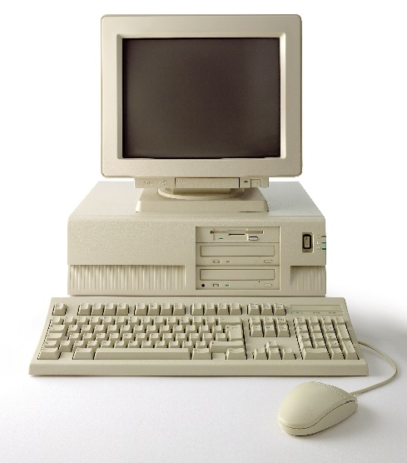
Image2Docker
ConvertTo-Dockerfile `
-RemotePath \\192.168.1.5\c$ `
-OutputPath c:\newDockerFile `
-Artifact IIS
# escape=`
FROM microsoft/aspnet:windowsservercore-10.0.14393.693
SHELL ["powershell", "-Command", "$ErrorActionPreference = 'Stop'; $ProgressPreference = 'SilentlyContinue';"]
RUN Remove-Website 'Default Web Site';
# Set up website: iis-env
RUN New-Item -Path 'C:\iis\iis-env' -Type Directory -Force;
RUN New-Website -Name 'iis-env' -PhysicalPath 'C:\iis\iis-env' -Port 8090 -Force;
EXPOSE 8090
COPY ["iis-env", "/iis/iis-env"]

Slide 26

Image2Docker
Open source PowerShell module
WIM, VHD, VHDx or Live Servers
Roles and Features along with installed programs
Internet Information Services (IIS)
- HTTP Handlers in IIS configuration
- IIS Websites and filesystem paths
- ASP.NET web applications
Microsoft SQL Server Instances
Apache Web Server
    https://www.powershellgallery.com/packages/Image2Docker/
    https://github.com/docker/communitytools-image2docker-win
Get It

Slide 27
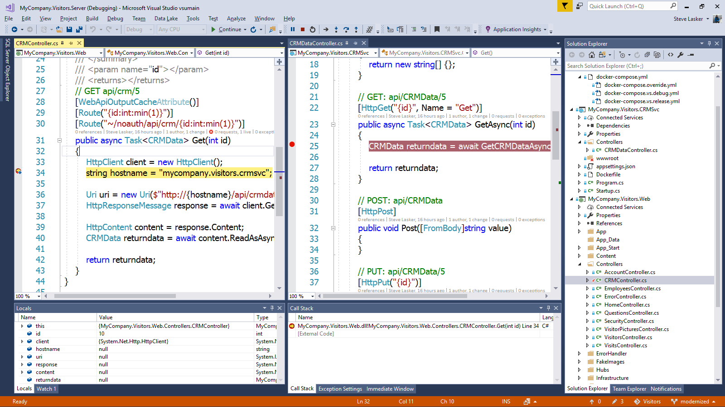
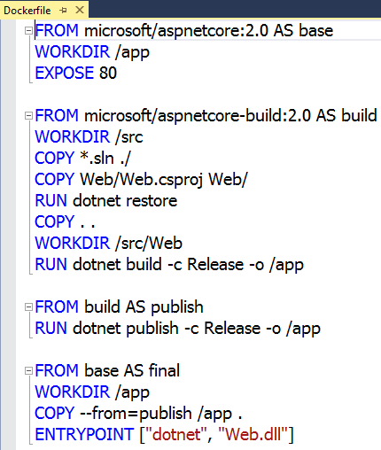
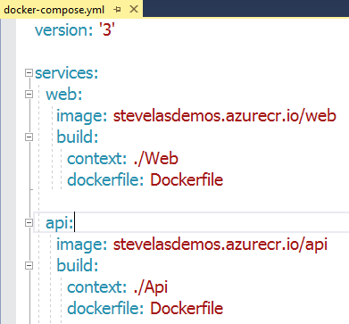

Visual Studio 2017 Container tools
Run, debug, test web, and console
apps in Docker Containers
  .NET FX w/Windows Server, .NET Core with Nano Server and Linux
Breakpoint debugging
Edit & refresh of code
Scaffolds Docker assets
  Multi-Stage Dockerfile, docker-compose.yml

Slide 28
Demo: Create Windows Container Image from Source

Slide 29
Image Registries
What is a registry?
  Stores container images
    Images are Pushed into a registry
    Images are Pulled from a registry
    Images are Searched for within a registry

Slide 30
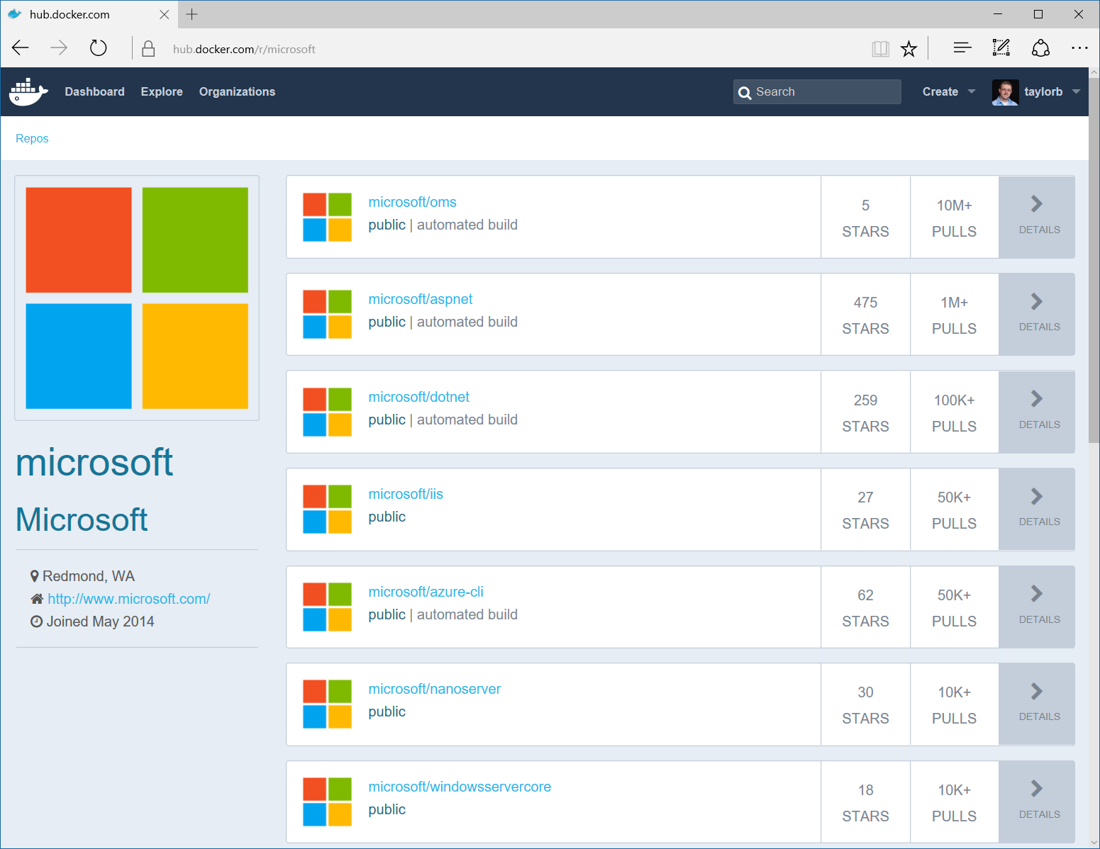
Image Registries
Docker Hub and Docker Store
  Public, Official and Private image repositories
  Granular access controls with organization support
  Automated image build support
Docker Trusted Registry
  Enterprise Grade Private Registries
  Runs on your infrastructure (on-prem or cloud)
  Active Directory and Role Based Access Controls
Azure Container Registry
  Store and manage container images across Azure deployments
  Maintain Windows and Linux container images
  Same API and Tools as Docker Hub/Store/Registry
Docker Registry
  Open source foundation of Hub and DTR
  Runs on your infrastructure (on-prem or cloud) as a container
  https://docs.docker.com/registry and or https://github.com/docker/distribution

Slide 31
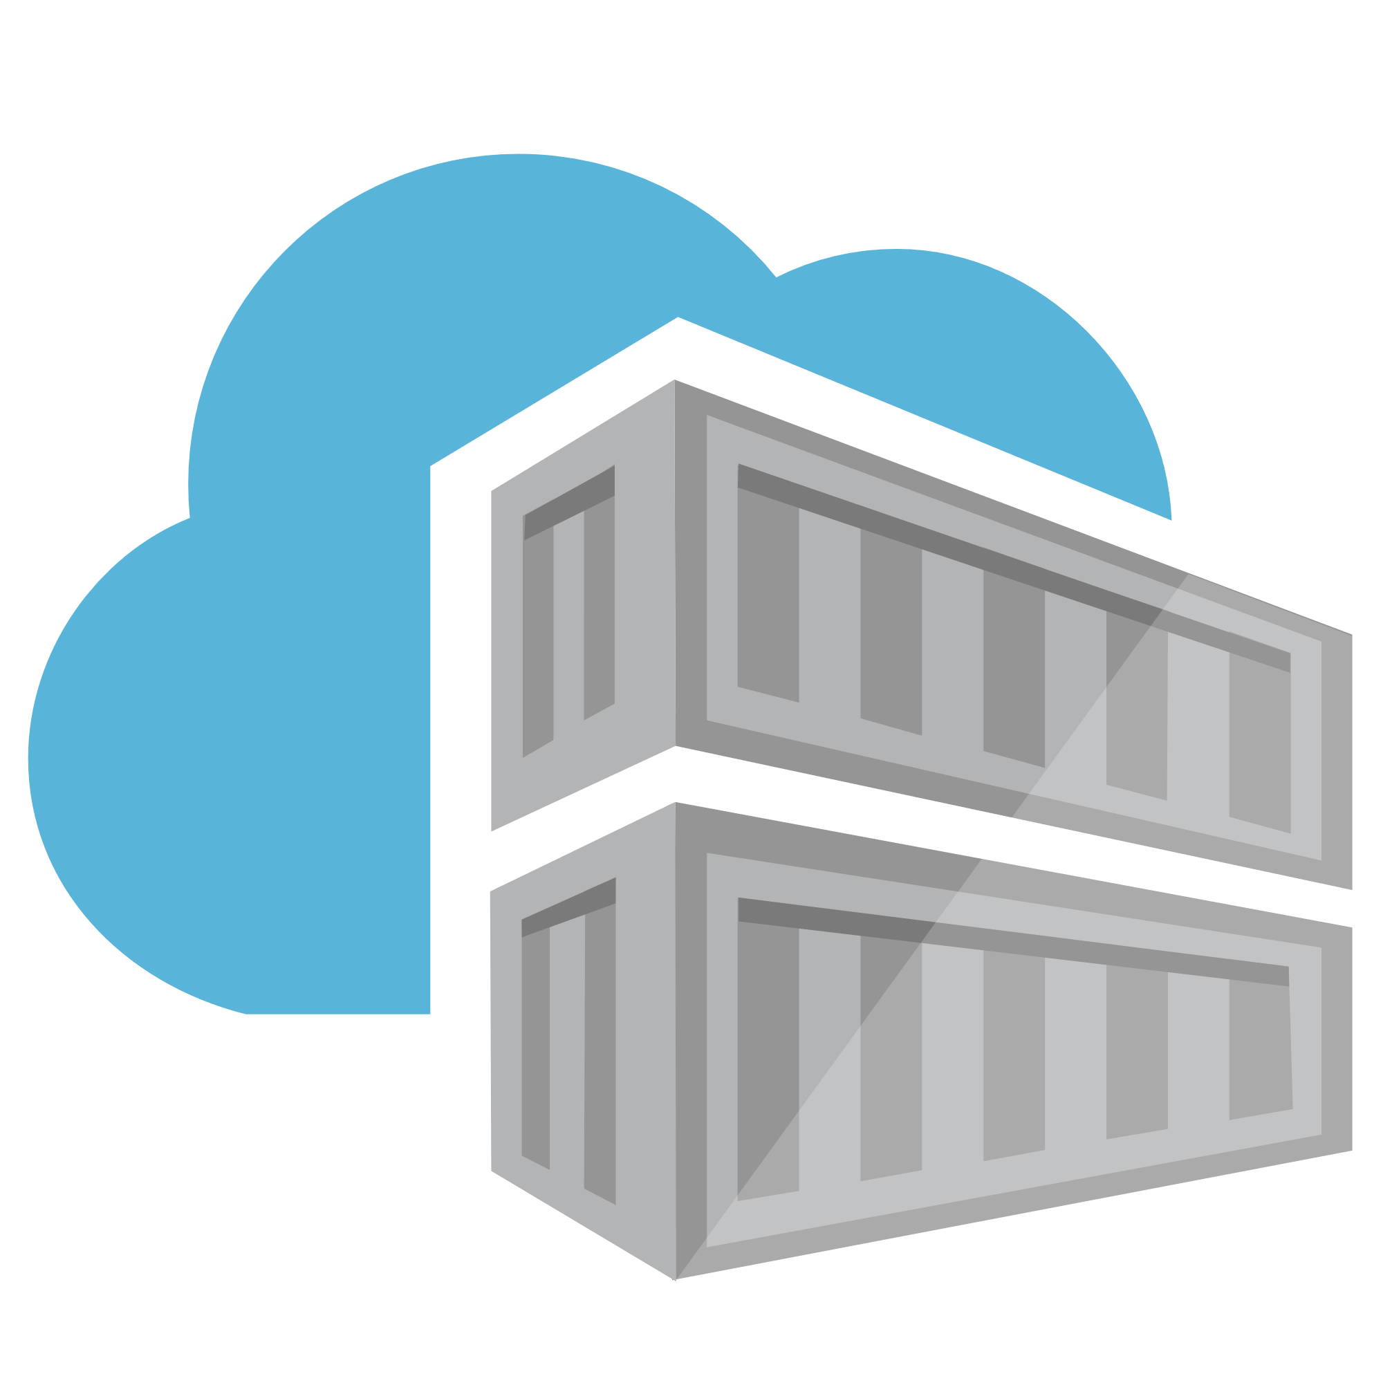

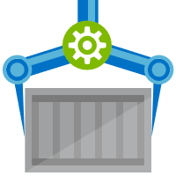
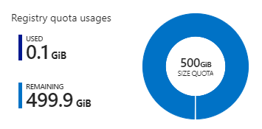
Azure Container Registry
Network-Close, Fast, Reliable, Secured w/ AAD, Image Management
Tiered SKUs providing low cost prototyping to hyper scale
  GA managed registries October ‘17
  52 million push/pull operations per month
    deployed 11gb images to 1,000 nodes in 10 mins-11TB throughput
Roadmap
  Geo-replication Preview enabling single management across all of Azure
  Auto-Build with automated OS & Framework Patching
  Multi-Arch Automation supporting IoT scenarios
aka.ms/ACR/Roadmap

Slide 32
Demo: Push to Azure Container Registry (ACR)

Slide 33
Azure Container Registry SKUs
Basic $5/month
Cost Optimized Entrypoint for individual devs & POCs
Standard $20/month
Majority of production deployments
Premium $50/month/region
Large Scale usage, Geo Replication Support
Higher throughput

Slide 34
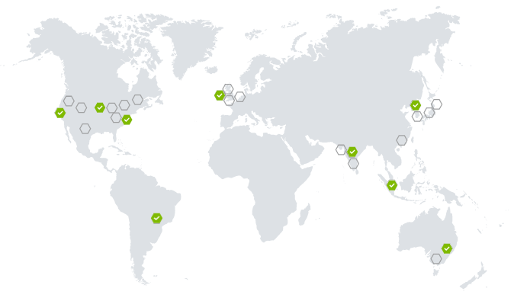
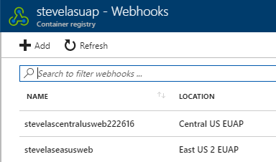
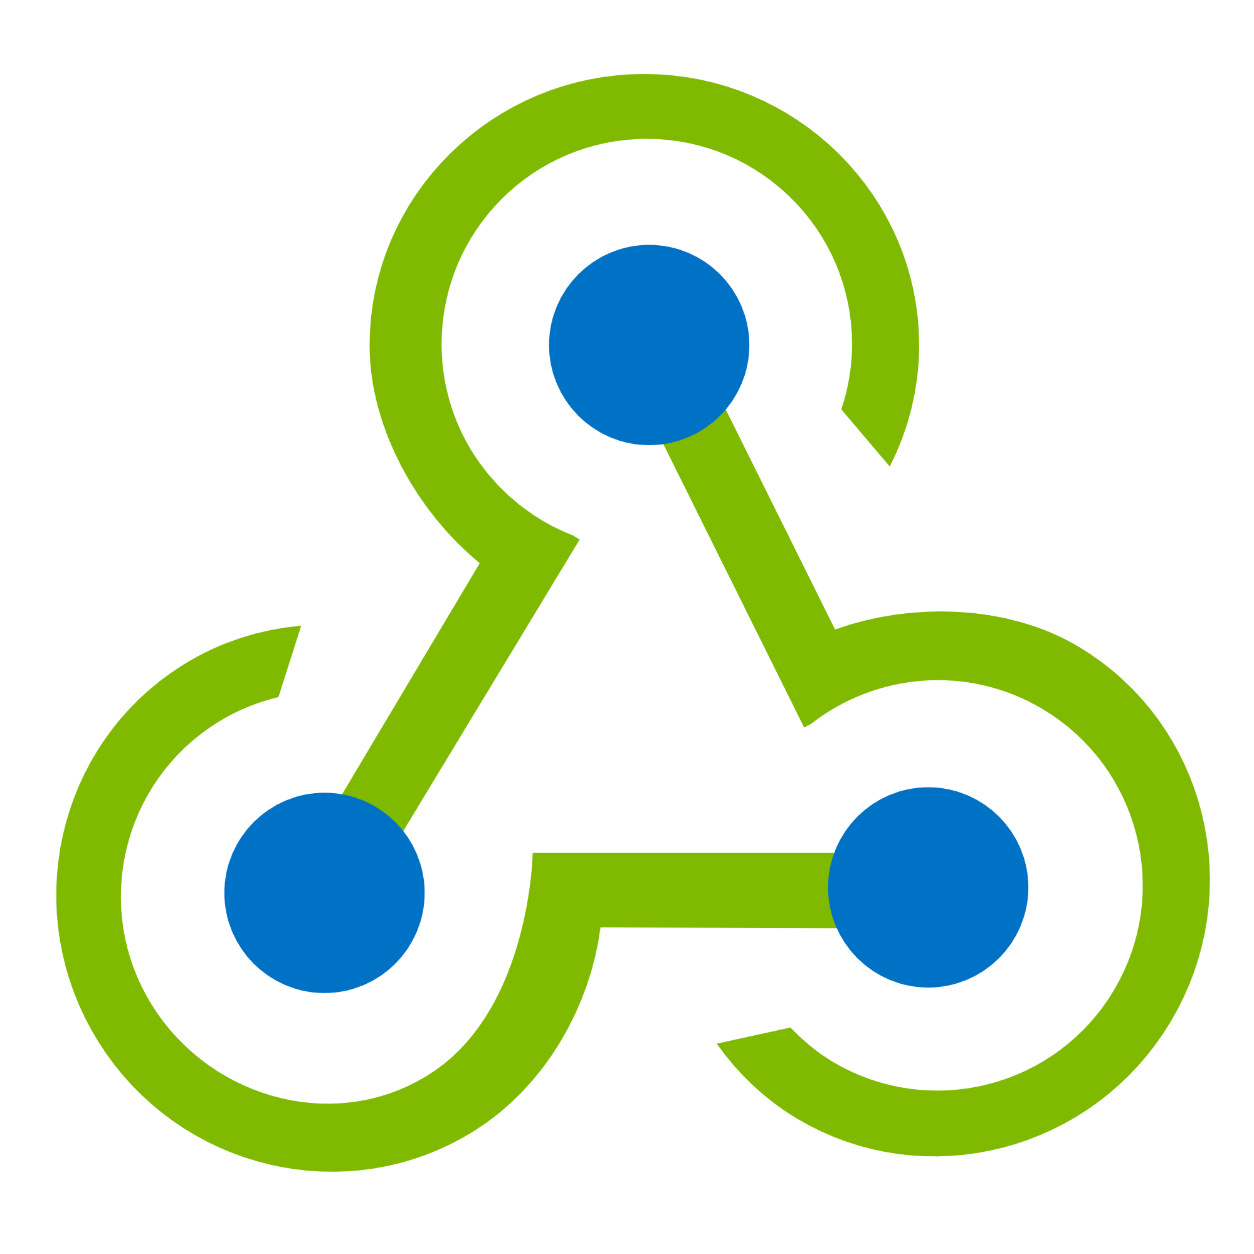
ACR Geo Replication
Enabling a global cloud as one
Serve local content
Push to a single registry
ACR will sync to replicated regions
Subsequent pulls will source from the closest replica
Regionalized Web Hooks
for local deployments

Slide 35
Automation and Management
Notes:
56 MIN

Slide 36

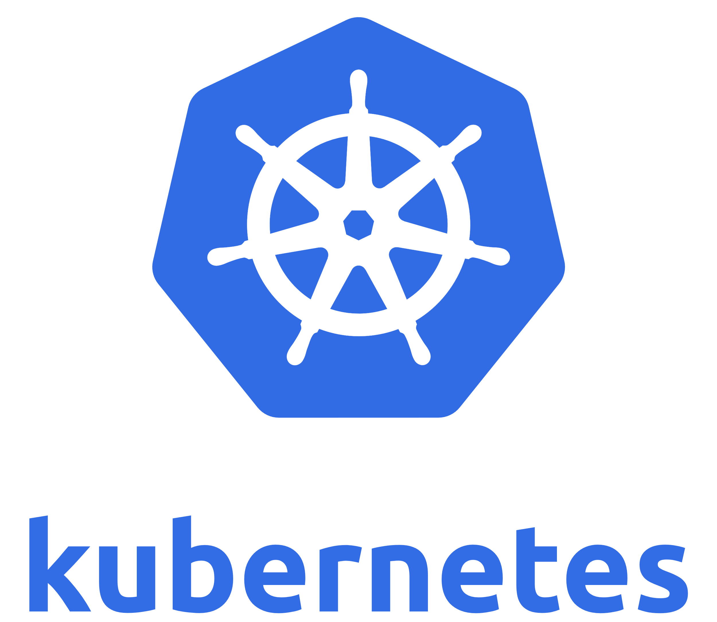


What do container orchestrators provide?
…
  Declarative model for multi-host apps
  High reliability
  Desired state reconciliation
  Health monitoring
  Dynamic scaling
  Security features
  (And more!)

Slide 37
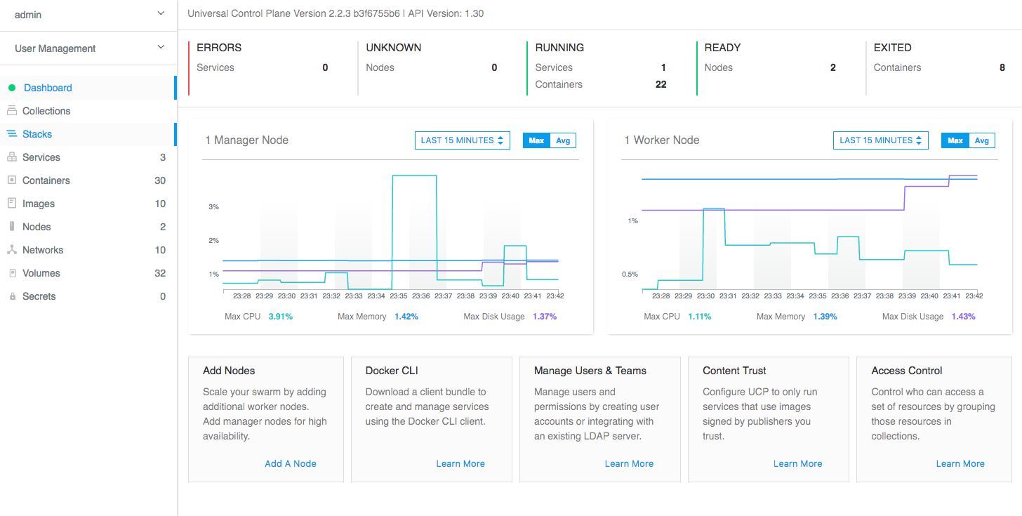
Docker Enterprise Edition: Docker Datacenter
Windows Server, Linux and mainframe
on-prem and cloud
Frictionless deployment experience
Self healing, rolling updates and health checks
E2E security, image scanning, signing, secrets
https://dockertrial.com
http://www.docker.com/enterprise
Granular role based and LDAP/AD access control

Slide 38
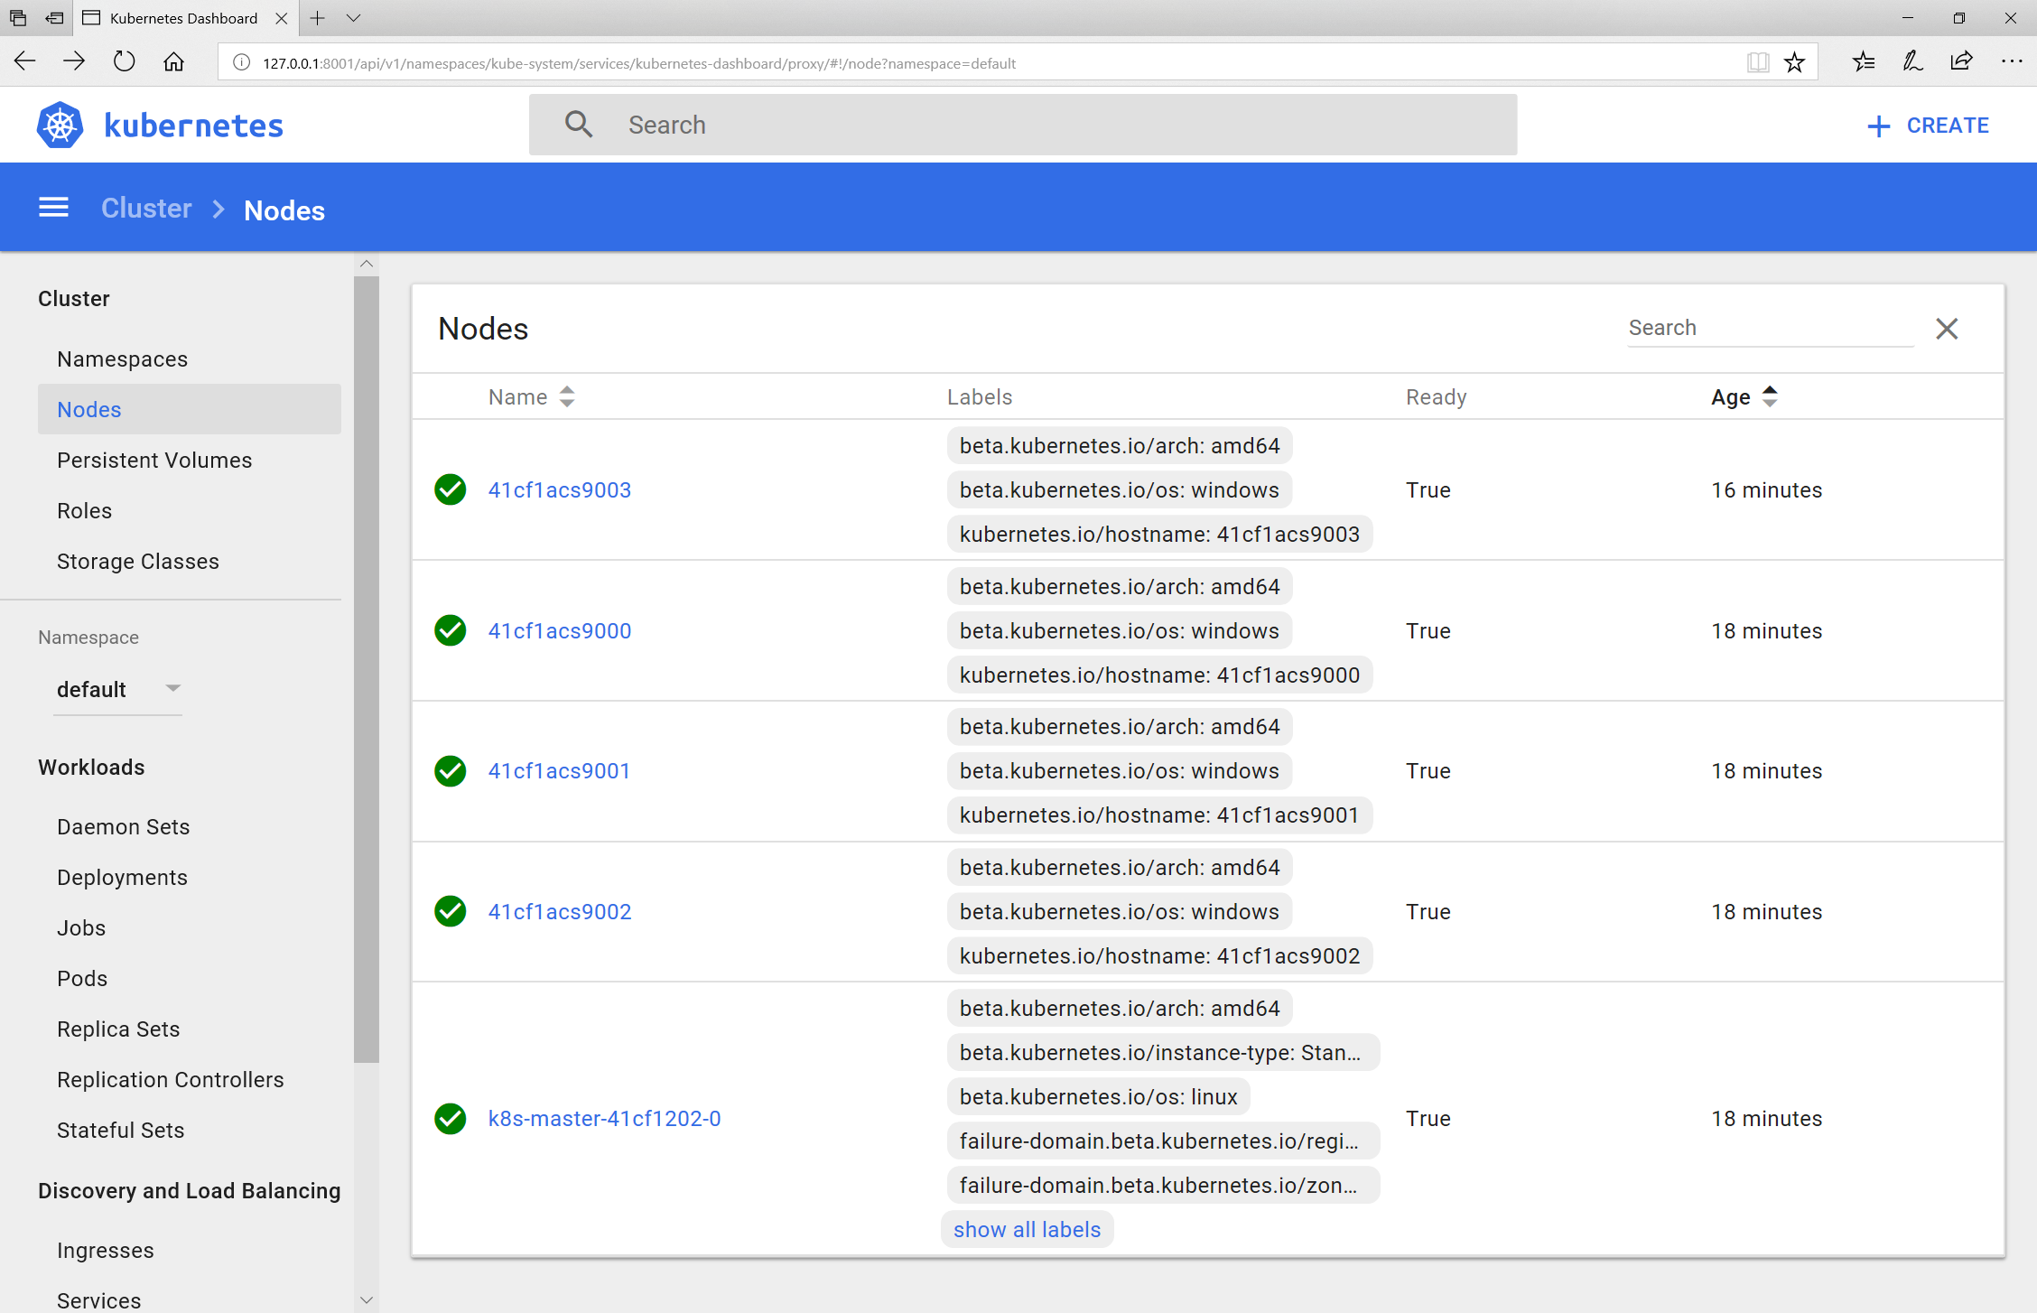
Kubernetes
Preview Support for
Windows Server Containers
Control plane runs on Linux nodes,
Kubelet/kube-proxy run on Windows
Network is achieved using L3 routing
Area of continual improvment
https://aka.ms/ignite17/acs-k8-win
https://aka.ms/ignite17/k8-gettingstarted

Slide 39
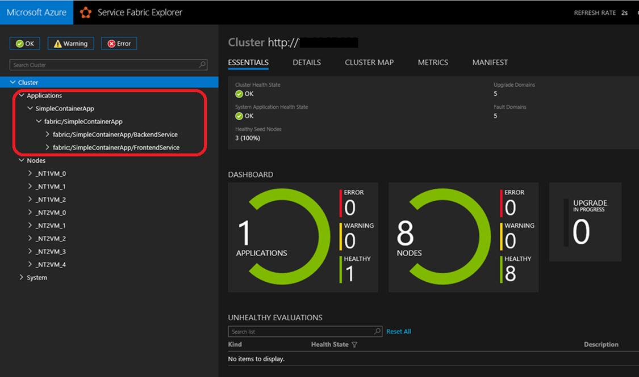
Azure Service Fabric
Support for Windows Server containers, Hyper-V isolation and Linux containers!
Image deployment and activation
Volume driver support
Networking and DNS discovery
Resource governance

Slide 40
What about…
Notes:
35 MIN

Slide 41
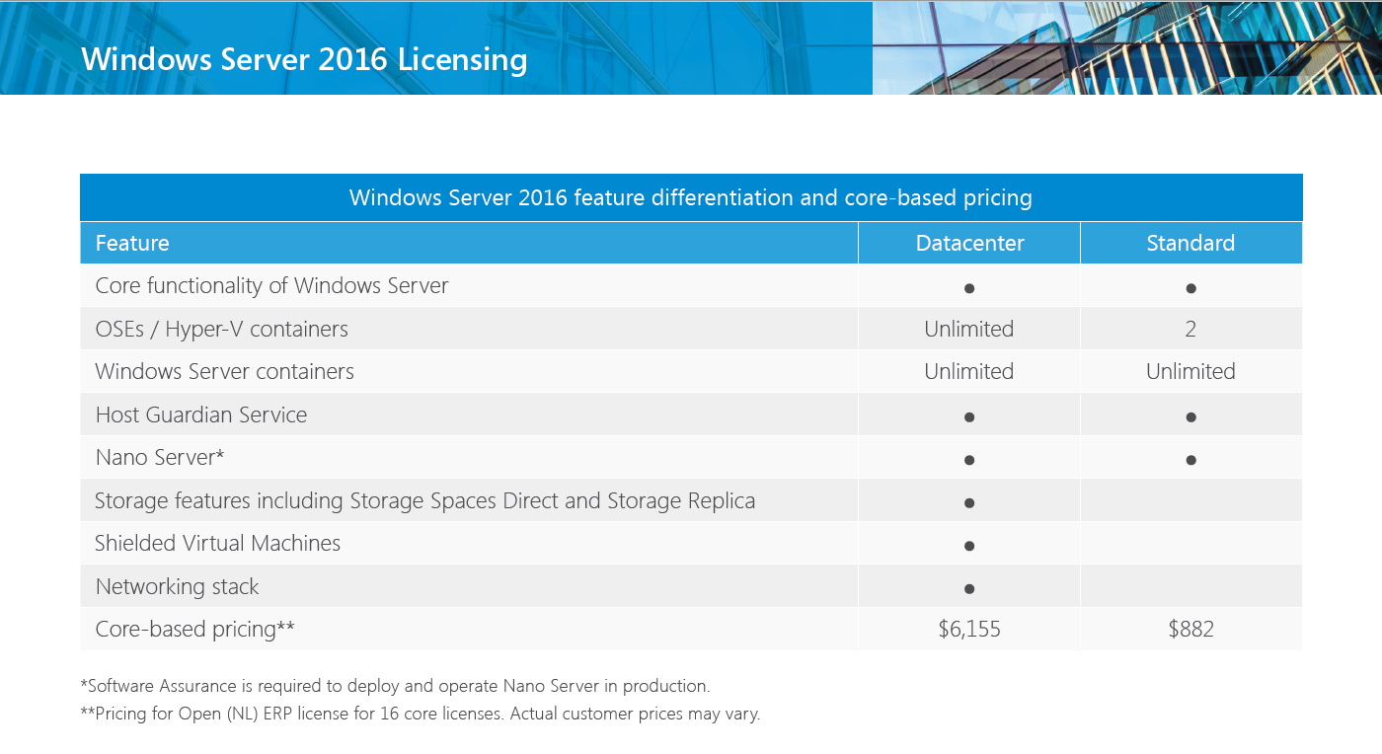
Licensing
https://www.microsoft.com/en-us/cloud-platform/windows-server-pricing

Slide 42
Patching and Updates

Slide 43
Patching and Updates
My Website
Update Container OS Image
  Pull updated base image
  Rebuild containers using dockerfiles
IIS
10.0.14393.0

Slide 44
Patching and Updates
My Website
Update Container OS Image
  Pull updated base image
  Rebuild containers using dockerfiles
IIS
10.0.14393.0

Slide 45
Patching and Updates
Update Container OS Image
  Pull updated base image
  Rebuild containers using dockerfiles
My Website
IIS
KB123456 = new image on Docker Hub
10.0.14393.0
10.0.14393.1

Slide 46
Patching and Updates
Update Container OS Image
  Pull updated base image
  Rebuild containers using dockerfiles
My Website
IIS
IIS
    FROM windowsservercore
    RUN powershell –command Add-WindowsFeature Web-Server
KB123456 = new image on Docker Hub
10.0.14393.0
10.0.14393.1

Slide 47
Patching and Updates
Update Container OS Image
  Pull updated base image
  Rebuild containers using dockerfiles
My Website
My Website
    FROM iis
    ADD mysite.htm inetpub\mysite.htm
IIS
IIS
    FROM windowsservercore
    RUN powershell –command Add-WindowsFeature Web-Server
KB123456 = new image on Docker Hub
10.0.14393.0
10.0.14393.1

Slide 48
External Storage (Volume Mapping)

Slide 49
Volume Mapping
My Container
Container Host
Container Host

Slide 50
Volume Mapping
Image Contents
My Container
License.txt
PerfLogs
Program Files
Program Files (x86)
Users
Windows
Host Storage
C:
D:
Container Host
Container Host
ContainerData

Slide 51
Storage Volume Mapping Example
Running a Container
docker run
–v d:\ContainerData:c:\data mycontainer
Image Contents
My Container
License.txt
PerfLogs
Program Files
Program Files (x86)
Users
Windows
Host Storage
C:
D:
Container Host
Container Host
ContainerData

Slide 52
Volume Mapping
Running a Container
docker run
–v d:\ContainerData:c:\data mycontainer
Image Contents
My Container
License.txt
PerfLogs
Program Files
Container View
Program Files (x86)
Users
Windows
Host Storage
License.txt
PerfLogs
Program Files
C:
D:
Program Files (x86)
Users
Windows
data
Container Host
Container Host
ContainerData

Slide 53
Volume Mapping
Running a Container
docker run
–v d:\ContainerData:c:\data mycontainer
Image Contents
My Container
License.txt
PerfLogs
Program Files
Container View
Program Files (x86)
Users
Windows
Host Storage
License.txt
PerfLogs
Program Files
C:
D:
Program Files (x86)
Users
Windows
data
Container Host
Container Host
ContainerData

Slide 54
Identity and Security

Slide 55
Active Directory Identity for Containers
Ready for Enterprise Applications
  No infrastructure changes to Active Directory required
  Leverages Group Managed Service Accounts
  Enables containerized applications to authenticate with SQL Server, file shares, and more
Simple and Secure
  Identity specified at container start time
  Credentials are not stored within the container image
  No changes required to move across environments i.e. dev, test, prod, cloud

Slide 56
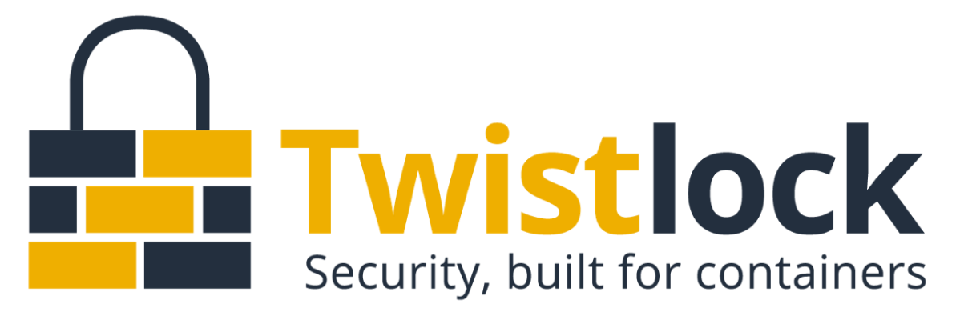

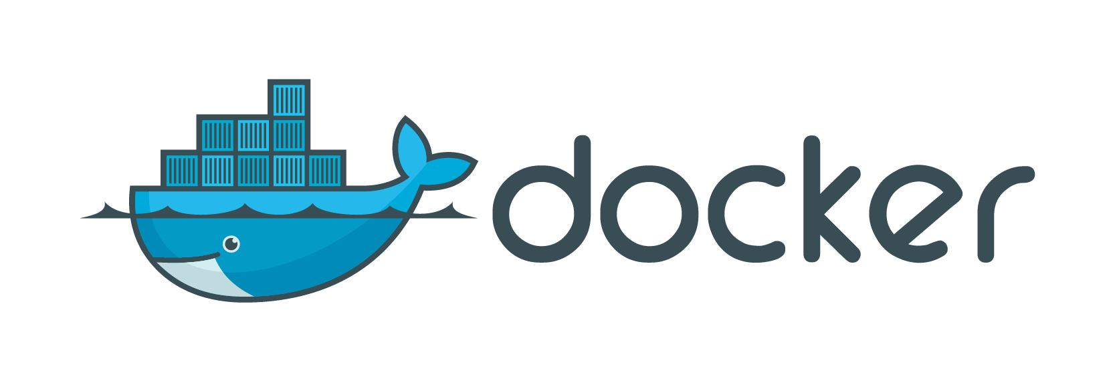
Secure Deployment and Auditing
Notes:
I’m still open to suggestions for slide title.
We shouldn’t imply that security is “missing” or go into a feature checklist so I want it to stay vague
“Two ecosystem players provide more granular security controls for deployment, management, vulnerability scanning, network policies, defense and auditing. Follow up with them to see demos and learn more about how they’re extending their capabilities across Windows & Linux, on-premises and in the cloud.”

