Slide 1
Application Migration​ & Modernization
Monitoring and alerting

Slide 2
Azure Monitoring Overview

Slide 3
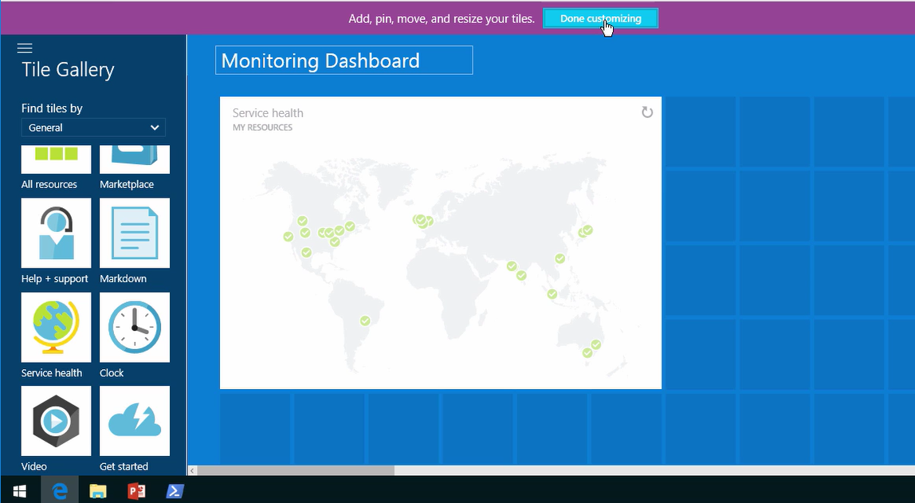
Azure Service Health Dashboard

Slide 4
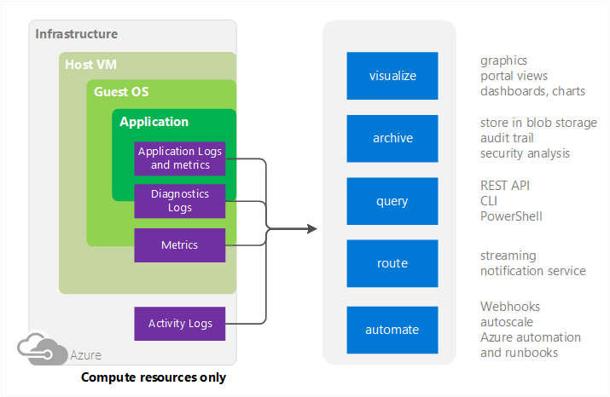
Azure Monitoring sources
Compute
  Host VMs
  Compute resource
  Applications
Notes:
Some compute resources like Cloud Services, Virtual Machines, and Service Fabric have a dedicated Host VM they interact with, and you can collect metrics on the host in addition to the guest
Compute resources such as VMs

Slide 5
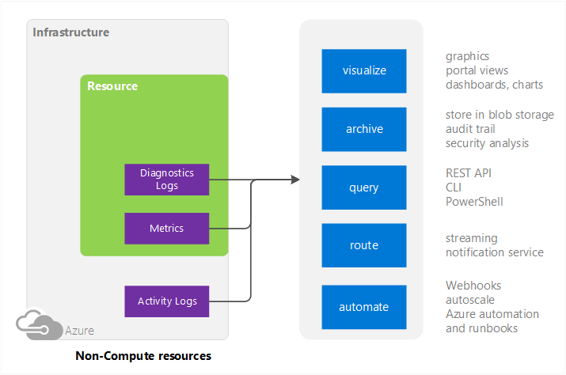
Azure Monitoring sources
Non-compute
  Activity Logs (formerly called Audit or Operational Logs)
  PaaS Services

Slide 6
Azure Monitoring Services
Azure Monitor (previously Azure Insights)
  Data from Azure Infrastructure (Activity Log) and each resource (Diagnostic Logs)
Azure Network Watcher
Diagnoses conditions at a network scenario level in, to, and from Azure
Azure Advisor
  Best practices to optimize Azure deployments on performance, security, HA, and costs
Azure Security Center
  Prevents, detects, and responds to threats on Azure resources.
Log Analytics (part of OMS)
  Holistic monitoring of on-premises, Azure, and third party clouds like AWS
Application Insights
  Detection and diagnostics at the application layer of services like App Service Web Apps
Notes:
Azure Monitor: Offers visualization, query, routing, alerting, autoscale, and automation on data both from the Azure infrastructure (Activity Log) and each individual Azure resource (Diagnostic Logs)
Log Analytics: Data from Azure Monitor can be routed directly to Log Analytics so you can see metrics and logs for your entire environment in one place

Slide 7
Azure Monitor

Slide 8
What is Azure Monitor?
Built-in monitoring for Azure resources
Out-of-box metrics and logs
Alert rules for notification and actions
Diagnostics’ metrics and activity logs available per resource level or holistically as a “herd” of resources.

Slide 9
Metrics (performance counters)
Collected with one-minute frequency
Retained for 30 days
Out-of-the-box (no setup or storage account required), only available for host metrics.
Azure extension required for Azure VM metrics. Specific logs to collect specified through XML file.
Export to Blob storage, Azure Event Hubs, or OMS.
Configure alert rules on metrics.
Notes:
You can access host-level metrics from VMs (Azure Resource Manager-based) and Virtual Machine scale sets without any additional diagnostic setup. These metrics are not to be confused with the Guest-OS-level metrics that you have access to when you turn on Azure Diagnostics on your VMs or Virtual Machine scale sets

Slide 10
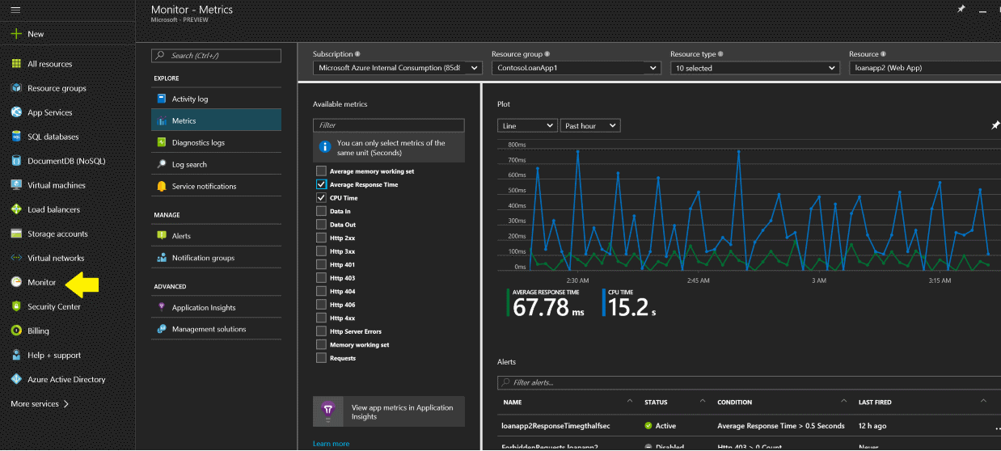
Metrics (performance counters)

Slide 11
Activity Log vs. Diagnostics Logs
One-off resource monitoring should be the exception and not the rule
Only use when troubleshooting
Activity Log
  Also called the audit log
  Records operational details
  Who did what and when in Azure
Diagnostic Log
Performance Counters
Event logs
  System, Application, Security
  IIS logs
  Crash dump data
  Custom Error Logs
Notes:
"The Activity Log differs from Diagnostic Logs. Activity Logs provide data about the operations on a resource from the outside. Diagnostics Logs are emitted by a resource and provide information about the operation of that resource.
You can retrieve events from your Activity Log using the Azure portal, CLI, PowerShell cmdlets, and Azure Monitor REST API."

Slide 12
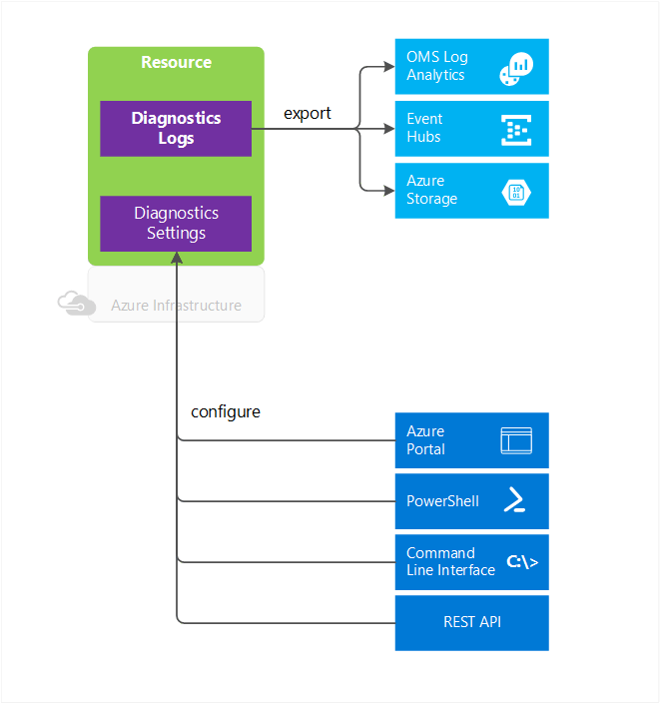
Diagnostic Logs
Diagnostics from a specific resource
Logs contents vary by resource type
Logging needs to be enabled.
Can be stored in Storage account, streamed to Event Hubs, or sent to OMS Log Analytics
365-day retention with storage account
Notes:
Windows event system logs are one category of Diagnostic Log for VMs. Blob, table, and queue logs are categories of Diagnostic Logs for storage accounts
On Windows and Linux Azure VMs, OS-level diagnostics logs are enabled through a Windows or Linux specific VM extension. This extension must be configured using a XML file which will specify the logs to collect.
For OMS Log Analytics to be able to get Azure VMs OS-level metrics, the OMS extension must be enabled for the Windows or Linux Azure VM.
IaaS Diagnostics extension for Windows and Linux vs. OMS extension for Windows and Linux are two separate extensions.
Save diagnostics logs to a Storage Account for auditing or manual inspection. You can specify the retention time (in days) using the Diagnostic Settings.
Stream them to Event Hubs for ingestion by a third-party service or custom analytics solution such as PowerBI.
Analyze them with OMS Log Analytics

Slide 13
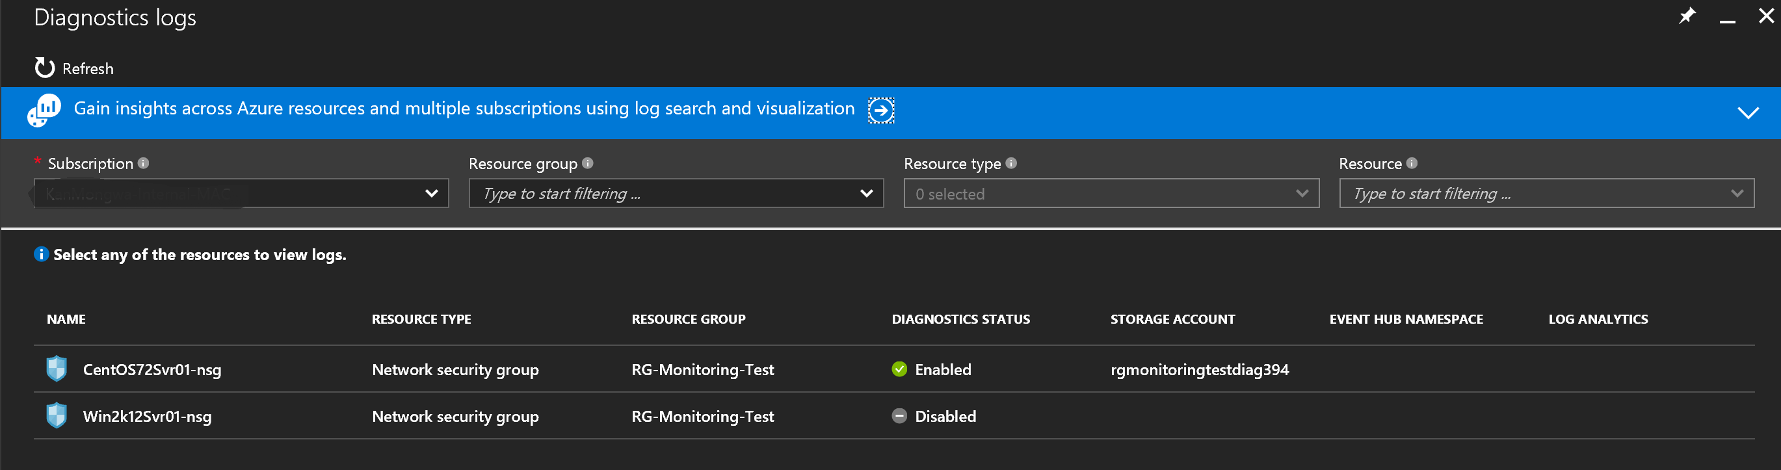
Diagnostic Logs

Slide 14
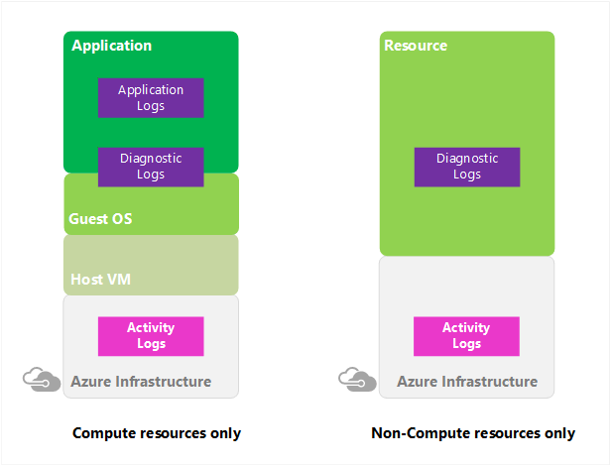
Activity Logs
Formerly called “Audit Logs” or “Operational Logs”
Who is doing what on your resources?
Excellent source for security admins to get audit trails for Azure resources
Retained for 90 days
Export to Blob storage or stream to Event Hub and analyze with Power BI
Create email or webhook triggers off events
Notes:
"The Azure Activity Log is a log that provides insight into the operations that were performed on resources in your subscription. Using the Activity Log, you can determine the ‘what, who, and when’ for any write operations (PUT, POST, DELETE) taken on the resources in your subscription. You can also understand the status of the operation and other relevant properties. The Activity Log does not include read (GET) operations or operations for resources that use the Classic/"RDFE" model."

Slide 15
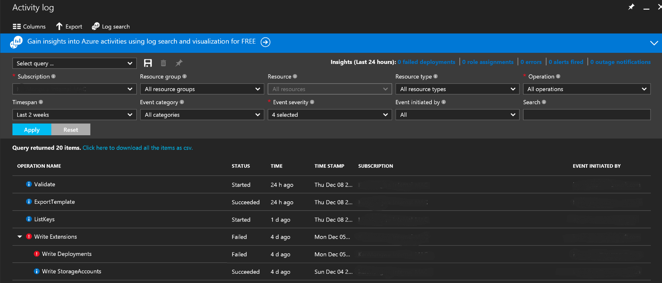
Activity Logs

Slide 16
Metric Alerts
This alert triggers when the value of a specified metric crosses a threshold that you assign in either direction. That is, it triggers both when the condition is first met and then afterward when that condition is no longer being met.
You can configure an alert to do the following actions:
  Send email notifications to the service administrator, to co-administrators, or to additional email addresses that you specify.
  Call a webhook, which enables you to launch additional automation actions. Examples include calling:
  Azure Automation Runbook
  Azure Function
  Azure Logic App
  a third-party service

Slide 17
Activity Log Alerts
This alert can trigger when a particular event occurs on a resource, or when a service notification is posted to your subscription.
You can configure an alert to do the following actions:
  Trigger whenever a specific event occurs one of the resources under your subscription
  Trigger whenever a service notification is posted to your subscription
  Alert members of an action group via
    SMS
    Email
    Webhook

Slide 18
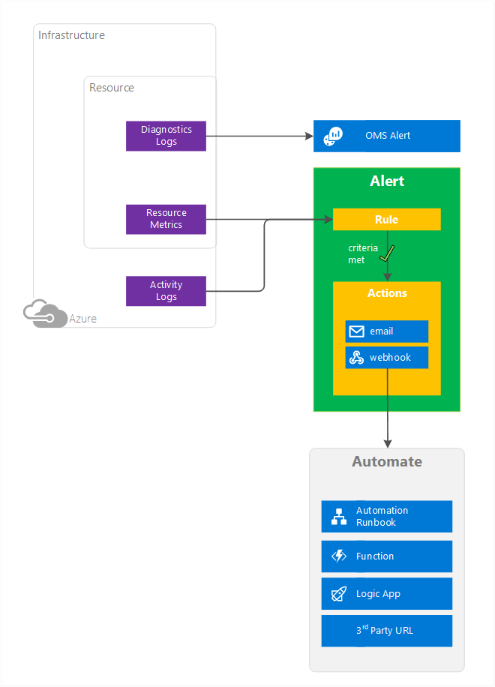
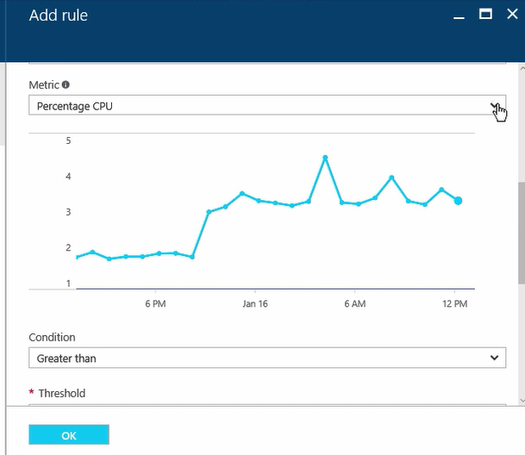
Alerts

Slide 19
Network Watcher

Slide 20
What is Network Watcher?
Regional service that enables monitoring and diagnosing through insights on the following Azure network resources:
Topology: Network level graphical topology on Azure networking resources.
Variable Packet Capture: Captures packet data in/out of a VM. Can be stored in blob storage and locally in .cap format.
IP flow verify: Checks if packet is allowed/denied by NSGs based on 5-tuple packet info.
Next hop: Determines next hop for packets being routed in the Azure Network fabric for UDR troubleshooting.

Slide 21
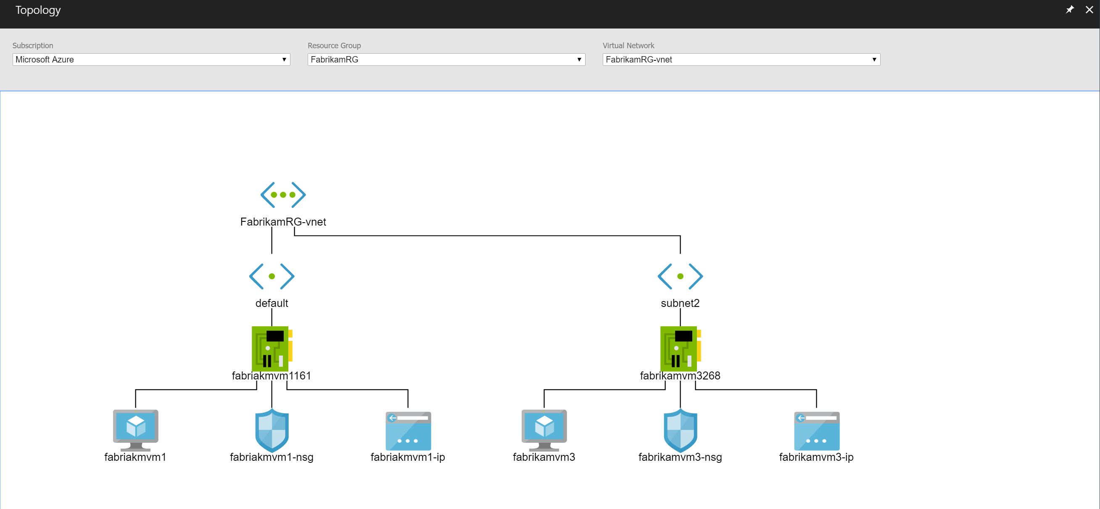
Topology

Slide 22
What is Network Watcher?
Security Group View: Gets effective and applied security rules that are applied on a VM.
NSG Flow Logging: NSGs logs on traffic that is denied/allowed
Virtual Network Gateway and Connection troubleshooting: Troubleshoot Virtual Network Gateways and Connections.
Network subscription limits: View network resource usage against limits.
Configuring Diagnostics Log: Enable/Disable Diagnostics logs for network resources in a resource group

Slide 23
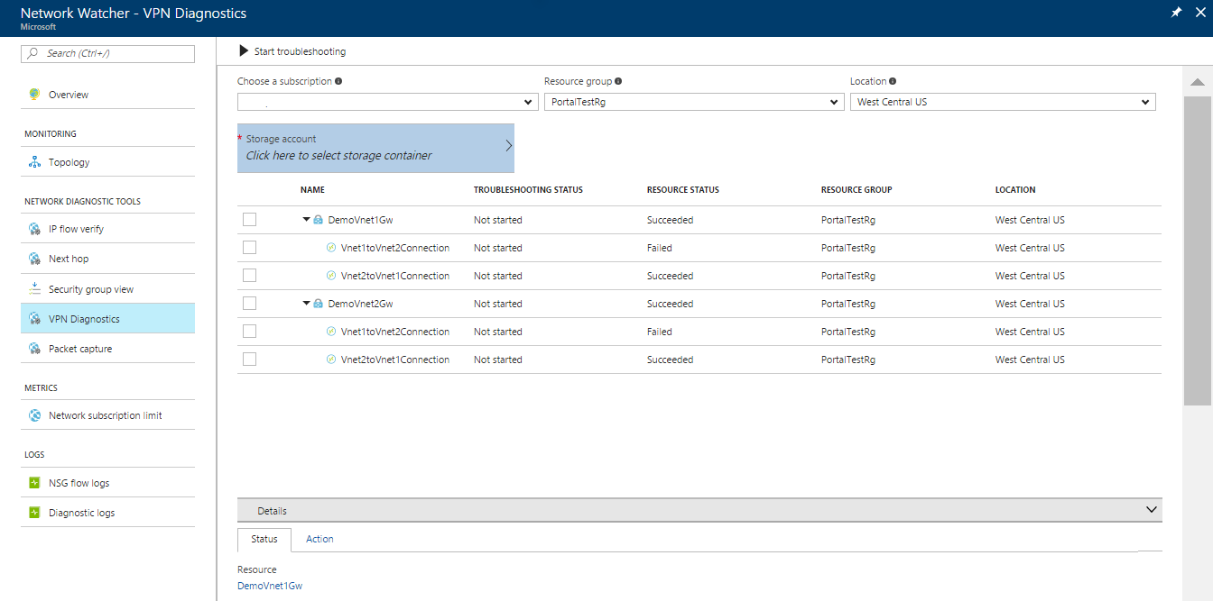
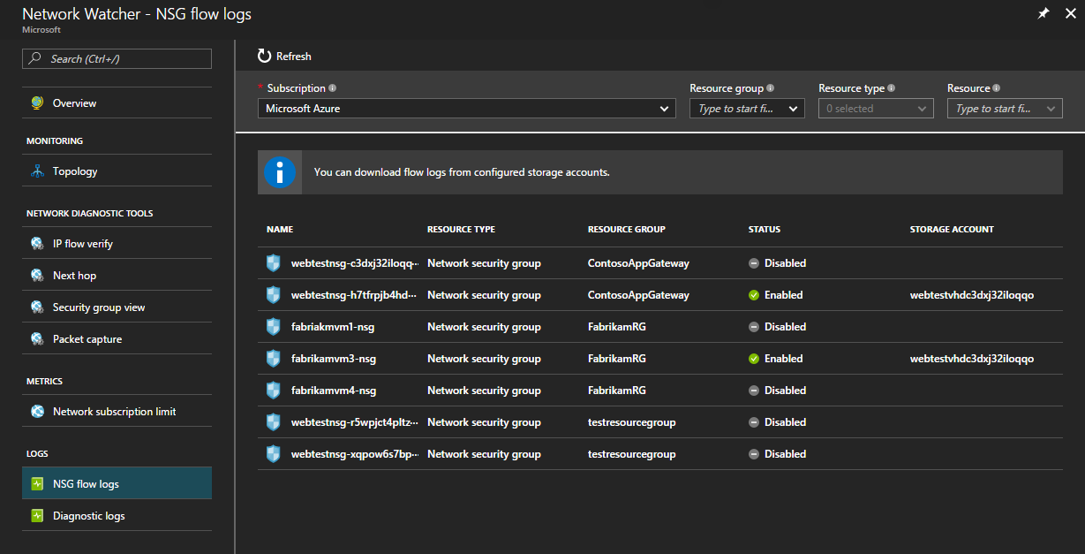
NSGs Flow Logging and VPN Gateway Logs

Slide 24
Azure Security Center

Slide 25
What is Azure Security Center?
Create Security Policies
Recommendations
Security Alerts
Partner Solutions available for additional features
Integrate with other SIEM systems through Microsoft Azure Log Integration and export data to PowerBI
Can be purchased as part of OMS
Available in different tiers for Basic vs. Advance threat detection
Notes:
Microsoft Azure Log Integration will integrate with other SIEM systems and send Virtual Machine logs, Azure Activity Logs, Azure Security Center Alerts, among other Azure Resource Provider’s Logs.

Slide 26
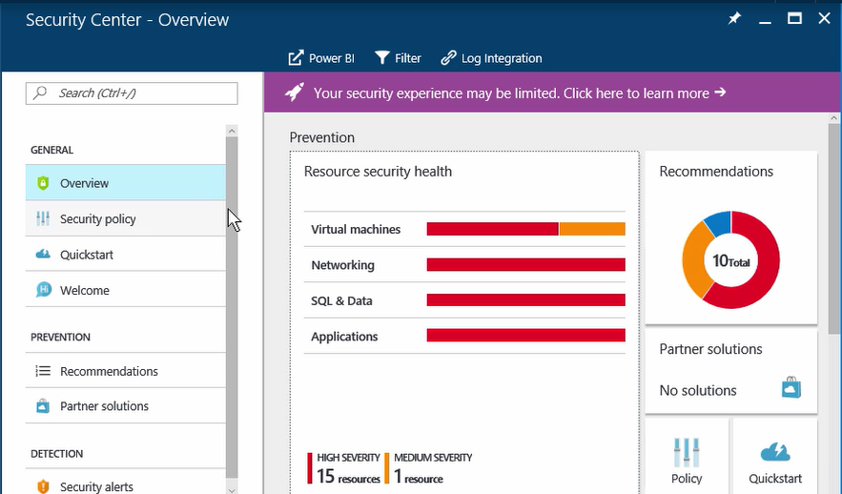
Azure Security Center

Slide 27
Security Policies
Enable or Disable VM data collection and send it to Azure Storage.
Configured based on Prevention Policy categories such as:
  System Updates
  OS vulnerabilities
  Endpoint Protection
  Disk Encryption
  Network Security Groups
  Etc.
Created globally for a subscription, which all resource groups will inherit. Inheritance can be overwritten per resource group.
Email and SMS Text for incident alerts.

Slide 28
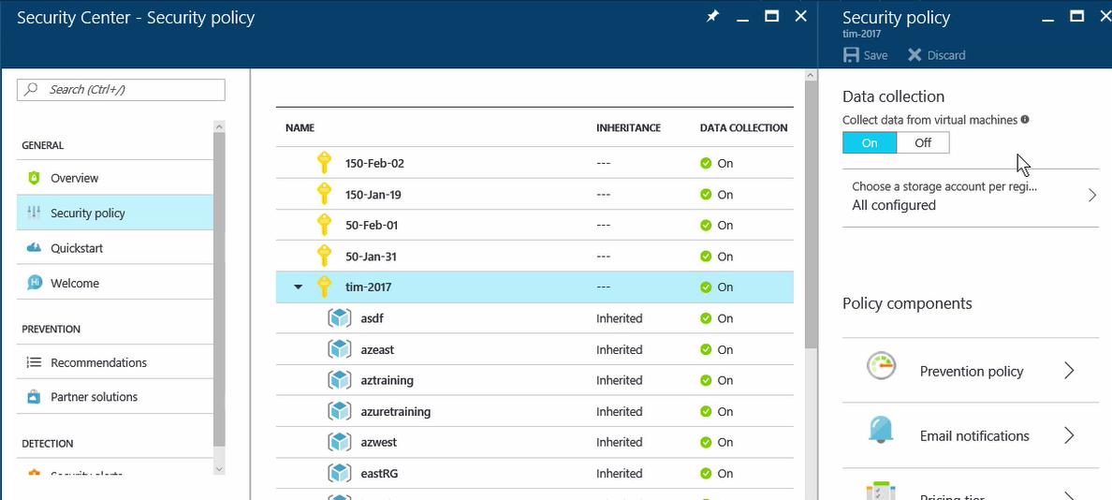
Security Policies

Slide 29
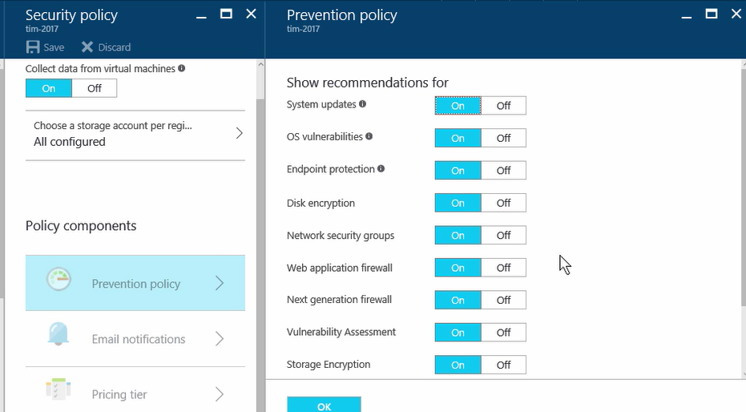
Security Policies: Prevention Policies

Slide 30
Recommendations
What has Security Center observed in the Azure infrastructure and what is the recommendation on these incidents for Prevention purposes.
Based on advanced vs. basic threat analytics tier chosen
Auto-remediation steps available on each recommendation
Recommendations must be periodically scanned

Slide 31
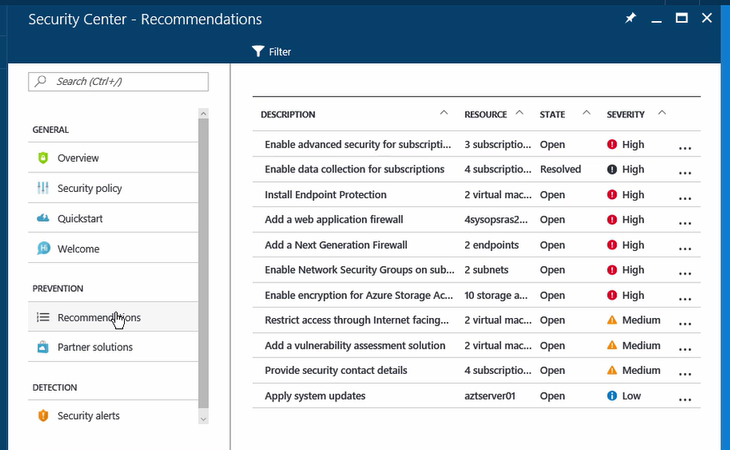
Recommendations

Slide 32
Security Alerts
What has Security Center detected in the Azure infrastructure and what is the alert on these incidents for Remediation purposes.
Provides report and remediation steps
Alerts must be periodically scanned

Slide 33
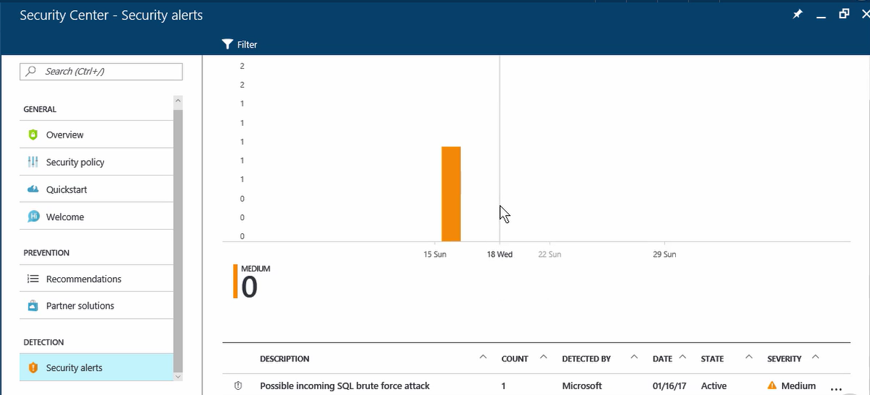
Security Alerts

Slide 34
OMS&S (Log Analytics)

Slide 35
Operations Management Suite (OMS)
Simplified guest and workload management anywhere
HYPER-V
LINUX
LINUX
WINDOWS
HYPER-V
WINDOWS
VMware
LINUX
LINUX
WINDOWS
VMware
WINDOWS
Public Cloud
AZURE or AWS
Private or Hosted Third Party Cloud Rackspace, GCE, etc.
Microsoft
Operations Management Suite
HYPER-V
LINUX
WINDOWS
VMWare
LINUX
WINDOWS
LINUX
WINDOWS
On-premises with System Center
Notes:
Customer environments are spanning on-premises and public clouds
Customer environments are heterogenous running multiple hypervisors and operating systems
Management of services is becoming more complex as service delivery evolves

Slide 36
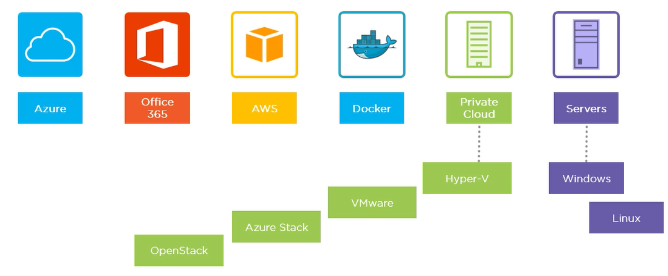
Operations Management Suite (OMS)
Available platforms to integrate as OMS Data Sources:
Notes:
Customer environments are spanning on-premises and public clouds
Customer environments are heterogenous running multiple hypervisors and operating systems
Management of services is becoming more complex as service delivery evolves

Slide 37
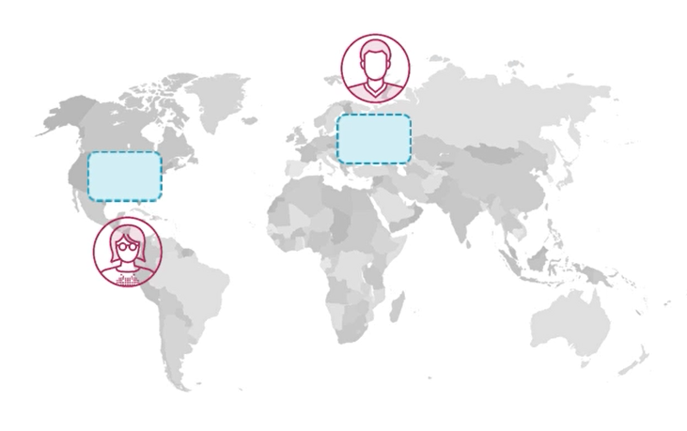
OMS Workspace
Administrative Boundary
All data is collected in the workspace region.
Larger orgs. should consider multiple regional workspaces closest to the infrastructure being monitored.
Workspaces are isolated from one another. They collect data independently.
Link multiple workspaces to single Azure subscription for ease of management.
Delegate workspace responsibility

Slide 38
Solutions
Modules in OMS similar to SCOM Management Packs.
3rd Party Solutions are available.
Solutions come with pre-built Log Analytics queries on connected Data sources to OMS. In addition to dashboards, recommendations, and alerting on the specific system the solution targets.
Solutions are added to the OMS workspace from the solutions gallery as a one-click operation.
Agent requirement changes per solution, some might allow to use the existing SCOM agent, while other solutions might require additional agents other than the OMS or SCOM agent.

Slide 39
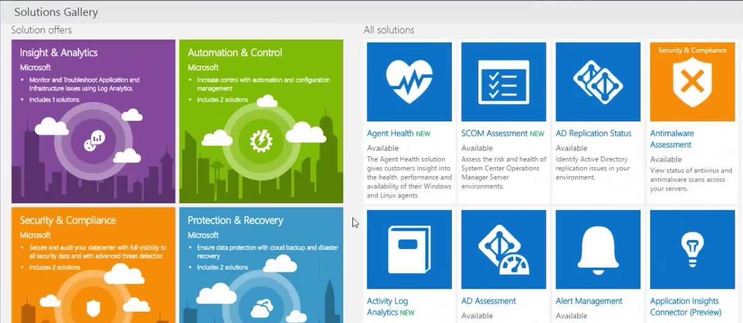
Solutions Gallery
Log Analytics solutions are a collection of logic, visualization and data acquisition rules that provide metrics pivoted around a particular problem area.

Slide 40
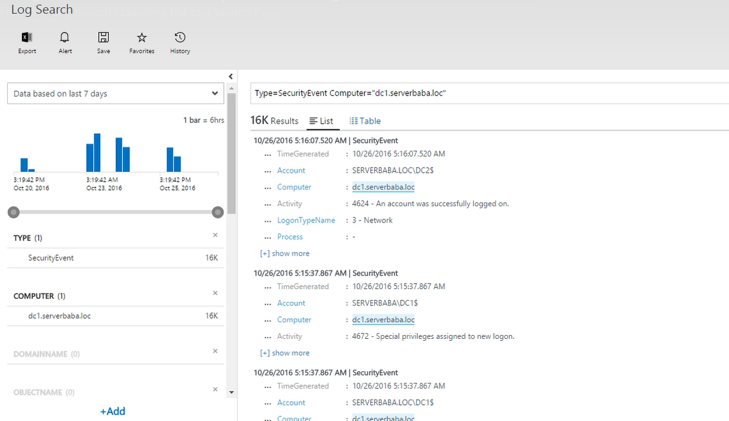
Log Analytics Search Page
Notes:
Log Search Page is the tool for all searches of data sent by connected sources:
Search Box for query
Results: Single vs. Multiple Records
Time Range for Query
Most common filters available
Manual Options, Top Left

Slide 41
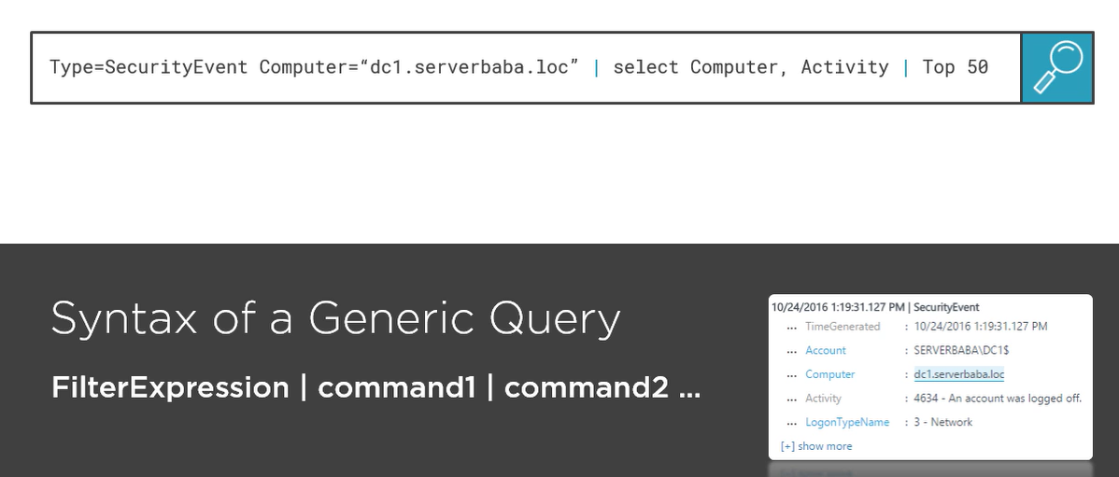
Log Analytics Search Query Language
Notes:
Language Query Syntax is fundamental in order to take full advantage of data analytics offered by OMS

Slide 42
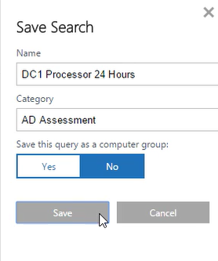
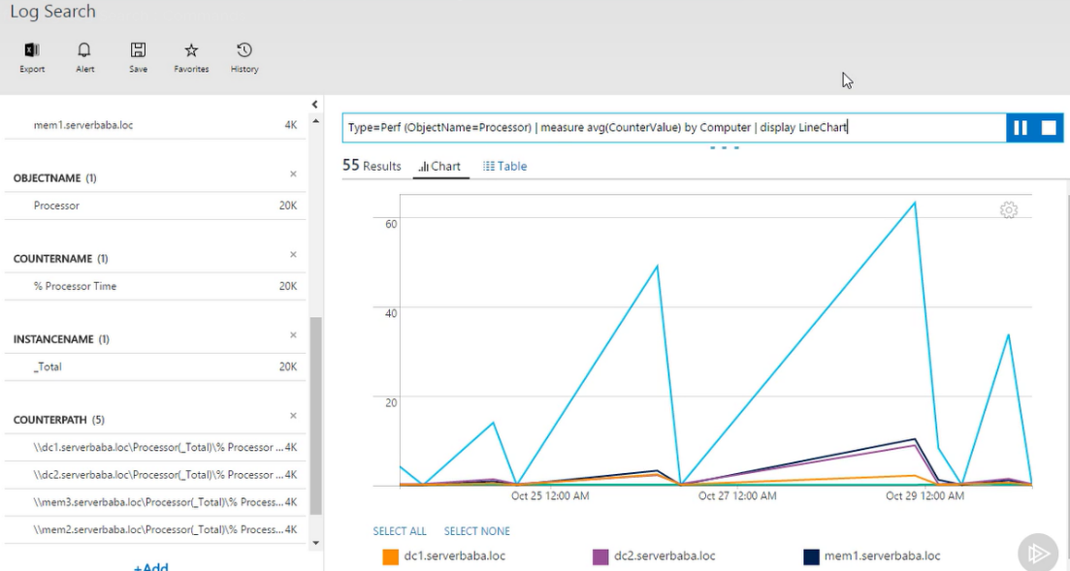
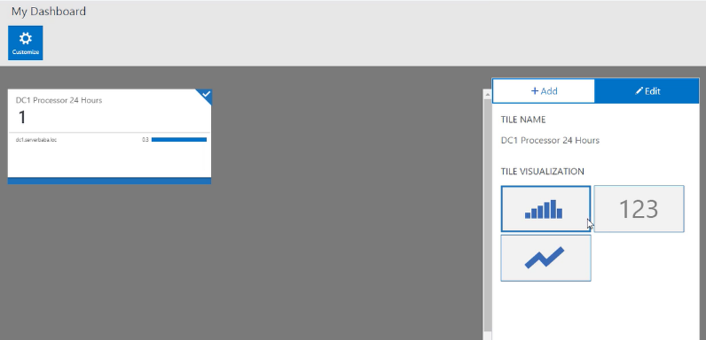
Query Features
Notes:
Queries can be saved, exported, transformed into visual data, and pinned to the OMS workspace dashboard

Slide 43
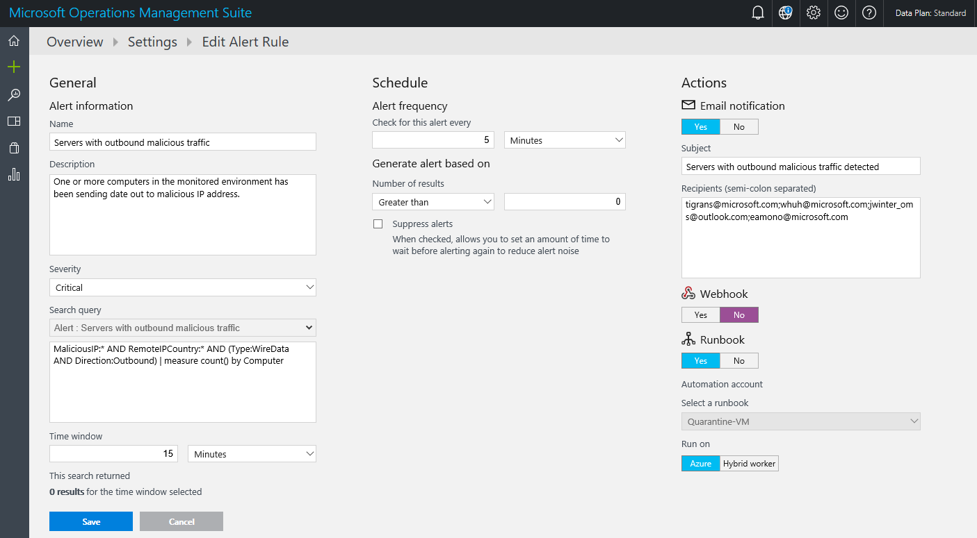
Alerts
Create alerts on queries from Log Analytics
Notes:
Alerts can be created with the following properties:
Severity, search query, time window
5 minutes <= time window <= 24 hours
Thresholds, frequency, suppress
5 minutes <= frequency <= 24 hours
Time Window >= frequency
Email, Runbook, Webhook
Turn off/on as desired

Slide 44
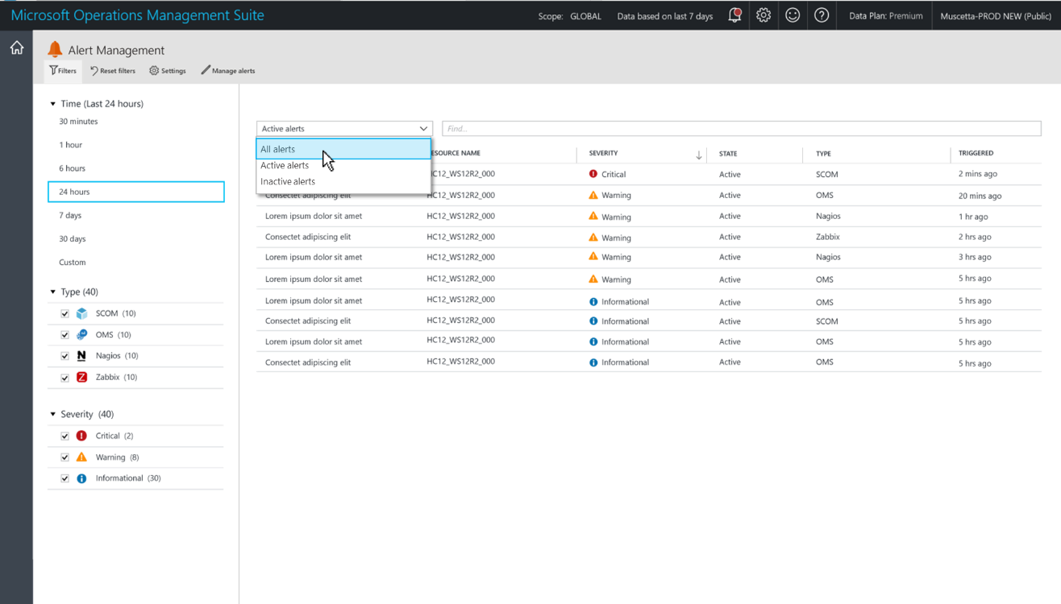
Enable the Alert Management Solution
Solution available in the Solutions gallery for alerts management.
Provides consolidated view of all alerts.
OMS+ SCOM alerts in a single-view pane
Immediately from OMS, 3 minutes for SCOM

Slide 45
Application Insights

Slide 46
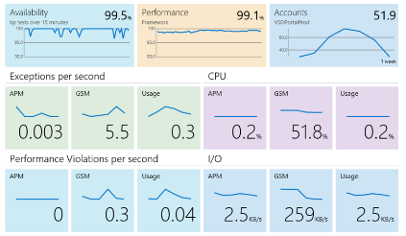
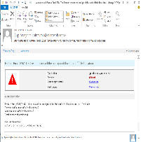
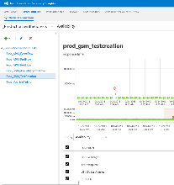
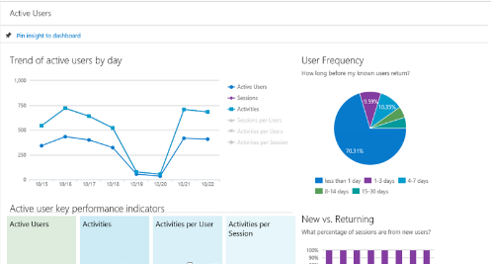
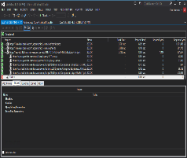
Application Insights
Available
Performing
Succeeding
Health dashboards
Notifications and deep insights
Usage dashboards
Is my application available and performing for users?
One dashboard
What’s wrong?
Show me performance problems, memory usage, and exceptions
Where do we invest next?
Show me top features and customer
Usage patterns

Slide 47
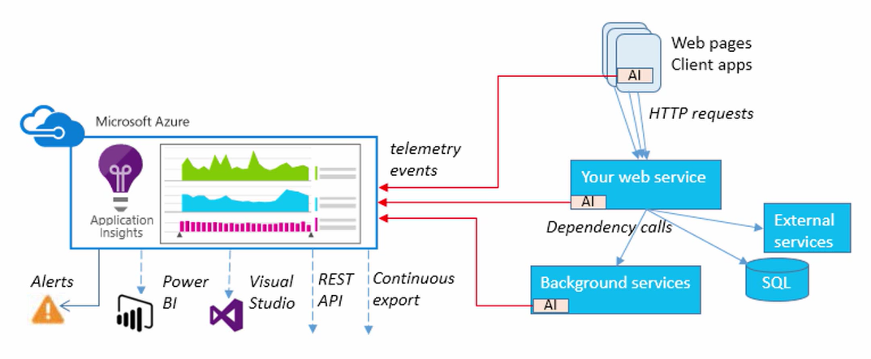
Application Insights

Slide 48
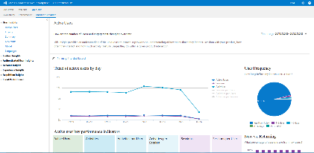
Application Insights
Application
Insights
service
1. Telemetry is collected at each component: usage, performance, exception, crash, event, synthetic transactions, logs, developer-supplied event data
2. Telemetry arrives to Application Insights service where it is processed
3. A 360-degree view of the application – help keep it available, performing,
and succeeding
Notes:
Application Insights for Visual Studio Online lets you monitor your deployed live application.
Find out what users are doing with your app, so that you can focus your development work where it’s most useful.
You can monitor a .NET web service. A .NET service running as an Azure web role, or a Java web service.
Make sure your web service is available and responsive. Whether the app is a web site or a device app that uses a web service, Application Insights can test a URL every few minutes from locations around the world, and let you know if there’s a problem.
Quickly diagnose any performance issues or exceptions in your web service. Find out if CPU or other resources are being stretched, get stack traces from exceptions, and easily search through log traces. And if the app’s performance drops below acceptable limits, we can send you an email. You can monitor both .NET and Java web services.
References:
http://msdn.microsoft.com/en-us/library/dn481095.aspx

Slide 49
Application Insights
HTTP request rates, response times, success rates.
Dependency (HTTP and SQL) call rates, response times, success rates.
Exception traces from server and client.
Diagnostic log traces.
Page view counts, user and session counts, browser load times, exceptions
AJAX call rates, response times and success rates.
Server performance counters.
Custom client and server telemetry.
Segmentation by client location, browser version, OS version, server instance, custom dimensions, etc.
Availability tests.
Azure Functions

Slide 50
Application Insights supported platforms
Server side:
  Net and Java
    Agent-based
      Windows: Microsoft Monitoring Agent
    Azure: Includes Azure Virtual Machines and Cloud Services
  ASP.NET
  SDK-based
Client side:
  Browser (JavaScript)
  Windows Phone
  Windows Store
Azure websites

Slide 51
Windows Container Monitoring

Slide 52
ADD CONTENT FOR CONTAINERS

